Slide 1
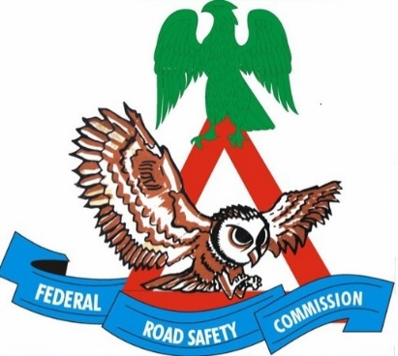

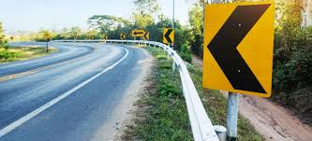
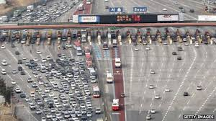
TRANSPORT SAFETY MANAGEMENT IN NIGERIA: Challenges and Possibilities
FEDERAL ROAD SAFETY CORPS
FRSC ACADEMY, UDI, ENUGU STATE
02 JUNE
2022
Presentation at the CIOTA Public Dialogue series on Transport and the Challenges of Road Safety in Nigeria
ACM Kayode OLAGUNJU, PhD, FCILT, FCAI, mni
Assistant Corps Marshal/ Commandant, FRSC Academy Udi, Enugu State

Slide 2
Outline
Introduction
Aim
Objectives
Global road safety issues
Global efforts on road safety-
UN Decade of Action
The African Road Safety Charter
Road Safety Management in Nigeria
Historical development of Road Traffic and Safety Management in Nigeria
Establishment of the Federal Road Safety Commission (Corps)
The Nigerian Efforts on Road safety/strategies of FRSC
Nigerian Road Safety Strategy (NRSSS)
Challenges of Road Safety in Nigeria
Possibilities
Way Forward
Conclusion
References

Slide 3



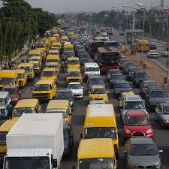
INTRODUCTION
Transport is key in our daily activities as we move to satisfy our needs for survival. It is regarded as a catalyst for development. There is a huge reliance on the road mode in Africa. The dominance of road transport has however attracted negative consequences which include heavy traffic congestion and road traffic crashes (RTC).
Also in Nigeria, road transportation is the most commonly used (means of transportation), mainly for its relative effectiveness, affordability and availability in the entire country, covering both rural and urban environments (Fanola, 2017).

Slide 4
INTRODUCTION
Road Safety is simply the use of the road without attracting any harm or death to ones self or others and also not destroying through automobile the road and infrastructure. It is safe mobility on the road.
Road Safety Management therefore could be described as the coordination of several inputs to enhance safety on the road. Of course there are challenges which are the militating issues affecting enhancement of road safety. There are positives as well as possibilities as we channel the way forward to have better road culture in Nigeria.

Slide 5
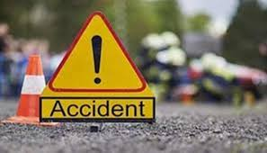
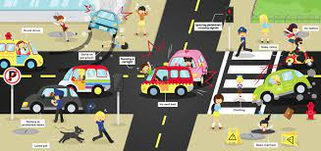
Each year, at least 1.25 million people are killed on roadways around the world and additional 20-50 million others injured with some resulting in disabilities. (WHO, 2018) . The rate of road crashes is also high in Africa as they cost about 2% of the GDP. The victims are mostly the vulnerable road users, which are pedestrians, cyclists and motorcyclists. These constitute largely young people who are in the productive brackets of the economy. RTC takes a heavy toll on the member state’s economies and have also adversely impacted on the social lives on the continent. (African Union, 2016)

Slide 6
The World Health Organization (WHO) recognised Road Traffic Crash as a complex public health issue and a leading cause of deaths the world over. In Nigeria. The negative effects of RTC appears terrifying . The economic consequence of road insecurity is estimated at over 2% of Nigeria’’s GDP. Specifically, the financial implication of road disasters is estimated at over $7 billion annually , (Oyeyemi, 2019)

Slide 7
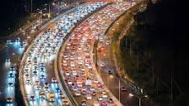
The Federal Road Safety Corps (FRSC) records revealed that between 1960 and 2021, a total of 1,180,475 crashes resulting in 378,525 deaths and 1,379,569 injuries, hence 1,758,094total casualties were recorded on Nigerian roads

Slide 8
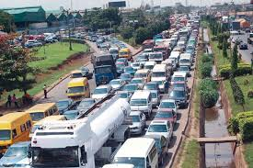
Several efforts have been made at global, continental, sub-regional, national and local levels to tackle the menace of RTC . However, there are Challenges and Prospects which form the focus of this Presentation

Slide 9

AIM
The aim of this presentation is to acquaint participants on the Transport Safety Management, Challenges and Possibilities of road safety in Nigeria

Slide 10

OBJECTIVES
At the end of this presentation, the following should have been brought to focus:
Global Road Safety Issues
African Road Safety Charter
The Nigeria Road Safety Situation
OBJECTIVES
OF TRANSPORT SAFETY MANAGEMENT IN NIGERIA

Slide 11
OBJECTIVES Cont,d
The Nigeria Efforts/ Strategies on Road Safety (Pre & FRSC Era)
Challenges of Road Safety in Nigeria
Possibilities
OBJECTIVE S
OF TRANSPORT SAFETY MANAGEMENT IN NIGERIA

Slide 12
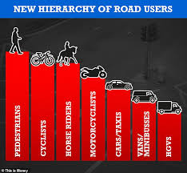
GLOBAL ROAD SAFETY ISSUES
Throughout the world, roads are shared by cars, buses, trucks, motorcycles, mopeds, pedestrians, animals, taxis, and other travellers. Travel made possible by motor vehicles supports economic and social development in many countries. Yet each year, vehicles are involved in crashes that are responsible for millions of deaths and injuries.

Slide 13
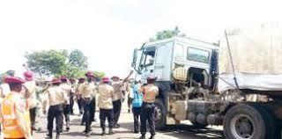
GLOBAL ROAD SAFETY ISSUES (Cont’d)
Global road traffic fatalities have remained high in recent years, reaching 1.35 million in 2016. Although road traffic casualties have decreased in some developed countries after the publication of their own road safety strategies, road traffic injuries remain a global public health problem, especially in low-income and middle-income countries.
Road traffic injuries are the eighth leading cause of death internationally, and each year, there are many people suffering from road traffic crash-related issues globally, indicating that road traffic crashes remain an extremely serious problem. Despite the attention road traffic safety receives worldwide, more effort is necessary. (WHO, 2011; 2015)

Slide 14
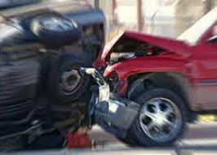
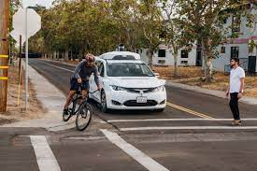
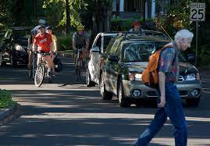
GLOBAL ROAD SAFETY ISSUES (Cont’d)
Crash injuries are estimated to be the eighth leading cause of death globally for all age groups and the leading cause of death for children and young people 5–29 years of age. More people now die in crashes than from HIV/ADS.
It is estimated that fatal and nonfatal crash injuries will cost the world economy approximately $1.8 trillion dollars external icon (in 2010 USD) from 2015–2030. That’s equivalent to a yearly tax of 0.12% on global GDP (WHO, 2011; 2015)

Slide 15
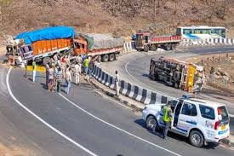
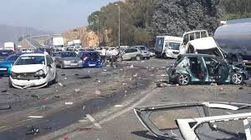
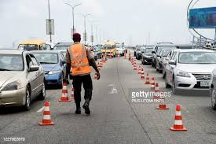
GLOBAL ROAD SAFETY ISSUES (Cont’d)
Low- and Middle-Income Countries (LMICs) are most affected.The crash death rate is over three times higher in low-income countries than in high-income countries. About 90% of deaths from RTCs occur in these countries though they account for only 54% of global vehicle population. While the global rate for road traffic fatalities is 17.4 per100,000 population, it is 24.1 per 100,000 population for the low-income countries,18.4 for the Middle-income countries and 9.2 for the high income countries. (WHO, 2011; 2015)

Slide 16
GLOBAL EFFORTS ON ROAD SAFETY: UN DECADE OF ACTION
In response to the global health and development burden of the RTC , the United Nations General Assembly in March 2010 adopted Resolution 64/255 which declared 2011-2020 as the Decade of Action for Road Safety. The Resolution called on all member states to implement clearly stated measures to stabilise and then reduce the forcast level of road fatalities globally by 2020. Specific objectives include creation of lead agency, developing and implementing sustainable road safety strategies and programmes. Member States were called to develop national strategy at a Cabinet or Ministerial level and to be coordinated by the lead agency. (WHO, 2010; 2011). Nigeria effectively keyed into this and it is instructive to note that the country lead Agency on Road Safety predated the UN Resolution

Slide 17
GLOBAL EFFORTS ON ROAD SAFETY: UN DECADE OF ACTION contd.
The resolution calls upon Member States to implement road safety activities, particularly in the areas of;
a. Road safety management
c. Vehicle safety
b. Road infrastructure
d. Road user behaviour
e. Road safety education and the post-crash response

Slide 18
GLOBAL EFFORTS ON ROAD SAFETY: UN DECADE OF ACTION 2
The second Phase of the UN Decade of Action for Road Safety 2021-2030 was formerly declared on 28 October, 2021, with the ambitious target of preventing at least 50% of road traffic deaths and injuries by 2030
Countries are to consider the five Pillars as it is in the First UN Decade within the framework of their own national road safety strategy, capacity and data collection systems. Countries are to further improve on the five Pillars of the Decade to further improve on their road safety situation by reducing road fatalities.

Slide 19
THE AFRICAN ROAD SAFETY CHARTER
The African Union on 31st January, 2016 at the 26th Ordinary Session of the Assembly, held in Addis Ababa, Ethiopia adopted the African Road Safety, Charter. The Charter provides a policy framework for road safety improvement in Africa. It calls on member states to facilitate the formulation of comprehensive Road Safety Policies at country level. The Charter serves as an advocacy tool and instrument for Road Safety improvement on the continent aimed at facilitating the creation of an enabling environment to drastically reduce road traffic crashes.(AU,2016, Olagunju, 2019) . This was in response to, among others the UN Resolution on Decade of Action for Road Safety and also being implemented in Nigeria. The West African Road Safety Organization (WARSO), with the Headquarters in Nigeria has been greatly involved in the monitoring of the implementation throughout the West African sub-region.

Slide 20
ROAD SAFETY MANAGEMENT IN NIGERIA
The global road safety picture is a challenge in Nigeria too. Every road became a potential death trap until government’s response and intervention. Achieving road safety in Nigeria required a well focused government intervention which has been manifested in a number of ways over the years.
Despite several interventions at different levels, Nigeria keeps recording high death toll on the roads. Several lives have been lost and the crashes have constituted a drain on the national economy and resources apart from the trauma and shock and trauma to victims, relations and the society at large
Though the rate of crashes is trending down, a lot of efforts is still required

Slide 21
ROAD TRAFFIC CRASH STATISTICS/ DATA FROM 1960 TO 2021
YEAR | FATAL CASES | SERIOUS CASES | MINOR CASES | TOTAL CASES | NO. KILLED | NO.INJURED | TOTAL CASAULTY
1960 | 826 | 9065 | 4239 | 14130 | 1083 | 10216 | 11299
1961 | 193 | 9982 | 5788 | 15963 | 1313 | 10614 | 11927
1962 | 1263 | 9159 | 5895 | 16317 | 1578 | 10341 | 11919
1963 | 967 | 6918 | 11950 | 19835 | 1532 | 7771 | 9303
1964 | 911 | 7371 | 7645 | 15927 | 1769 | 12581 | 14350
1965 | 1029 | 7762 | 8113 | 16904 | 1918 | 12024 | 13942
1966 | 1680 | 5600 | 6270 | 14000 | 2000 | 13000 | 15000
1967 | 1560 | 5200 | 6240 | 13000 | 2400 | 10000 | 12400
1968 | 459 | 5865 | 5839 | 12163 | 2808 | 9474 | 12282
1969 | 1559 | 5199 | 6230 | 12998 | 2347 | 8804 | 11151
1970 | 1999 | 6666 | 7991 | 16666 | 2893 | 13154 | 16047
1971 | 129 | 8098 | 8518 | 17745 | 3206 | 14592 | 17798
1972 | 2782 | 9275 | 11130 | 23187 | 3921 | 16161 | 20082
1973 | 2981 | 9275 | 11925 | 24844 | 4537 | 18154 | 22691
1974 | 3467 | 11557 | 13869 | 28893 | 4992 | 18660 | 23652
1975 | 2834 | 9446 | 11331 | 23651 | 5552 | 20132 | 25684
1976 | 905 | 17352 | 19624 | 40881 | 6761 | 28155 | 34916
1977 | 4242 | 14140 | 17334 | 35351 | 8000 | 30023 | 38023
1978 | 4333 | 14444 | 17334 | 36111 | 9252 | 28854 | 38106
1979 | 3513 | 11708 | 14050 | 29271 | 8022 | 21203 | 29225
1980 | 1856 | 14855 | 15427 | 32138 | 8736 | 25484 | 34220
1981 | 4053 | 13510 | 16214 | 33777 | 10202 | 26337 | 36539
1982 | 4451 | 14838 | 17805 | 37094 | 11382 | 28539 | 39921
1983 | 3853 | 12844 | 15412 | 32109 | 10462 | 26866 | 37328
1984 | 4467 | 10557 | 13868 | 28892 | 8830 | 23861 | 32691
1985 | 3597 | 11991 | 14380 | 29978 | 9221 | 23853 | 33074
1986 | 3022 | 10075 | 12091 | 25188 | 8154 | 22176 | 30330
1987 | 3385 | 11286 | 13544 | 28215 | 7912 | 22747 | 30659
1988 | 4127 | 11091 | 10574 | 25792 | 9077 | 24413 | 33490
1989 | 3838 | 10314 | 9835 | 23987 | 8714 | 23687 | 32401
1990 | 6140 | 8796 | 6998 | 21934 | 8154 | 22786 | 30940
Source: FRSC

Slide 22
YEAR | FATAL CASES | SERIOUS CASES | MINOR CASES | TOTAL CASES | NO. KILLED | NO.INJURED | TOTAL CASAULTY
1991 | 6719 | 8982 | 6845 | 22546 | 9525 | 24508 | 34033
1992 | 6986 | 9324 | 6554 | 22864 | 9620 | 25759 | 35379
1993 | 6735 | 8443 | 6281 | 21459 | 9454 | 24146 | 33600
1994 | 5407 | 7522 | 5275 | 18204 | 7440 | 17938 | 25378
1995 | 4701 | 7276 | 5053 | 17030 | 6647 | 14561 | 21208
1996 | 4790 | 6964 | 4688 | 16442 | 6364 | 15290 | 21654
1997 | 4800 | 7701 | 4987 | 17488 | 6500 | 10786 | 17286
1998 | 4757 | 7081 | 4300 | 16138 | 6538 | 17341 | 23879
1999 | 4621 | 6888 | 4356 | 15865 | 6795 | 17728 | 24523
2000 | 5287 | 6820 | 4499 | 16606 | 8473 | 20677 | 29150
2001 | 6966 | 8185 | 5379 | 20530 | 9946 | 23249 | 33195
2002 | 4029 | 7190 | 3325 | 14544 | 7407 | 22112 | 29519
2003 | 3910 | 7882 | 2572 | 14364 | 6452 | 18116 | 24568
2004 | 3275 | 6948 | 4051 | 14274 | 5351 | 16897 | 22248
2005 | 2299 | 4143 | 2620 | 9062 | 4519 | 15779 | 20298
2006 | 2600 | 5550 | 964 | 9114 | 4944 | 17390 | 22334
2007 | 2162 | 4812 | 1503 | 8477 | 4673 | 17794 | 22467
2008 | 3024 | 5671 | 2646 | 11341 | 6661 | 27980 | 34641
2009 | 2460 | 6024 | 2370 | 10854 | 5693 | 27270 | 32963
2010 | 2388 | 6815 | 2182 | 11385 | 6052 | 35691 | 41743
2011 | 2840 | 8357 | 1999 | 13196 | 6054 | 41165 | 47219
2012 | 2935 | 8277 | 2050 | 13262 | 6092 | 39348 | 45440
2013 | 3294 | 8589 | 1700 | 13583 | 6544 | 40057 | 46601
2014 | 3117 | 6356 | 907 | 10380 | 5996 | 32063 | 38059
2015 | 2854 | 6039 | 841 | 9734 | 5440 | 30478 | 35918
2016 | 2638 | 5633 | 1423 | 9694 | 5053 | 30105 | 35158
2017 | 2587 | 5456 | 1340 | 9383 | 5121 | 31094 | 36215
2018 | 2739 | 5849 | 1153 | 9741 | 5181 | 32220 | 37401
2019 | 2896 | 6911 | 1265 | 11072 | 5483 | 35981 | 41464
2020 | 2961 | 7567 | 1347 | 11875 | 5574 | 33311 | 38885
2021 | 3218 | 8324 | 1485 | 13027 | 6205 | 38073 | 44278
TOTAL | 200416 | 531818 | 443423 | 1180475 | 378525 | 1379569 | 1758094
ROAD TRAFFIC CRASH STATISTICS/ DATA FROM 1960 TO 2021 CONTD.
Source: FRSC

Slide 23
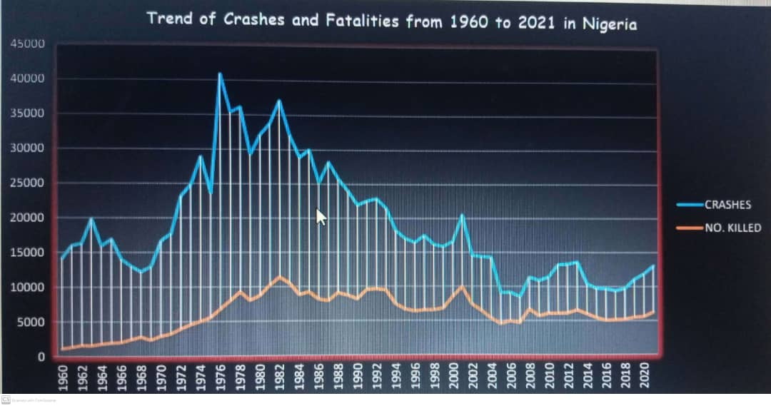

Slide 24
HISTORICAL DEVELOPMENT OF ROAD TRAFFIC AND SAFETY MANAGEMENT IN NIGERIA
The first step in the administration of road traffic in Nigeria was the enactment of the Motor Traffic Ordinance of 1913 in the Southern Protectorate
Then in 1916 after the merger of the Northern and Southern protectorates in 1914, the National Motor Traffic Ordinance came into existence . (Balogun, 2006)
The 1916 Ordinance placed traffic management responsibilities and motor vehicle administration under the Directorate of Works while that of motor licensing was placed under the Colony’s Finance Officer
The Ordinance was reviewed in 1940 and 1945 in line with the English Road Traffic Act of 1930
In 1949 Road Traffic Act that brought to fore the Vehicle Inspection Office was created. (Ogunsanya, 2004)

Slide 25
HISTORICAL DEVELOPMENT OF ROAD TRAFFIC AND SAFETY MANAGEMENT IN NIGERIA contd.
In 1955 in order to further enhance road safety administration, the Motor Traffic division MTD which took charge of vehicle inspection activities was created under the Nigerian Police Force (Odekunle 2006).
In 1960 the Federal Government established Traffic Police, a unit dedicated to properly man the road, instil discipline and road etiquette (Odekunle, 2006).
The first constitutional effort in Road safety Adminsitration took place in 1958 when Nigerian Government recognized road safety management as a shared responsibility. The constitution conferred powers on regional governments to create their own traffic laws and agencies. (Mfon, 2013)
Major Private concern on Road Safety Administration can be traced to the activities of Shell Petroleum Development Company Nigeria Ltd between 1960 and 1965.

Slide 26
HISTORICAL DEVELOPMENT OF ROAD TRAFFIC AND SAFETY MANAGEMENT IN NIGERIA contd.
In order to give road safety matters legal backing, the Federal Government promulgated the Federal Highway Declaration Order of 1971,Federal Highway Amendment Act 1973 and Road Traffic Accident Act of 1976 to improve road traffic administration in the Country
1972 Nigerian Army concerned with the increasing accident fatalities involving their officers and men organized a one week road safety campaign to sensitize her personnel and the general public on the need to be road safety conscious.

Slide 27
The Army effort prompted the federal government to publish the first Nigerian Highway Code in 1972.
The National Road Safety Commission (NRSC) was established in 1974. The Commission was put together with representatives from selected ministries, other government agencies and the police. The enforcement arm of the National Road Safety Commission was entrusted to the Nigerian Police, equipped with emergency and rescue devices, highway patrol vehicles as well as other electronic and communication gadgets. (Gboyega, 1992).
There were also State Traffic Laws in 1976.

Slide 28
Oyo State Edict 18 of 1977 created the Oyo State Road Safety Corps (OSRSC)
The recorded success by the OSRSC resulted in its replication in Anambra, Lagos, Kano and Ogun states between 1979 and 1982. However, in 1983, the Federal Government banned the operations of the State Traffic Management Agencies on federal roads for security and political reasons (Wilson 2006). The ban served as the death knell for the agencies as most of their operations were on federal roads.
1n 1988 the Federal Military Government of Nigeria through Decree 45 of 1988 established the Federal Road Safety Commission.

Slide 29
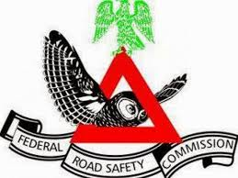
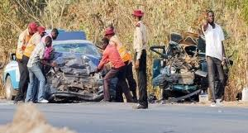
ESTABLISHMENT OF THE FEDERAL ROAD SAFETY COMMISSION (CORPS)
The Federal Road Safety Commission was established by the Federal Military Government of the Federal Republic of Nigeria vide decree 45 of 1988 as amended by decree 35 of 1992, otherwise known as FRSC Act Cap 141 Laws of the Federation (1990). The Commission was charged with the responsibility for policy making, organization and administration of Road safety in Nigeria.

Slide 30

ESTABLISHMENT OF THE FEDERAL ROAD SAFETY COMMISSION (Cont’d)
Federal Road Safety Corps is the government agency with statutory responsibilities for road safety administration in Nigeria. The Federal Road Safety Corps (FRSC) operates in all Nigerian states as well as the Federal Capital Territory and is the lead agency in Nigeria on road safety administration and management.
The statutory functions include: Making the highways safe for motorists and other road users as well as checking road worthiness of vehicles, recommending works and infrastructures to eliminate or minimize accidents on the highways, and educating motorists and members of the public on the importance of road discipline on the highways.

Slide 31
THE NIGERIAN EFFORTS ON ROAD SAFETY- STRATEGIES OF THE FRSC
The FRSC designed the under listed strategies among others to enhance safety on the Nigerian roads;
Enlightenment
Education
Engineering
Environment
Emergency management services
Enforcement
Evaluation

Slide 32
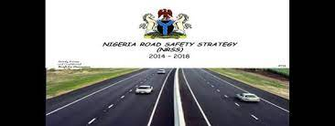
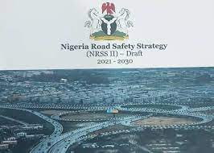
NIGERIA ROAD SAFETY STRATEGY (NRSS)
The Nigerian government in collaboration with all the state government through the National Economic Council approved the first phase of the NRSS 2014-2018 as a road map for safer road culture in Nigeria. The strategy sets a major target of;
a. 35 percent reduction in Road Traffic Crash (RTC) fatality rate by 2018 (2012 as Baseline).
b. Set up of the State Road Safety Advisory Council (SaRSAC)
c. Stakeholder focus – MDAs and private Sector
d. Globalisation of strategic activities.

Slide 33
ASSESMENT OF THE PERFORMANCE OF THE NIGERIA ROAD SAFETY STRATEGY 1 (2014-2018)
Olagunju, (2018) appraised the performances of the NRSS 201-2018 and key findings include:
The UN Decade of Action on Road Safety 2014-2018 had about 57% overall implementation performance in Nigeria. He revealed that the level of implementation could have been higher if all the States of the Federation and the Local Governments had keyed fully to the implementation of the strategy.
Though the NRSS lead to reduction of RTC fatalities, the targeted 35% reduction in 2018 was not met as only 15% reduction in RTC fatalities was achieved at the end of the strategies. Also 27% reduction was achieved on total number of reported cases of crashes while a 17% reduction was achieved for people injured in road traffic crashes

Slide 34
NIGERIA ROAD SAFETY STRATEGY (NRSS)
The Nigerian government in collaboration with all the state government through the National Economic Council approved the Second Nigerian Road Safety Strategy, NRSS 2021-2030 as a road map for safer road culture in Nigeria. The strategy sets a major target of;
a. 35 percent reduction in Road Traffic Crash (RTC) fatality rate by 2030 (2018 as Baseline).
b. Set up of the State Road Safety Advisory Council (SaRSAC)
c. Stakeholder focus – MDAs and private Sector
d. Improvement on compliance level on vehicle standards and road infrastructure.

Slide 35
NIGERIA ROAD SAFETY STRATEGY (NRSS) cont’d
e. Strategic activities defined by pillars and GFPA area.
f. Domestication of strategic activities.
g. Review and upgrade of design standards.
h. Capacity building.
i. Enhanced funding and efficient road safety administrative system.
j. Enhanced funding and efficient road safety administrative system.

Slide 36
NIGERIAN ROAD TRAFFIC CRASHES IN DECADES
DECADE | YEARS | TOTAL CRASH | NO. KILLED | NO.INJURED | TOTAL CASUALTY
1 | 1960-1969 | 151237 | 18748 | 104825 | 123573
2 | 1970-1979 | 276600 | 57136 | 209088 | 266224
3 | 1980-1989 | 297170 | 92690 | 247963 | 340653
4 | 1990-1999 | 189970 | 77037 | 190843 | 267880
5 | 2000-2009 | 129166 | 64119 | 207264 | 271383
6 | 2010-2021 | 136332 | 68795 | 419586 | 488381

Slide 38
ROAD TRAFFIC CRASHES IN DECADES
DECADE-1 Nigeria’s Road Traffic Crash records showed that at least 18748 lives were lost on the roads between the country’s year of independence, 1960 and 1969. Additional 104825 persons were injured, hence a total of 123573 casualties were recorded in a total 151237 road traffic crashes.
DECADE-2 Nigeria’s Road Traffic Crash records showed that at least 57136 lives were lost on the roads between the country’s year of, 1970 and 1979. Additional 209088 persons were injured, hence a total of 266224 casualties were recorded in a total 276600 road traffic crashes
DECADE-3 Nigeria’s Road Traffic Crash records showed that at least 92690 lives were lost on the roads between the country’s year of 1980 and 1989. Additional 247963 persons were injured, hence a total of 340653 casualties were recorded in a total 297170 road traffic crashes
DECADE-4 Nigeria’s Road Traffic Crash records showed that at least 77037 lives were lost on the roads between the country’s year of 1990 and 1999. Additional 190843 persons were injured, hence a total of 267880 casualties were recorded in a total 189970 road traffic crashes showing a decrease in no of RTCs and Deaths.
DECADE-5 Nigeria’s Road Traffic Crash records showed that at least 64119 lives were lost on the roads between the country’s year of post independence, 2000 and 2009. Additional 207264 persons were injured, hence a total of 271383 casualties were recorded in a total 129166 road traffic crashes (decrease in no of crashes and deaths)
-++
DECADE-6 Nigeria’s Road Traffic Crash records showed that at least 68795 lives were lost on the roads between the country’s year of post independence, 2010 and 2021. Additional 419586 persons were injured, hence a total of 488381 casualties were recorded in a total 136332 road traffic crashes (increase in no of crashes and deaths)

Slide 39
CHALLENGES OF ROAD SAFETY IN NIGERIA
The challenges militating against the thriving of road safety in Nigeria include;
1. Cultural conflicts: In some parts of the Country, certain cultures do not align with basic road safety rules as they perceive them to conflict with their cultural practices making enforcement in these areas a challenge.
2. Myths and Beliefs: Pre-destination beliefs which cannot be sustained when weighed side by side with road safety considerations pervades in some parts of the country for example the belief that “What will be will be”

Slide 40
CHALLENGES OF ROAD SAFETY IN NIGERIA (Cont’d)
3.Funding: Road Safety is capital intensive . The FGN has invested extensively on Road Safety but this is not the case in the sub-national level as many still see Road Safety as a revenue generation project
4.Low level of STI: The overall engagement of Science, Technology and Innovation in our Road Transport Administration Sector is still on the low side. Though the FRSC has done much here, others need to key into it
5. Shortage in Competent Manpower: A lot of people still see transport in general and road safety administration in particular as an all-comer issue hence many incompetent hands handling the issues

Slide 41
CHALLENGES OF ROAD SAFETY IN NIGERIA (Cont’d)
6.Non Implementation of Road Safety Strategies: Many Stakeholders are yet to fully understand their roles in terms of implementing Strategies, hence low performance
8. Poor Enforcement of Traffic Laws: The fines for traffic violations are low while the level of enforcement is also comprehensively low
7.Low level of Public Education: Even though several efforts have been made to raise the level of public education and enlightenment in Nigeria, many are still so ignorant

Slide 42
CHALLENGES OF ROAD SAFETY IN NIGERIA (Cont’d)
9, Licensing of Vehicles and Drivers We still need a lot of improvements in these nationwide
11.Obsolete Laws: Some of the laws are obsolete
10.Corruption: many players are involved in corruptive practices

Slide 43
CHALLENGES OF ROAD SAFETY IN NIGERIA (Cont’d)
12. Ineffective implementation of Traffic Laws: The non alignment of some state traffic laws with the national laws is an issue which has led to the ineffective implementation of the laws as there are certain conflicts
13. State of Road Infrastructure: The state of the roads and road infrastructure is a major challenge as most roads especially in rural areas are dilapidated with dangerous portholes
14. Ineffective Vehicle Inspection System: A lot of vehicle which are not road worthy ply our roads today and this contributes proportionally to crashes and fatalities in Nigeria.

Slide 44
CHALLENGES OF ROAD SAFETY IN NIGERIA (CONT’D)
15. . The love for money and neglect of Safety Issues: Lack of proper mindset in people especially those in transporting business always making efforts to cut corners and compromising on safety matters
16. Impatience and Subversion of due Process: This is a clear problem as most people especially drivers prefer to take short cuts or bribe their way through instead of patiently following the right process for the processing and accessing of road safety services

Slide 45
CHALLENGES OF ROAD SAFETY IN NIGERIA (CONT’D)
17. Many Unlicensed Drivers: FRSC records revealed that as at May 2021, Nigeria with a Population of over 200m people has a total number of 7, 861,086 licenced drivers in our National Drivers Licence Database. That means we have so many unlicensed drivers plying our roads
18. Many Unregistered Vehicles: Also, many of the vehicles on our roads are also not properly registered as we presently have only 16, 180, 247 comprising of 208,112 Federal Government Vehicles, 11, 104, 918 Private, 4, 867,217 commercial Vehicles in Nigeria. When Vehicles are not properly registered, regulations become very difficult
19. Poor Vehicle Insurance: Fuomsuk (2022) disclosed that as at 9th February 2020, the National Vehicle Identification Scheme Database contained only 5,324,981 Vehicles in Nigeria had valid Insurance Policies. This also affects the safety components on our roads.

Slide 46
CHALLENGES OF ROAD SAFETY IN NIGERIA (CONT’D)
20. Inadequate and Non-Reliability of Data: Several safety related activities on our roads do not have good and reliable data making planning difficult. Many agencies collect and collate data and there is hardly any comprehensive harmonisation of such data. Data Management is a major road safety challenge in the country
21. Lack of Synergy: Many agencies and stakeholders are involved in road safety in the country and many not getting FRSC as the lead agency involved or rather competing instead of collaborating among themselves resulting in duplication of efforts or creating avoidable gaps. The FRSC and the Federal Ministries of Works and Transport are collaborating effectively

Slide 47
CHALLENGES OF ROAD SAFETY IN NIGERIA (CONT’D)
22. Dominance of commercial motorcycles in the mobility system: There are so many non-structured and unregulated commercial motorcycles with little or no Safety consideration in our urban mobility. Cycles are mostly not registered and riders not licenced. Paratransit’s have contributed greatly to RTCs in Nigeria

Slide 48
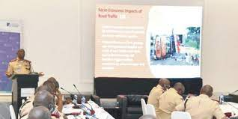

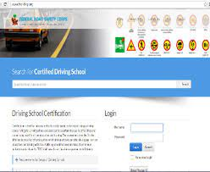
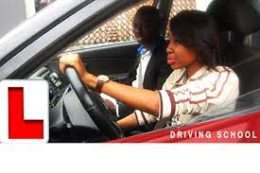
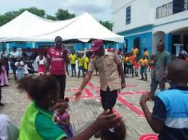
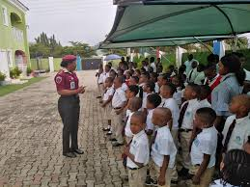
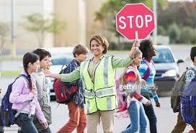

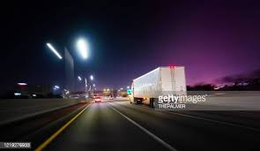
POSSIBILITIES
Despite the numerous challenges to road safety in Nigeria which include the few mentioned earlier, there are new prospects to road safety such as;
NRSS (Nigeria Road Safety Strategy) has been developed and is being implemented,
The Driving School Standardization programme,
Infusion and implementation of Road Safety education in Primary and Secondary School Curriculum,
Effective fleet management systems, and stakeholder involvement.

Slide 49
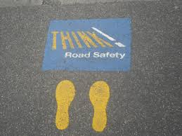
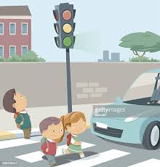
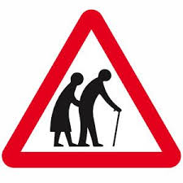
POSSIBILITIES (cont’d)
5. Adoption of the Safe System Approach: This approach aims to develop a road transport system that is better able to accommodate human error and take into consideration the vulnerability of the human body. It starts from the acceptance of human error and thus the realization that traffic crashes cannot be completely avoided. The goal of a safe system is to ensure that accidents do not result in serious human injury.

Slide 50
POSSIBILITIES (cont’d)
6. Institutions such as the Universities and FRSC Academy, NITT and others now engaging in development of right competences in the Transport and Road Safety related disciplines
Improved transport initiatives which will accommodate multi-modal transport system e,g BRT in Lagos
I must acknowledge the collaboration efforts of the FRSC and the Federal Ministries of Works, Transport and Budget and National Planning as well as the Nigerian Bureau of Statistics

Slide 51
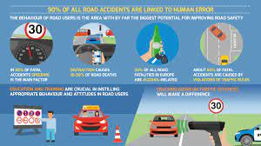
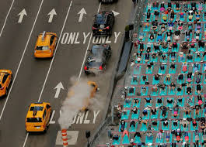
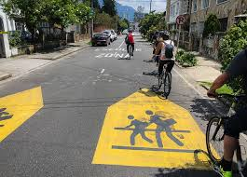
POSSIBILITIES (Cont’d)
9. The dividends of policies and strategies on road traffic safety shows a positive trend. It is evident that if efforts are sustained with support from all stakeholders in no time Nigeria will join other nations in craving for ZERO fatality in RTCs.

Slide 52
WAY FORWARD
There are still certain areas we need to look into as part of our routes to better Road Safety. These include
Improved Funding .
Adoption of STIs
All should key into and perform their roles in formulating and implementation of Road Safety Strategies
Enhanced Public Education
Improved Enforcement
Improvement in our Driver and Vehicle Licensing as well as Modern Vehicle Inspection Strategies like the adoption of PTI

Slide 53
WAY FORWARD Contd.
g. Elimination of Corruption
h. Review of Obsolete Laws
Improvement in our road infrastructure nationwide
j. We should all insist on following due process
k. Improved Data system which include data harmonizatioin
l. More Stakeholders Engagements
m. Synergy rather than competitions among key players

Slide 54

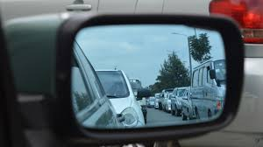


CONCLUSION
Road safety in Nigeria is no different from road safety anywhere in the world. The major challenge is the mindset and the will to effect measures that will enhance the safety of every road user.
Until road safety is seen as a personal commitment and shared responsibility, efforts and interventions of government alone cannot solve the problem.
Road Safety is you and I.
Lets Join hands and make it work.

Slide 55
REFERENCES
African Union (2016), African Road Safety Charter; Adopted at the 26th Ordinary session of the Assembly, held in Adeh Abetra http://au.int/sites/default/files/traties/3251-treaty-0052-road safety-charter.pdf retrieved 30 May,2022
Balogun, S.A. (2006) Roas Safety Practice in Nigeria, Lagos; BOAAS Rdesources Nigeria Ltd, Lagos, Nigeria.
FRSC annual report (2021) Executive Summary Report of RTCs in Nigeria.
Foumsuk, HZ. (2020) National Uniform Licensing Scheme and National Security An Appraisal. A lecture delivered at the Federal Road Safety Corps 8th Valedictory Lecture Series on 27th may, 2022 in Abuja.
Fanola, (2017). Road Transport Safety Standardization Scheme and passenger fleet operation in Nigeria: An assessment; unpublished Individual Research Project, NIPSS, Kuru.
Gboyega, (1992).

Slide 56
REFERENCES
Mforn, T. (2013) Traffic Management and Economic Development; an appraisal of Lagos State. Unpublished Research work submitted to the Nigeria Defence College in partial fulfilment for the award of Fellow National Defence College, Course 21
Odekunle, A. (2016) Road Traffic Accidents in Nigeria: causes and preventive measures: An appraisal of south western states. Civil and environmental research. Vol.7 No.11. pp 90.
Ogunsanya AA. (2004). Strategies for minimizing road traffic accidents in Nigeria a case study of Abuja, paper presented to the Nigerian Institute of Transport Technology, Zaria, June, 2004.
Olagunju, K. (2019) Nigerian Road Safety Strategy – An evaluation of the implementation.
Oyeyemi, BO. (2003). Productivity and Road Traffic Administration in Nigeria, Issues, Impediments and Strategies

Slide 57
REFERENCES
WHO (2011), ‘Global Plan for the decade of Action for Road Safety 2011-2020’, www.who.int/roadsafety/decade-of-action/plan-english.pdf retrieved 30 May,2022.
WHO (2015), ‘Glogal Status Report on Road Safety 2015’.
WHO, (2017), Road Traffic deaths data by country. https.who.int/gho/data/node.mainA997 retrieved 30 May,2022
WHO (2018), Fact Sheet, www.who.int/mediacentre/factsheets/fs358/en/ retrieved 30 May,2022

Slide 58


Slide 59
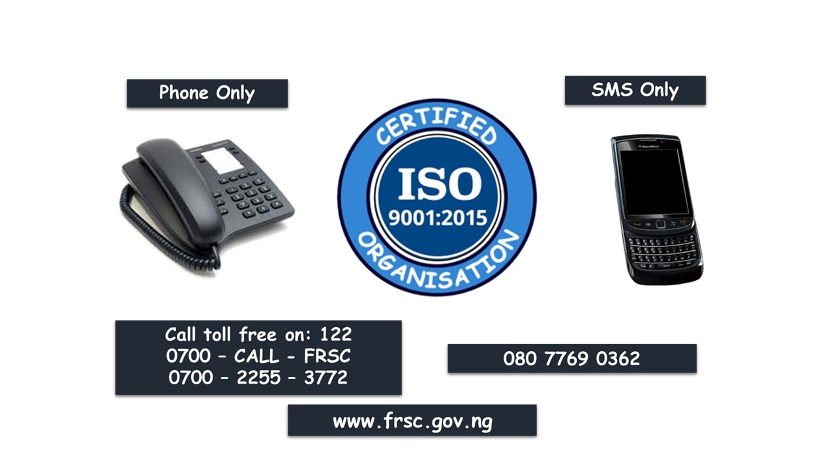
THE END

