Slide 1

2022
FRSC CORPORATE STRATEGIC GOALS
A brief and Justifications on the Goals
Boboye Oyeyemi, Ph.D. MFR, mni, NPoM
21
Dec
2021
Corps Marshal

Slide 2
02
INTRODUCTION
Within the context of global, continental, regional and national realities, the following Corporate Goals are hereby presented for consideration for year 2022:
a
b
c
Accomplish 15% reduction in Road Traffic Crash Fatality
Enhance Road Safety Partnership for Innovative Intervention
Consolidate on the Road Traffic Data System for Improved Road Safety Policy Formulation.

Slide 3
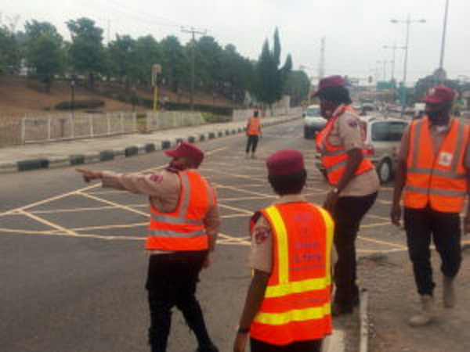
03
JUSTIFICATION
Goal 1:
Accomplish 15%
reduction in Road Traffic Crash Fatality
The proposed 15% reduction in Road Traffic Crash Fatality is based on the Corps’ data and trend review on annual Corporate Goals and achievements.

Slide 4
04
JUSTIFICATION – cont’d
Table 1: Year-on-Year Targeted and Achieved % Changes for RTC and Fatality
Year/Annual Expectation | 2015 | 2016 | 2017 | 2018 | 2019 | 2020 | 2021
Fatality Target (%) | -30 | -25 | -25 | -30 | -25 | -20 | -20
Fatality Achieved (%) | -9 | -7 | 1 | 1.2 | 6 | 2 | -----
Total RTC Target (%) | -20 | -15 | -15 | -15 | -20 | -15 | -15
Total RTC Achieved (%) | -6 | 0.4 | -3 | 4 | 14 | 7 | -----
?

Slide 5
05
JUSTIFICATION – cont’d
YEAR | Target (% Reduction | Expected (Forecast) | Actual | % Achieved | % Diff
2015 (30% reduction from 2014 baseline figure) | 4,197 | 5,355 | 5,440 | -9 | 1.6
2016 (25% reduction from 2015 baseline figure) | 4,080 | 5,226 | 5,053 | -7 | -3.3
2017 (25% reduction from 2016 baseline figure) | 3,790 | 5,435 | 5,121 | 1 | -5.8
2018 (30% reduction from 2017 baseline figure) | 3,585 | 5,194 | 5,181 | 1.2 | -0.3
2019 (25% reduction from 2018 baseline figure) | 3,886 | 5,378 | 5,483 | 6 | 2.0
2020 (20% reduction from 2019 baseline figure) | 4,386 | 4,889 | 5,575 | 2 | 14.0
2021 (20% reduction from 2019 baseline figure) | 4,386 | 6,117 | 4,553(As at Sep,2021). As at Sept,2019 we have 3,817. | 19 | -25.6
Table 2: Year-on-Year expected and achieved % changes for Fatality

Slide 6
06
JUSTIFICATION – cont’d
YEAR | Target (% Reduction | Expected Forecast | Actual | % Achieved | % Diff
2015 (20% reduction from 2014 baseline figure) | 8,304 | 9,697 | 9,734 | -6 | 0.4
2016 (15% reduction from 2015 baseline figure) | 8,274 | 9,628 | 9,694 | -0.4 | 0.7
2017 (15% reduction from 2016 baseline figure) | 8,240 | 10,066 | 9,383 | -3 | -6.8
2018 (15% reduction from 2017 baseline figure) | 7,976 | 9,879 | 9,741 | 4 | -1.4
2019 (20% reduction from 2018 baseline figure) | 7,793 | 10,568 | 11,072 | 1 | 4.8
2020 (15% reduction from 2019 baseline figure) | 9,411 | 10,671 | 11,875 | 7 | 11.3
2021 (15% reduction from 2019 baseline figure) | 9,411 | 12,864 | 9,620 (As at Sept,2021.) As at sep,2019 we have 7,602 | 27 | -25.2
Table 3: Year-on-Year expected and achieved % changes for total RTC

Slide 7

07
JUSTIFICATION – cont’d
For the period 2021-2030, the Second Decade of Action for Road Safety is aiming to achieve 50% reduction in global fatality in line with the Sustainable Development Goals for Road Safety.
For the remaining nine (9) years (2022-2030), a target of 15% reduction in annual fatality is viewed ambitious enough to achieve Nigeria’s target of the goal considering other determinants like population, motorization, urbanization and other factors.

Slide 8
08
JUSTIFICATION – cont’d
To achieve the proposed 15% reduction, specific and focused activities of the Corps will be targeted at the following road safety behavioural risk factors:
 | Speed (Excess and Inappropriate) on all roads in the country
 | Driving Under the Influence of Drug and Alcohol
 | Riding Motorcycle Without Helmet
 | Distracted Driving (Use of Phone While Driving)
 | Seatbelt and Child Restraints.

Slide 9
09
JUSTIFICATION – cont’d
In a bid to align with the recently launched UN Global Plan of Action for Road Safety 2021-2030, there is need to enhance Stakeholders partnership for innovative interventions.
This also seeks to achieve the country’s goals as outlined in the Nigeria Road Safety Strategy (NRSS) –II, SDGs, five (5) Pillars of the UN Decade of Action for Road Safety 2021-2030.
Goal 2:
Enhance Road Safety Partnership for Innovative Intervention

Slide 10
10
JUSTIFICATION – cont’d
To achieve goal 2, the Corps would partner with Stakeholders on Specific, Measurable, Achievable, Realistic and Time bound (SMART) interventions around:
Safe Road Infrastructures Particularly Road Safety Audit | Safe Road Use | Safe Vehicles | Post-Crash response

Slide 11
11
JUSTIFICATION – cont’d
Goal 3: Consolidate on the Road Traffic Data System for Improved Road Safety Policy Formulation.
In line with the expected annual road safety data for Nigeria and the WHO, it has become pertinent to enhance and consolidate the Corps data systems from collection, collation, dissemination, analysis and reporting to achieve the following:

Slide 12
12
JUSTIFICATION – cont’d
Generate data that can be relied upon for planning and policy purposes
Make all the Station Officers posted to LGAs more efficient and purposeful
Close the observed gaps in FRSC and WHO annual data
Establish a functional and reliable Road Safety Observatory.

Slide 13

13
CONCLUSION
The Proposed Goals if not activated and owned are like books kept on the shelve that were never read.
We must have a conscious commitment towards the goals and taking incremental but progressive steps at all levels till the main aim is achieved at the end of 2022.

Slide 14
14
You were part of the 2021 Corporate Goals Accomplishment
The 2022 Goals
Starts With You

Slide 15




Thank you
15
Phone Only
SMS Only
Call toll free on: 122
0700 – CALL - FRSC
0700 – 2255 – 3772
080 7769 0362
www.frsc.gov.ng

