Slide 1


TIME MANAGEMENT: AN ESSENTIAL FOR ORGANIZATIONAL PERFORMANCE
Dr. Boboye Oyeyemi , MFR, mni, NPoM
Corps Marshal
Federal Road Safety Corps
24 May, 2021

Slide 2

What Time Management Is?
Time management is the process of planning and exercising conscious control of the time spent on specific activities to work smarter than harder.
It is a juggling act of various things that help you increase efficiency and strike a better work-life balance.

Slide 3

THE IRONY OF TIME
Time is an irreplaceable asset. It is more valuable than money, especially in today’s fast-paced, overly-competitive business world.
You can get more money, but you cannot get more time.

Slide 4

IMPORTANT TIME MANAGEMENT SKILLS/STRATEGIES
Prioritizing.
Delegation.
Decision-making.
Goal setting.
Multitasking.
Problem solving.
Strategic thinking.
Scheduling.
Be self-aware: track your time
Habit tracking, distraction prevention

Slide 5


7 STEPS TO EFFECTIVE TIME MANAGEMENT
Step 1 – Write A To Do List. ...
Step 2 – Remove Yourself From Distraction.
Step 3 – Take Breaks When Working. ...
Step 4 – Break Big Tasks Up Into Smaller Chunks.
Step 5 – Find Your Most Productive Times.
Day 6 – Become More Efficient. ...
Day 7 – Accept Your Limitations.

Slide 6

TIME MANAGEMENT TOOLS
Calendar
Task manager or project manager
Time tracker
Note‑taking app (with templates)
Habit tracking, distraction prevention tools and others

Slide 7
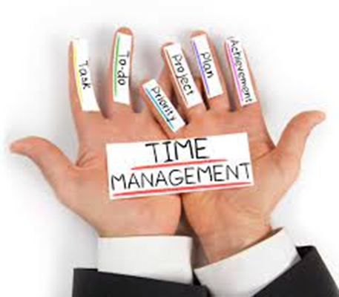
TASK CLASSIFICATION TO ENHANCE TIME MANAGEMENT
Urgent + Important (Do)
Urgent + Not Important (Delegate)
Not Urgent + Important (Schedule them in your calendar in advance)
Not Important + Not Urgent (Delete)

Slide 8

BENEFITS OF TIME MANAGEMENT
Greater productivity and efficiency
A better professional reputation.
Less stress.
Increased opportunities for advancement.
Greater opportunities to achieve important life and career goals.

Slide 9
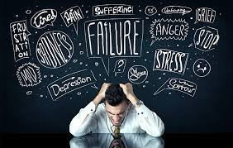
FAILURE TO MANAGE TIME OR POOR TIME MANAGEMENT AT WORK
Can result in:
Missed deadlines and appointments
Procrastination and lack of focus
Lack of professionalism
Inefficient workflow and low work quality
Unwanted stress
Poor professional reputation
Strained workplace relationships
Financial penalties
Work and life imbalance

Slide 10
Time Management: Applicable Areas in FRSC
Routine Tasks
Client Services
Patrol Operations
Rescue
1
2
3
4

Slide 11
Time Management: Applicable Areas in FRSC - II
1 | Routine Tasks | Effective time management should be incorporated into the general administrative duties of the Corps to boost organizational performance and minimize redundancy among personnel. A situation where the visible output of the Corps is borne by a few Staff in line with the Pareto principle” should be discouraged and discontinued.
2 | Client Services | Sustainability in production and the supply chain for Drivers Licence and Number Plates require effective time management to meet the demand and also satisfy all customers of the Corps.

Slide 12
Time Management: Applicable Areas in FRSC - III
3 | Patrol Operations | As a preventive enforcement strategy on road traffic crash, practical time management skills must be applied to forestall lags in any particular function especially on priority routes, corridors and places.
4 | Rescue Services | In responding to distress calls and other traffic emergencies, time management is of essence in sustaining the GOLDEN HOUR of crash victims.

Slide 13
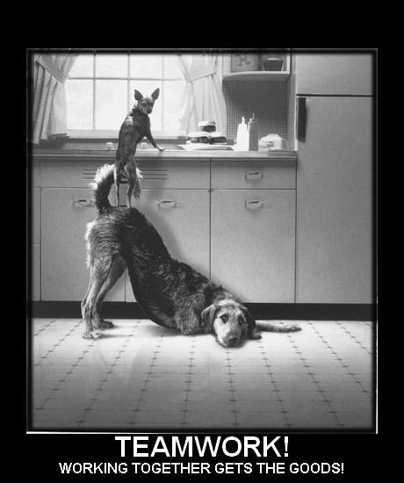

Team Work + Time Management is PROFITABLE

Slide 14

Good time management enables an individual to complete more in a shorter period of time, lowers stress, and leads to career success. It is also an essential for building a high performance team leading as well as organizational aggregate performance/ service delivery which ultimately enhances public perception.
Conclusion

Slide 15


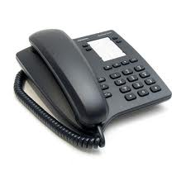

Thank you
Phone Only
SMS Only
Call toll free on: 122
0700 – CALL - FRSC
0700 – 2255 – 3772
080 7769 0362
www.frsc.gov.ng

