Slide 1

BRIEF ON THE ACTIVITIES OF THE POLICY, RESEARCH AND STATISTICS DEPARTMENT
A PRESENTATION AT THE CAPACITY BUILDING PROGRAMME FOR PRINCIPAL OFFICERS IN RSHQ
VICTOR C. NWOKOLO, fdc
Deputy Corps Marshal
Head, Policy, Research and Statistics Department
24 May, 2021

Slide 2
OUTLINE
Introduction
Department’s Vision and Mission Statements
Aims and Objectives
Functions of the Department
Achievements
Challenges and Way forward
Conclusion

Slide 3

INTRODUCTION
The Department of Policy, Research and Statistics is made of four sections namely; Policy, Research, Statistics and NaRSAC with 12 Units.
Policy section
Bilateral
SGD/Gender
Non- Motorized
Research section
Research
Monitoring &Evaluation
Library and
Research and Development Unit

Slide 4

Statistics section
Operational statistics
Road Traffic Information
Harmonization& Reconciliation
The Admin unit

Slide 5
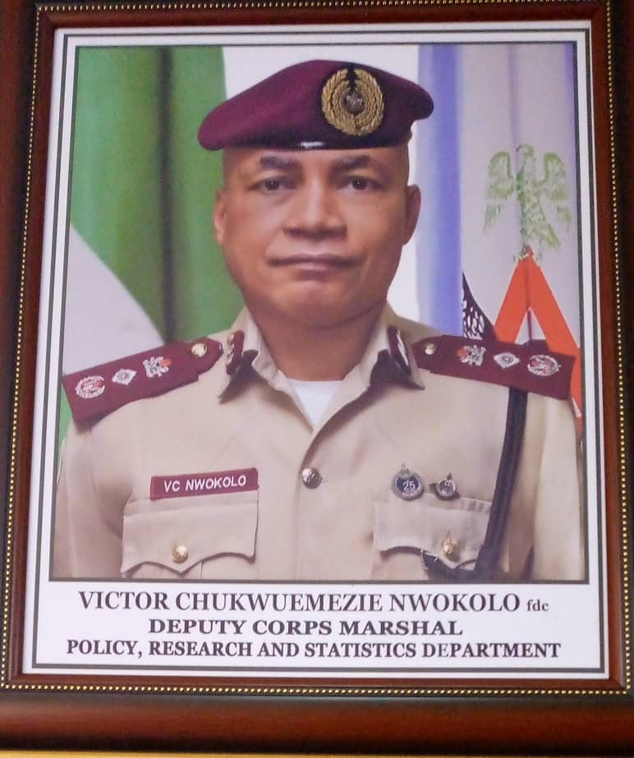
Head of PRS reports directly to the Corps Marshal. He is responsible for co-ordination and Management of the department in line with the Corps’ mandate and corporate Strategic objectives. He does these through the assistance of the four sectional Heads and other principal officers who are answerable to the sectional Heads on matters concerning their respective sections and units.
Notes:
Insert a map of your country.

Slide 6
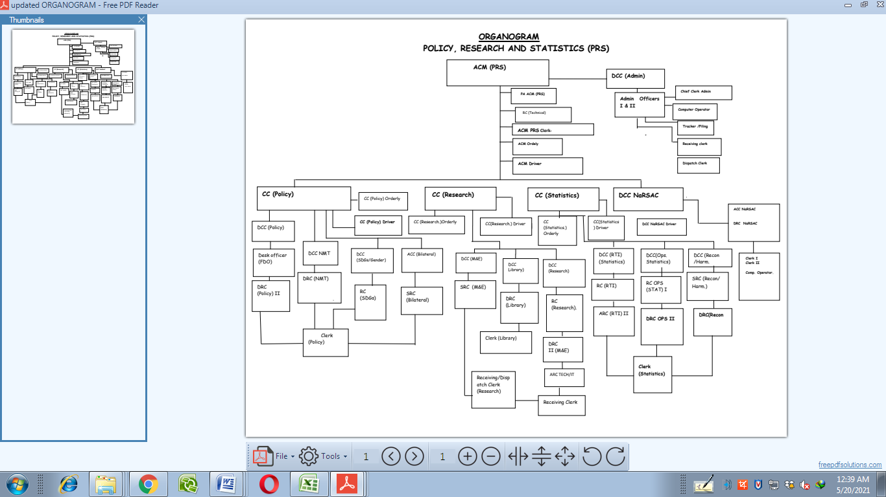
Organogram

Slide 7

To sufficiently satisfy the information and data requirement of the Corps towards the actualization of its mandate.

Slide 8

Collate, analyze and process data relating to Road Traffic Administration and Safety Management
Co-ordinate collaboration with local stakeholders and International partners in intellectual exchanges through meetings and conferences
Secure assistance, collaboration and funding of Road Traffic Administration and Safety Management activities
Collaborate with other departments and Corps offices in the formulation of policies for the Corps.

Slide 9
FUNCTIONS OF PRS DEPARTMENT

Slide 10
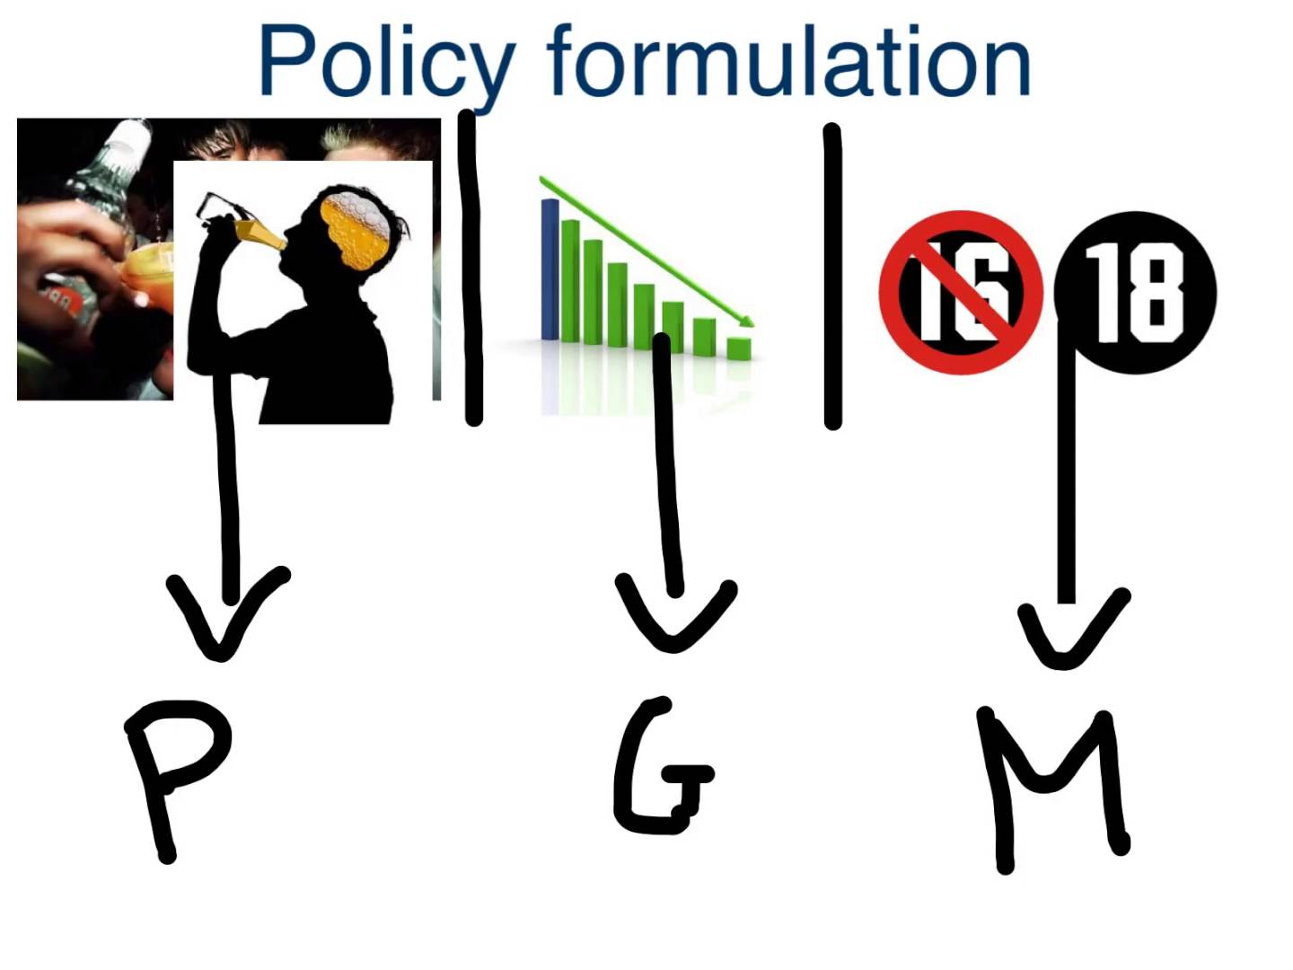
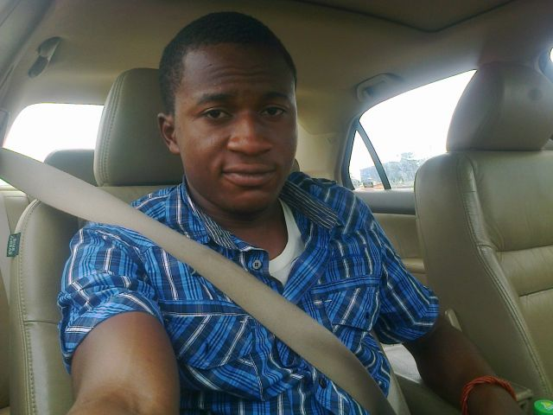
Policy Formulation, implementation, monitoring and Evaluation

Slide 11
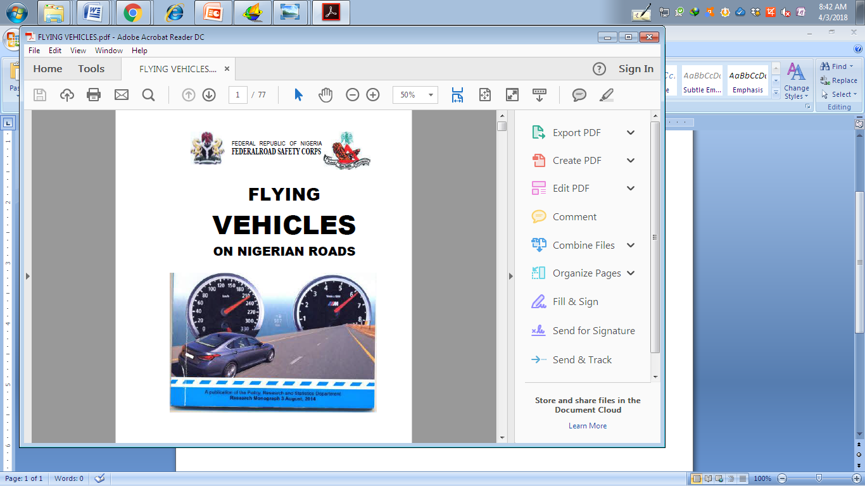
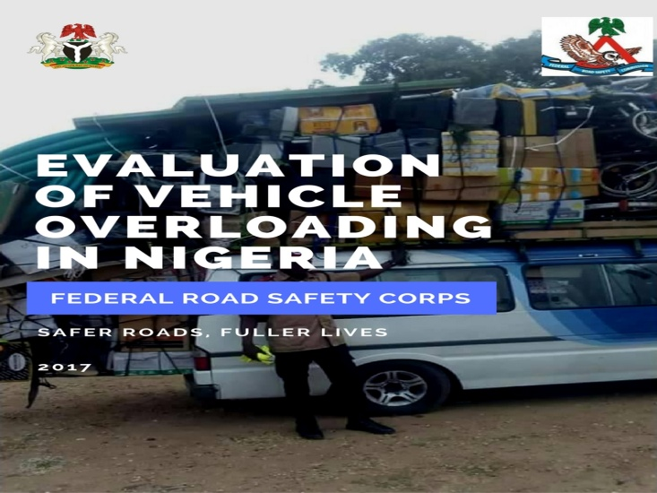
Conducts researches for decision making

Slide 12
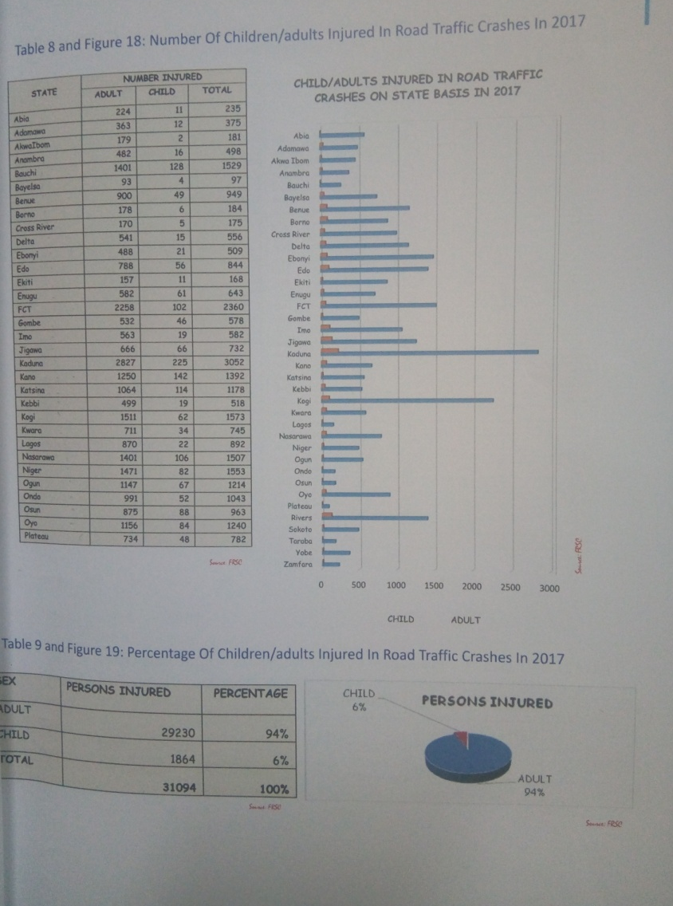
Collation and Analysis of RTC/RTI data and other
statistical data

Slide 13
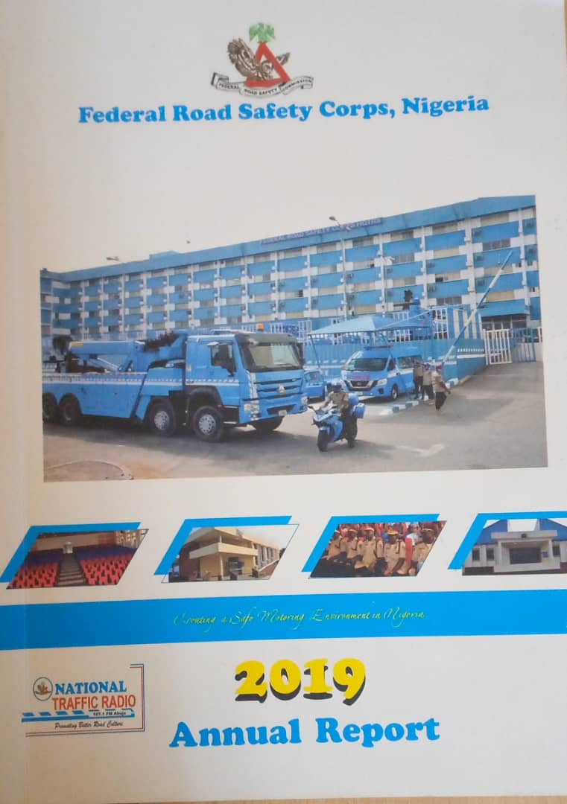
Generation of Annual and other reports

Slide 14
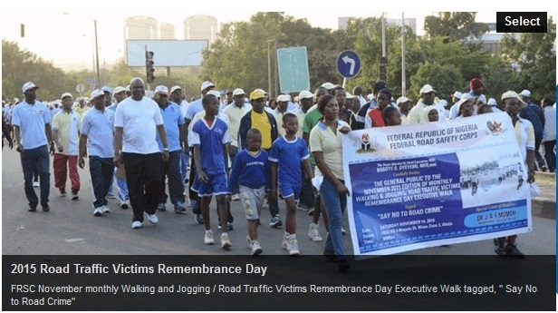
Organizes commemorative events like the
  African Road Safety Day
  UN Global Road Safety Week
  World Day of Remembrance for RTC victims every November.
  World Bicycle Day

Slide 15
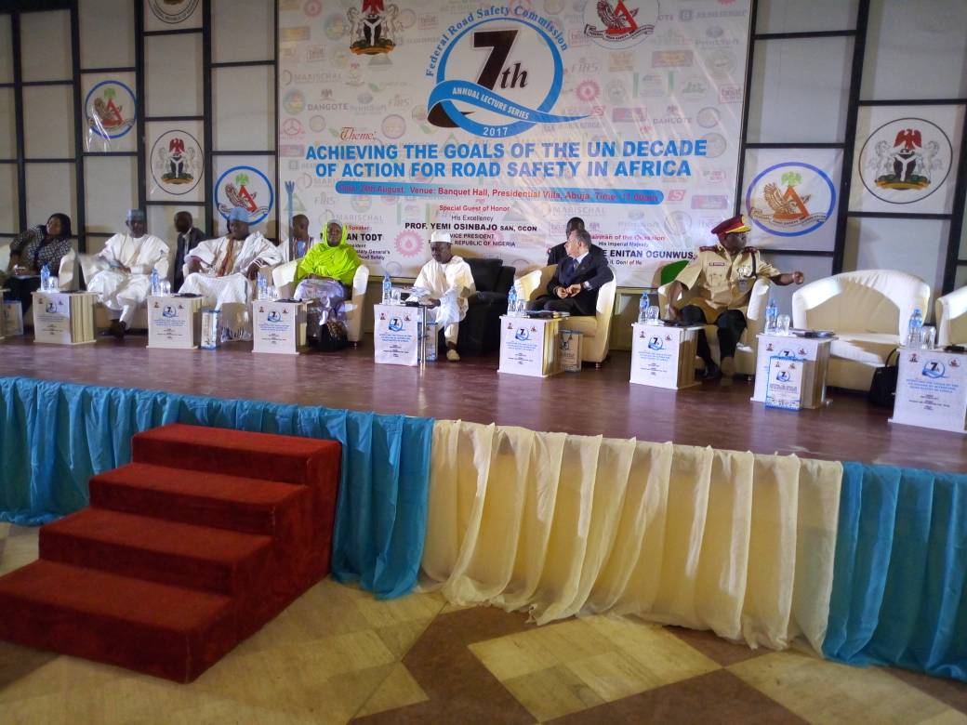
Organizes Annual Lecture Series for the Corps, produce reports and compendium of the lectures.

Slide 16
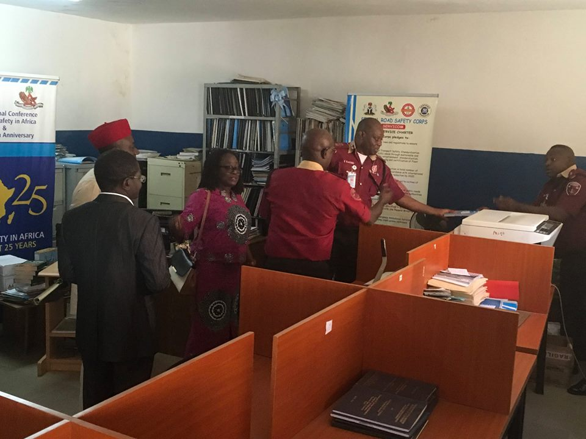
Coordinates the acquisition of Books and Relevant Materials as well as receiving new books/Journals in the FRSC Library.

Slide 17
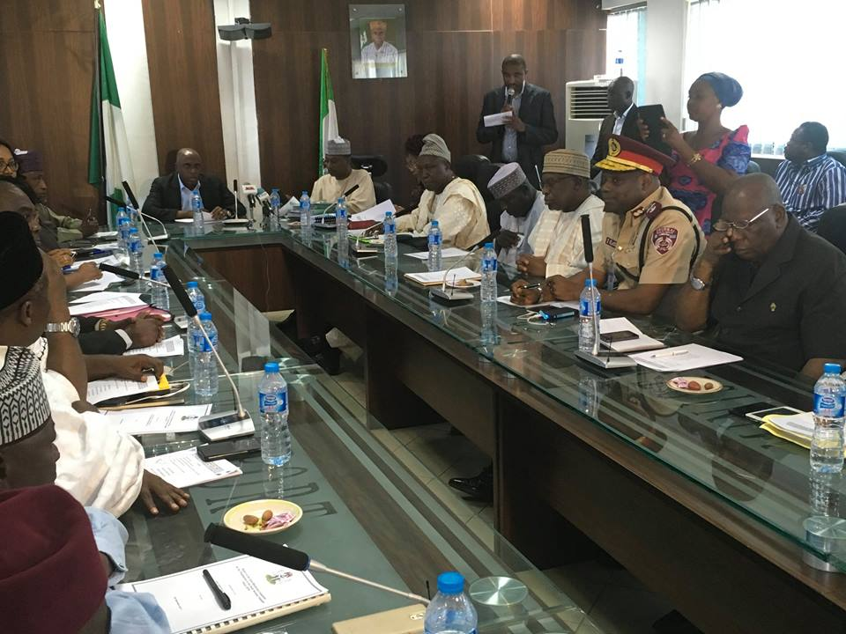
Organizes Conferences,
Seminars And Workshops

Slide 18
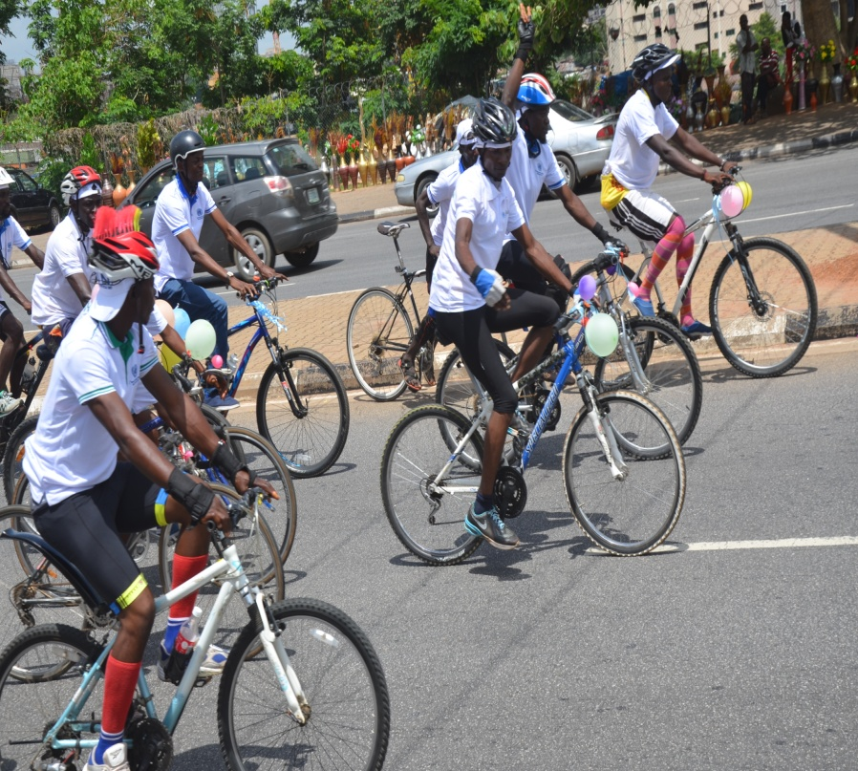
Initiates and provides guide for the conduct of the Annual National Bicycle Week

Slide 19
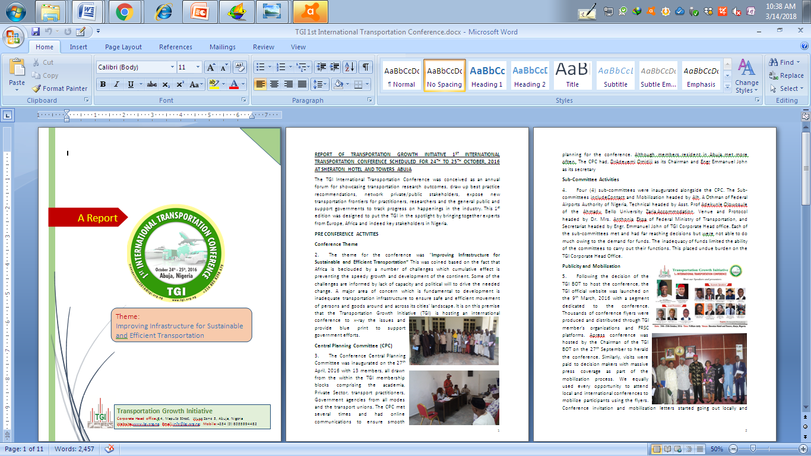
Coordinates the activities of Transportation Growth Initiative (TGI) secretariat

Slide 20

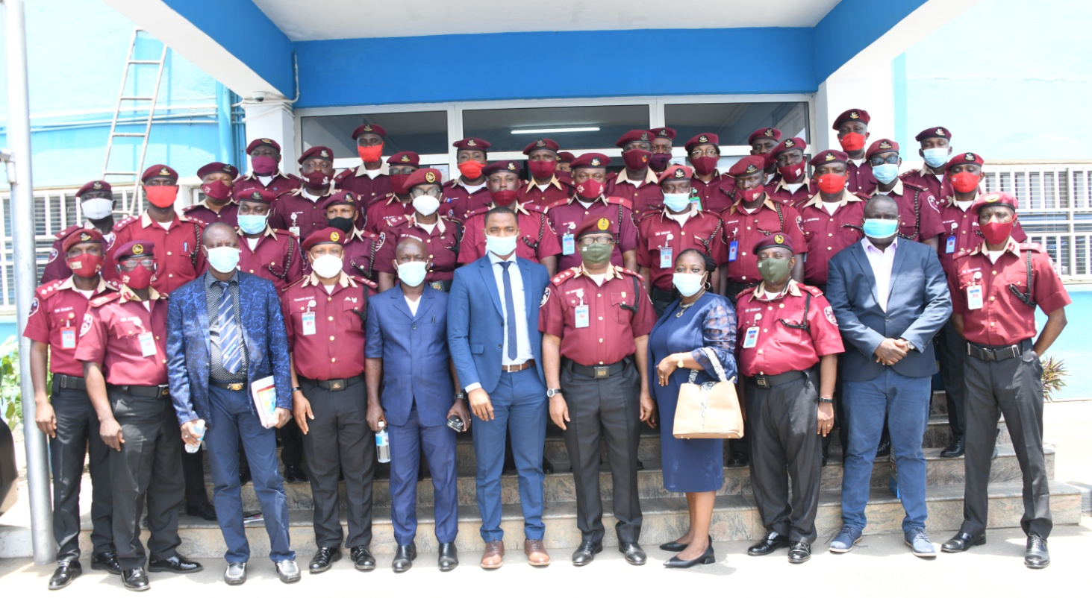
Organizes all West African Road Safety Organization (WARSO) programmes in the Corps. The West African Road Safety Organization is a body of member countries within the ECOWAS Sub-region; with the common resolve to promote and improve road safety activities within the sub-region. It is made up of 15 member countries and 4 Non-governmental Organizations. It was inaugurated by His Excellency Dr. Mohammed Ibn Chambers, the then President ECOWAS Commission in Abuja with the Corps Marshal, FRSC, as the First President.

Slide 21






Nominates participants for Conferences of International affiliates of the Corps, for Corps Marshal’s approval

Slide 22
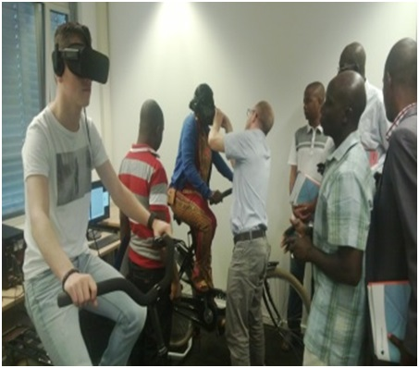
Coordinates activities of Non-Motorized Transportation Unit.
Initiates and provides guide for the development of manuals, policies and standards on non-motorized transportation
Reviews field reports relating to Non-Motorised Transportation
Training of young officers on Non-Motorized Transportation in Netherlands

Slide 23
Collaboration with Stakeholders: External/Inter-Agency Liaison.
Sustainable Development Goals (SDGs): Annual Proposal to the Office of the Special Assistant to the President (OSSAP) on SDGs.
Representation of the Corps on SDGs programs

Slide 24
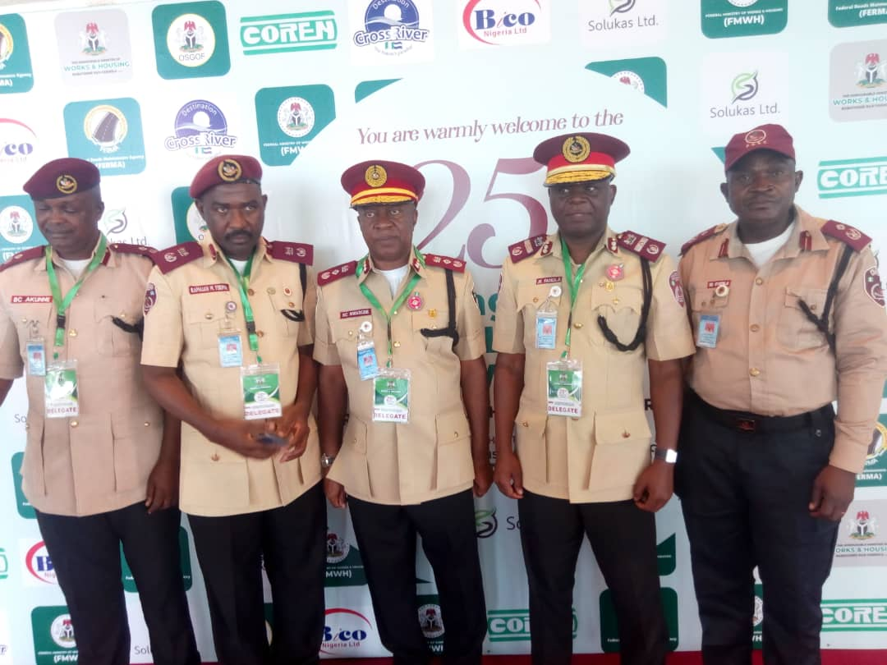

Prepares the Council memos on road safety related activities and forwards same to the CM and also represents the Corps at the Council Meetings of;
National Council of Transportation
National Council of Communication Technology
National Council of Works, Housing and Power
National Council of Health
National Council on Climate Change
National Council on Education e.t.c

Slide 25
Champions the Corps partnership with the Centre for Logistics and Transport Studies, University of Portharcourt (CELTRAS) where the Corps was endowed with a professorial chair named ‘’Federal Road safety Corps Professorial Chair for Road Safety Management’’.
Represents the Corps Marshal as member, Board of the Center for Logistics and Transport studies at the University of Portharcourt.

Slide 26

ACHIEVEMENTS

Slide 27

ACHIEVEMENTS CONT’D
Anchored the Corps’ participation at the Transport Research Board (TRB) Meeting in Wale Washington Convention Centre Washington DC, January, 12th to 16th 2020 .
Production of 2019 annual report and currently working on that of 2020.
Represented the Corps at the Inaugural meeting of the reference group on Gender Responsive Security Sector with Technical Support of United Nations (UN) Women)

Slide 28
ACHIEVEMENTS CONT’D
Monthly Collation and Analysis of Road Traffic Crashes data nationwide.
Forwarding of Monthly Executive summary of RTC to SGF and National Security Adviser (NSA)

Slide 29
ACHIEVEMENTS CONT’D
Successfully conducted a survey to evaluate National Community Post Crash Care Initiative to Road Traffic Victims in Critical Corridors.
Also successfully carried out a study to assess the activities Of Tanker/Trailer Drivers along Lagos-Ibadan Express.
Also carried out a survey to Evaluate FRSC Response to Road Traffic Crashes in Nigeria.
Conducted a research on the Causes of increased Cases of Knock Down of FRSC Personnel
Produced and uploaded Statistical digest on FRSC website.

Slide 30
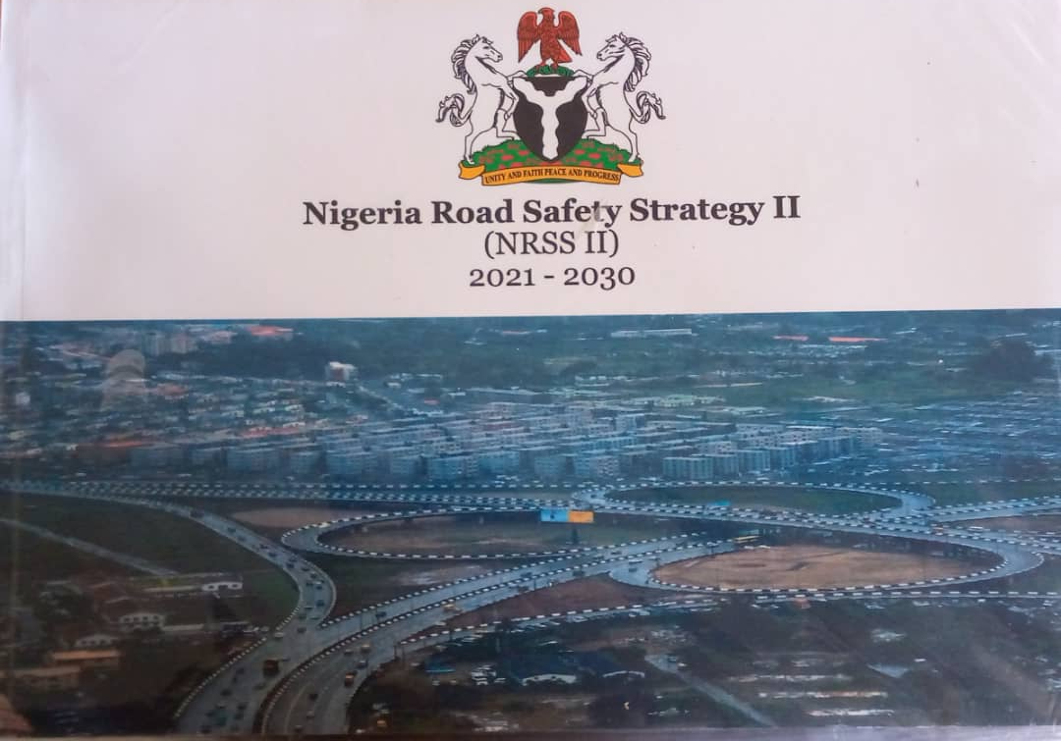
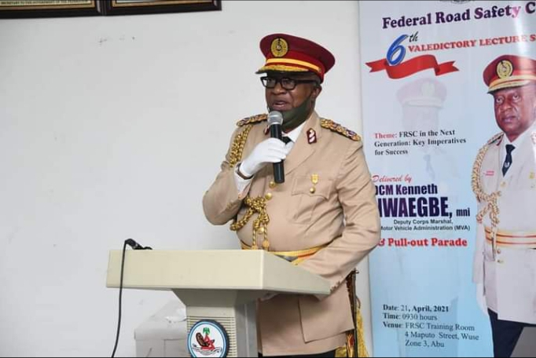
ACHIEVEMENTS CONT’D
Through bilateral relationship with Federal Ministry of Budget and National Planning, the Corps secured approval of the Nigeria Road Safety Strategy (NRSS II 2021-2030) by Federal Executive Council on the 9th December, 2020.
Organized the 6th valedictory lecture series and pull out parade for retiring DCM Kenneth Nwaegbe,mni Rtd.

Slide 31
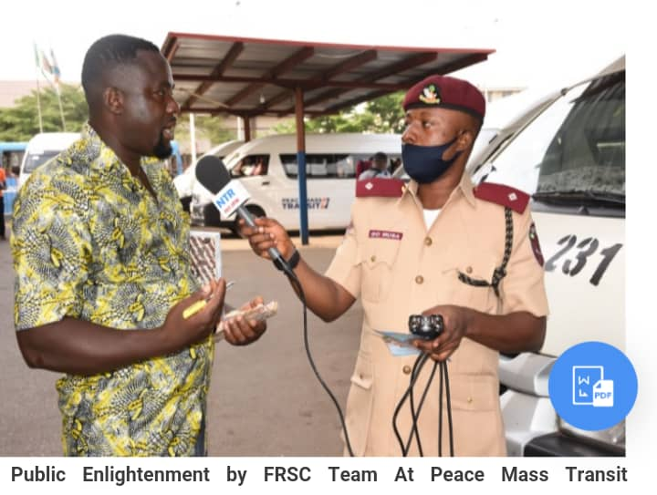
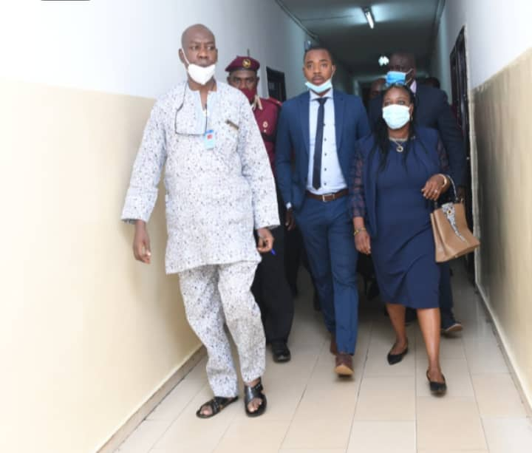
ACHIEVEMENTS CONT’D
Organized the commemoration of the 2021 edition of the West African Road Safety (WARSO) Day nationwide with theme; ‘’Road Safety Consciousness in the Midst of Global Pandemic’’on the 8th May 2021.
Anchored the working visit of Sierra Leone Road Safety Authority to Nigeria (SLRSA)
from 19^{th-} 26th April, 2021

Slide 32
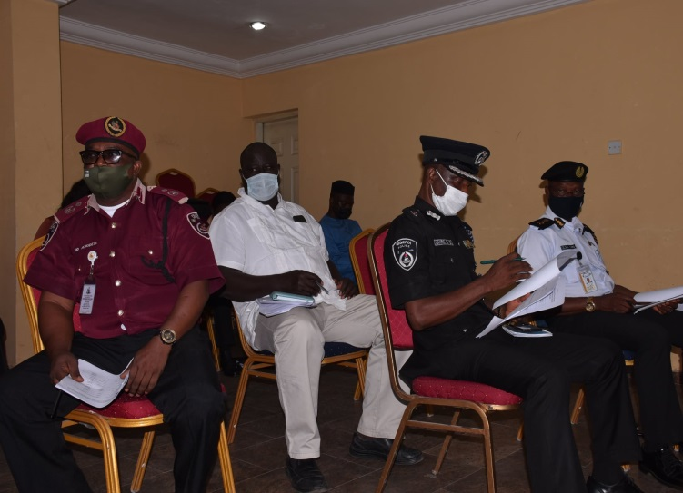
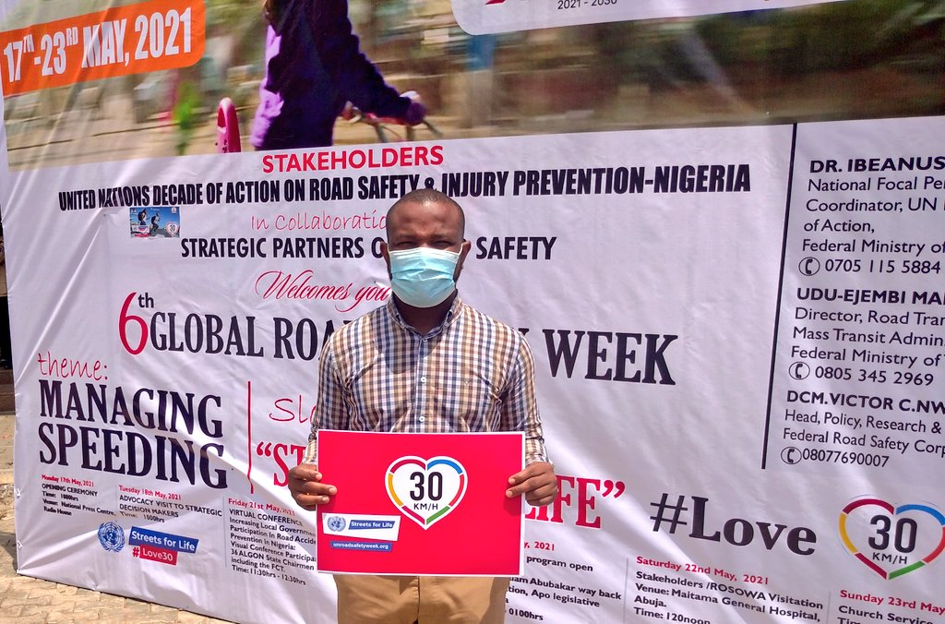
ACHIEVEMENTS CONT’D
Organized the 1st quarter 2021 National Crash Information System (NACRIS) Stakeholders meeting and a roundtable discussion with Vehicle Safety Research Group (VSRG) University of Lagos.
Hosted the 6th UN Global Road Safety Week from 17th-23rd May, 2021 with the theme ‘’Managing Speeding-Streets for life’’.

Slide 33
  ACHIEVEMENTS CONT’D
  Produced Standard Operating Procedure (SOP) for all the FRSC processes as documented titled “FRSC Compendium of SOPs 2020 to ensure standard and uniformity in all FRSC processes in line with ISO which will guide the implementation and enforcement of its policies.
  The department produced the status report on UN Decade of Action 2011 - 2020. The report which was produced in a book form contained FRSC achievement and activities under the Five (5) Pillars and Projections for 2021 – 2030 in line with SDGs and NRSS document.
  The department produced 25 thousand copies of crash report form. This is to ensure accurate and reliable RTC Data collection through the use of standard template.
  The department produced gigantic roll-up banners on the activities and achievements of FRSC under the five pillars of UN Decade of action. The roll-up banners were donated to Corps Marshals office and were strategically placed on the corridor of Corps Marshal’s conference room.
  The department also organized Train-The –Trainers Workshop for Zonal Heads of PRS, Sector DIOs, and representatives of Operations department, CMRS, CSEO, Academy, and PRS Via zoom platform on 14th to 16th July 2020.

Slide 34
OTHER ON GOING ACTIVITIES
Production of 2020 FRSC Annual Report
Hosting of 8th Annual Lecture Series.
Presentation of FRSC gender Policy to the Management.
United Nations Bicycle Day scheduled for June 3rd 2021
Africa Road Safety Day/World Day of Remembrance for Road Traffic Victims in November 2021.
Council Meetings.
WARSO AGM and Technical Meetings 2021.
Design of NRTCDMS portal.
Survey into Immediate and Remote Causes of Bribe Taking by FRSC Operatives.
Proposal on Survey to assess Tanker Fleets with and without Safety Valves in all Tank Farms across the Country.

Slide 35
CHALLENGES

Slide 36
CHALLENGES CONT’D
Inadequate funding: The funding of the department’ activities such as research projects, NACRIS meetings and capacity building for staff is an enormous challenge.
Lack of adequate gadgets and tools for research and traffic counts, such as Alcoholizers, Metro counter etc.
Lack of well equipped and fully functional FRSC e- library
Inadequate Trained Manpower for research.
Inadequate working tools, like statistical software

Slide 37
CHALLENGES CONT’D
Constraints on training, implementation and stakeholders buy-in of the use Crash Report Form designed for National Road Traffic Crash Data Management System (NRTCDMS)
Lack of fund to ensure quarterly meeting of Committee on National Crash Reporting Information System (NACRIS) with a view to harmonizing RTC data of all relevant agencies.
Inadequate Marshal Assistants in the department

Slide 38
WAY FORWARD

Slide 39
WAY FORWARD CONT’D
Research grants to facilitate conducts of adequate survey, analysis and policy towards an improved road safety administration in Nigeria
Adequate funding of the Department activities
Provision of adequate fund for the Corps participation in all annual events of Road Safety International Bodies (IRTAD, IRF, PRI, TGI, TRB, SSATP etc)
Ensure timely production and distribution of the 2020 Annual Report of the Corps

Slide 40
WAY FORWARD CONT’D
Training of Research Officers and Statisticians to enhance job performance
Funding of quarterly meeting of NACRIS with a view to harmonizing RTC data with all relevant agencies
Provision for adequate working tools, eg Laptops, Statistical software, fireware, back-ups etc
Posting of Marshal Assistants

Slide 41
WAY FORWARD CONT’D
Engagement with more Universities for collaboration on Research and Development
Upgrade of the FRSC database into a National Road Safety Observatory.
Encourage more officers to embark on Operational Research that will bring up new ideas into Road Safety Administration
Expedite action on the harmonization of all road traffic related data with a view to bridging the gap between the FRSC and the WHO data on Road Traffic deaths and injuries

Slide 42
Conclusion
The PRS Department is known for its excellent performance in all assigned duties.it has been ranked amongst the best departments in the yearly assessment.
I sincerely thank the Corps Marshal for the privilege to pilot the affairs of the Department.
I am sure that with the support and cooperation of the entire staff, we will continue to contribute our quota in moving the Corps forward towards achieving its Mandate.

Slide 43


