Slide 1
LECTURE NOTE ON JOB SCHEDULES AND WORKPLAN OF xRECORDS MANAGEMENT UNIT PRESENTED AT THE CAPACITY BUILDING PROGRAMME FOR PRINCIPAL OFFICERS IN RSHQ ON 24TH MAY, 2021
BY
DCC KAMLA N DAKUP
DCC (xRECORDS)
xRecords Unit

Slide 2
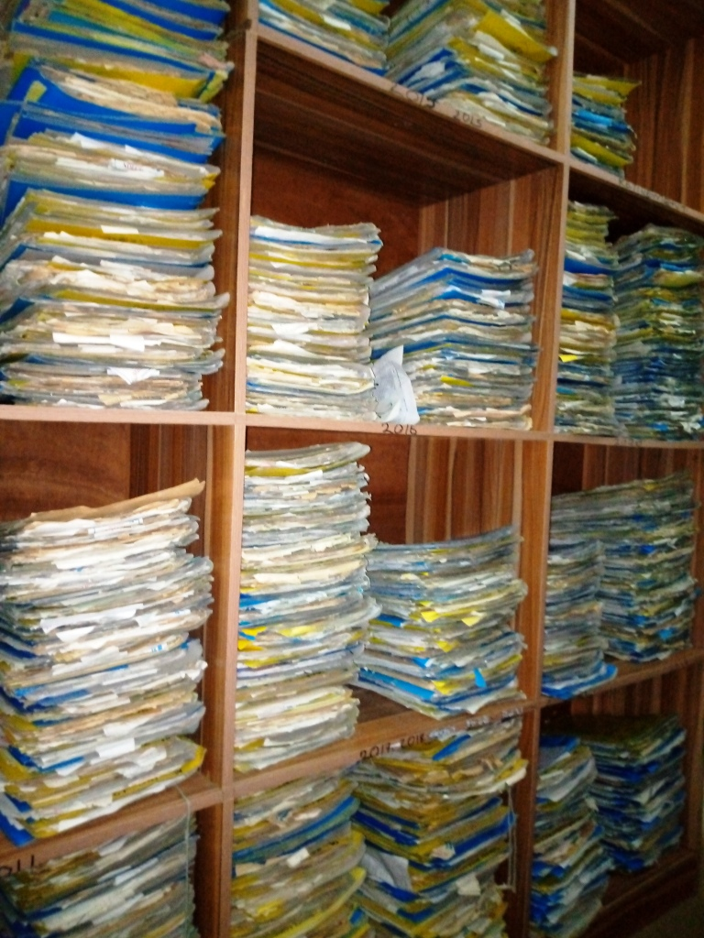
The xRecords unit of the FRSC is a Special Unit saddled with a clear cut responsibility of handling the staff personal files (SPFs) of every disengaged staff of the Corps. The special Unit (xRecords) was established on 15th September, 2020 under CM’s office, with a clear job description of managing the records of disengaged staff of the Corps. The responsibilities of the unit are not limited to the custody of disengaged Staff Personal File (SPFs).
INTRODUCTION

Slide 3
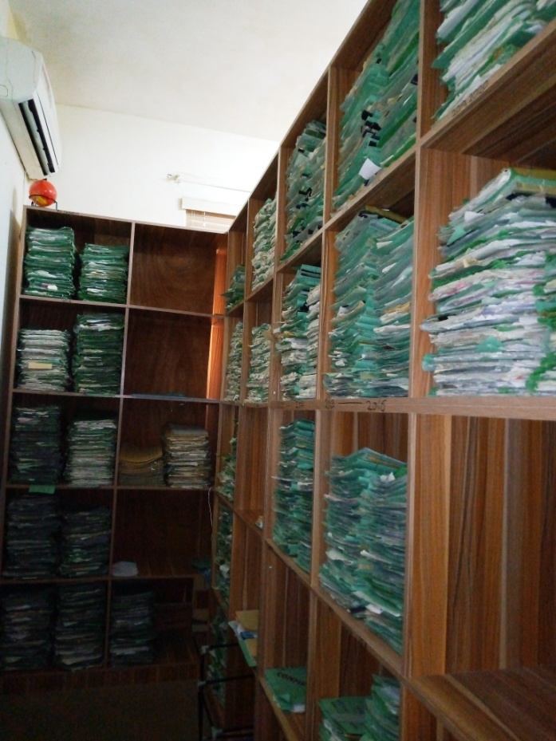
The xRecords management deals with records and information management of disengaged staff of the Corps. This includes identifying, classifying, storing, securing, retrieving, tracking and destroying or permanently preserving records.
INTRODUCTION CONTD’

Slide 4
At the end of this presentation, participants should be able to;
AIM
The aim of this presentation is to acquaint participants (Senior Officers) with the responsibilities of xRecords Unit through the processes of receiving, managing and releasing disengaged Staff Personal Files (SPFs).
OBJECTIVES
Explain the concepts of xRecords and records management in FRSC.
List and explain the Functions/Responsibilities of xRecords Unit.
List and explain the process of receiving disengaged SPFs from AHR and CS
Mention and explain the process of releasing disengaged SPFs to relevant offices on request

Slide 5
Concepts of record
The concept of record is variously defined. The ISO 15489-1:2001 defines records as "information created, received, and maintained as evidence and information by an organization or person, in pursuance of legal obligations or in the transaction of business".
Key Records Management Terminologies
Not all documents are records. A record is a document consciously retained as evidence of an action. Records management systems generally distinguish between records and non-records (convenience copies, rough drafts, duplicates), which do not need formal management.
Physical controls may be used to keep confidential records secure – personnel files, for instance, which hold sensitive personal data, may be held in a locked cabinet with a control log to track access.
File maintenance Records may be formally and discretely identified by coding and housed in folders specifically designed for optimum protection and storage capacity, or they may be casually identified and filed with no apparent indexing. Organizations that manage records casually find it difficult to access and retrieve information when needed.

Slide 6
A disaster recovery plan is a written and approved course of action to take after a disaster strikes that details how an organization will restore critical business functions and reclaim damaged or threatened records.
An active record is a record needed to perform current operations, subject to frequent use, and usually located near the user. More modern usage tends to refer to the entire ' lifecycle' of records – from the point of creation right through until their eventual disposal.
Records life-cycle
The records life-cycle consists of discrete phases covering the life span of a record from its creation to its final disposition.
Records management practices and concepts
A Records Manager or Officer is someone who is responsible for records management in an organization. Section 4 of the ISO 15489-1:2001 states that records management includes:

Slide 7
Setting policies and standards
Assigning responsibilities and authorities
Establishing and promulgating procedures and guidelines
Providing a range of services relating to the management and use of records designing, implementing and administering specialized systems for managing records integrating, records management into business systems and processes.
Thus, the practice of records management may involve:
Planning the information needs of an organization
Creating, approving, and enforcing policies and practices regarding records, including their organization and disposal
Developing a records storage plan, which includes the short and long-term housing of physical records and digital information
Identifying, classifying, and storing records
Coordinating access to records internally and outside of the organization, balancing the requirements of business confidentiality, data privacy , and public access.

Slide 8
Classification of records management
Physical records are those records, such as paper, that can be touched and which take up physical space.
Electronic records, also often referred to as digital records, are those records that are generated with and used by information technology devices.
XRecords in FRSC
The xRecords represent those records that are common to disengaged staff of FRSC. Such records often revolve around the day-to-day operations of the Corps and cover areas such as but not limited to litigation, employee management, consultant or contractor management.

Slide 9
Job Schedules of xRecords Unit
The Unit is saddled with the custody of disengaged (Terminated, Deceased, Resigned, Retired and Dismissed) SPFs.
In order to accomplish this mandate in line with the vision of the present Management, the following steps are taken to execute the mandate;
Managing the records of disengaged staff through:
Liaising with AHR and CS on the transfer of files of disengaged staff to xRecords Unit.
Storing and retrieval of records of disengaged staff.
Tracing, tracking and updating records of disengaged staff
Preventing unauthorized access to records of disengaged staff

Slide 10
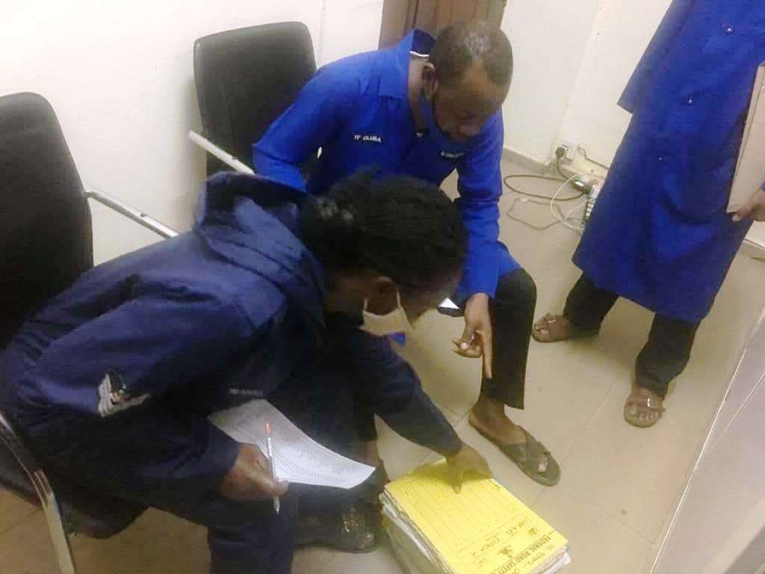
Procedure For Receiving SPFs of Disengaged Staff
The following procedures are required for receiving SPFs of Disengaged staff:
xRecords receives SPFs of disengaged Staff from AHR/CS through Corps Marshal
xRecords crosschecks the SPFs of disengaged Staff in the presence of the dispatch clerk.
xRecords scans SPFs of disengaged Staff into soft copy and shelves on the appropriate cabinet.
xRecords submits status report of SPFs of disengaged Staff to Corps Marshal on weekly basis.

Slide 11
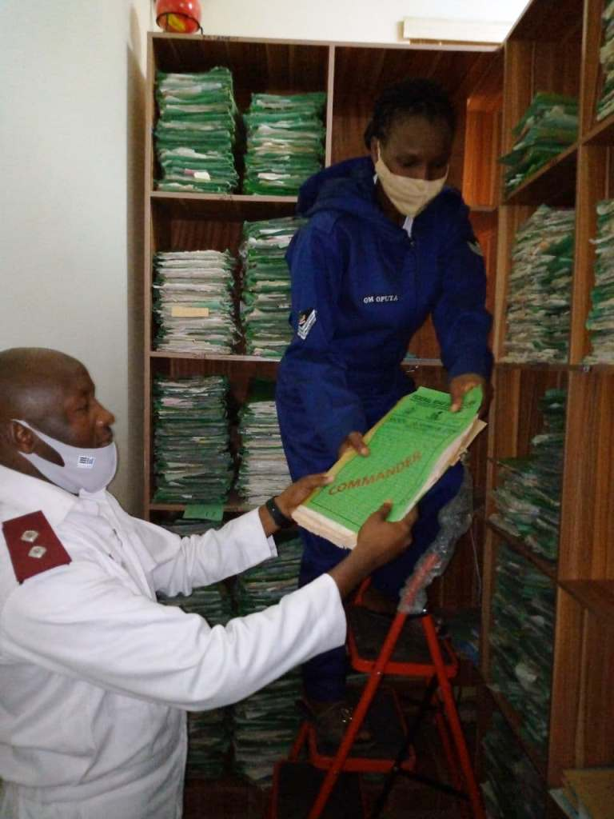
Custodian Of Disengaged Staff Personal Files
The following procedures are required for taking custody of disengaged staff personal files from AHR and CS after approval is granted by Corps Marshal:
xRecords ensures the receipt of disengaged Staff personal files from AHR and CS.
xRecords ensures the pages of the disengaged Staff personal files received are complete, well paginated and shelved according to years of occurrences.
xRecords ensures report of received files is forwarded to Corps Marshal.
xRecords ensures that correspondences on disengaged-staff personal files requests are adequately handled and forwarded to the appropriate office.
xRecords ensures the tracking of all disengaged staff personal files on transit.

Slide 12
Procedure For Releasing SPFs of Disengaged Staff
The following procedures are required for releasing SPFs of Disengaged staff on requests by relevant offices as approved by the Corps Marshal:
xRecords receives requests for the release of SPF of disengaged staff from relevant offices.
xRecords acts on the requests and communicates Corps Marshal on action taken.
Procedure for Tracking/Monitoring of Released SPFs of Disengaged Staff to Relevant Offices
The following procedures are required for tracking/monitoring of released SPFs of Disengaged staff:
xRecords identifies SPF of disengaged Staff which has overstayed approved 72 working hours in a particular office depending on the purpose of request.
xRecords raises a memo to the relevant office for the return of the SPF having overstayed the approved 72hours with the office.

Slide 13
Procedures for Update of SPFs of Disengaged Staff
The following procedures are required for updating SPFs of Disengaged staff:
DCC (xRecords) receives SPF of disengaged Staff from relevant offices.
DCC (xRecords) under his supervision directs Computer Operator to scan documents into softcopy, save on cloud.
DCC (xRecords) directs Staff Officer to categorize and shelf SPF of disengaged Staff within 72hours of receipt.
DCC (xRecords) writes status report of SPF within 72hours of receipt and forwards to Corps Marshal.

Slide 14
Challenges of Records Management in an Organization
Security
Privacy, data protection, and identity theft have become issues of increasing interest. The role of the records manager in the protection of an organization's records has grown as a result.
Transparency
The increased importance of transparency and accountability in public administration, marked by the widespread adoption of Freedom of Information laws, has led to a focus on the need to manage records so that they can be easily accessed by the public.
Adoption and implementation
Implementing required changes to organizational culture is a major challenge, since records management is often seen as an unnecessary or low priority administrative task that can be performed at the lowest levels within an organization.
Impact of internet and social media
Another issue of great interest to records managers is the impact of the internet and related social media, such as wikis , blogs , forums , and companies such as Facebook and Twitter, on traditional records management practices, principles, and concepts, since many of these tools allow rapid creation and dissemination of records and, often, even in anonymous form.

Slide 15
Records life cycle management
A difficult challenge for many enterprises is tied to the tracking of records through their entire information life cycle so that it's clear, at all times, where a record exists or if it still exists at all.
Conversion of paper records to electronic form
As the world becomes more digital in nature, an ever-growing issue for the records management community is the conversion of existing or incoming paper records to electronic form. Such conversions are most often performed with the intent of saving storage costs, storage space, and in hopes of reducing records retrieval time.
Education and certification
Many colleges and universities offer degree programs in library and information sciences which cover records management. Furthermore, there are professional organizations such as the Records and Information Management Professionals Australasia (RIMPA) and the Institute of Certified Records Managers which provides a separate, non-degreed, professional certification for practitioners, the Certified Records Manager designation or CRM.

Slide 16
2021 WORK PLAN OF xRECORDS UNIT
In order to ensure a seamless and productive output of xRecords Unit, a work plan for 2021 has become very imperative.
In order to achieve this therefore, a work plan for the Unit is designed as follows:
S/N | INITIATIVE | OBJECTIVES | ACTIVITIES TO ACHIEVE THE INITIATIVES (PLANNED ACTIVITITES) | RESPONSIBILITY PERSON | EXPECTED TIME OF COMPLETION
1. | Liaise with AHR and CS for prompt forwarding of disengaged staff personal files to xRecords Unit | To ensure effective update of list of disengaged staff | Ensure receipt of SPFs of disengaged staff. Update list on computer Shelf files Write report to CM | DCC (xRecords) | 31st Dec, 2021
2. | Scan all documents of disengaged staff | To ensure safety of documents | Ensure scanning and saving of all documents of SPFs in the cloud. | DCC (xRecords) | 31st Dec, 2021

Slide 17
2021 WORK PLAN OF xRECORDS UNIT CONTD’
S/N | INITIATIVE | OBJECTIVES | ACTIVITIES TO ACHIEVE THE INITIATIVES (PLANNED ACTIVITITES) | RESPONSIBILITY PERSON | EXPECTED TIME OF COMPLETION
3. | Liaise with AHR and CS for graphic analysis of disengaged staff from 1989 – 2020 | To give an overview to Management on number of disengaged staff on yearly basis | Calculate total number of disengaged staff yearly and present on bar chart for easy comprehension at a glance. | DCC (xRecords) | 31st Dec, 2021
4. | Liaise with the relevant stakeholders within and outside the Corps for capacity building workshop. | To ensure effective productivity of xRecords staff | Inform relevant stakeholders Collect feedback Create a timetable convenient for both parties Execution Write report to CM | DCC (xRecords) | 31st Dec, 2021
5. | Liaising with sister agencies to understudy the processes of xRecords Units | To enable xRecords Unit of FRSC key into areas that can improve its processes for optimal productivity | Inform relevant agencies Collect feedback Create a timetable convenient for both parties Execution Write report to CM | DCC (xRecords) | 31st Dec, 2021

Slide 18
WAY FORWARD
In order to have a convenient work environment for optimal productivity, there is a need for management to plan towards acquiring a bigger office for future expansion.
The staff need to attend Education and training courses and workshops on technical records management and the Quality Electronic Records Practices Standards (Q-ERPS), Information Management and Library and Information Management with a specialist stream in records management. Electronic Document and Records Management and specialized education opportunities in records management, Archives and Records Management.
CONCLUSION
The welfare policy of FRSC retirees has become a very important aspect that is key to the present Management. Therefore, records of disengaged staff must be guided jealously by updating and protecting their records from inception till date and making them readily available as the need arises.

Slide 19
THANK YOU FOR YOUR TIME

