Slide 1

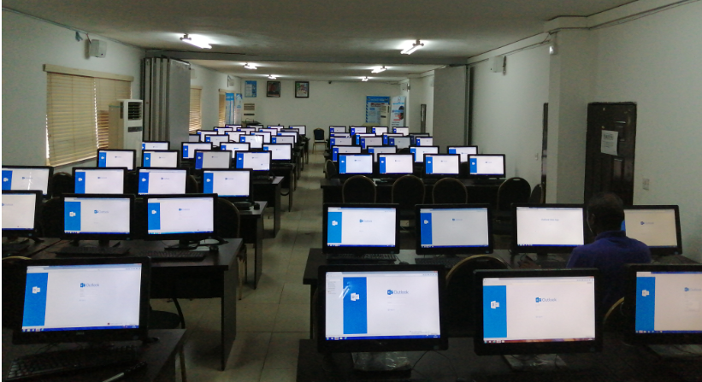
CIT OFFICE (Achievements, and Action Plan for 2021)
DCC Wasiu A Adenekan
Deputy Corps Information Technology Officer (DCITO)
Corps Information Technology Office

Slide 2
INTRODUCTION:
The Corps Information Technology Office is saddled with the responsibility of coordinating and supervising activities in the Corps and it comprises of the following units:
IT Strategy & Infrastructure Unit
Information Security, Risk Mgt & Control Unit
Application & Client Support Unit
IT Service Management Unit
CIT Admin Unit

Slide 3
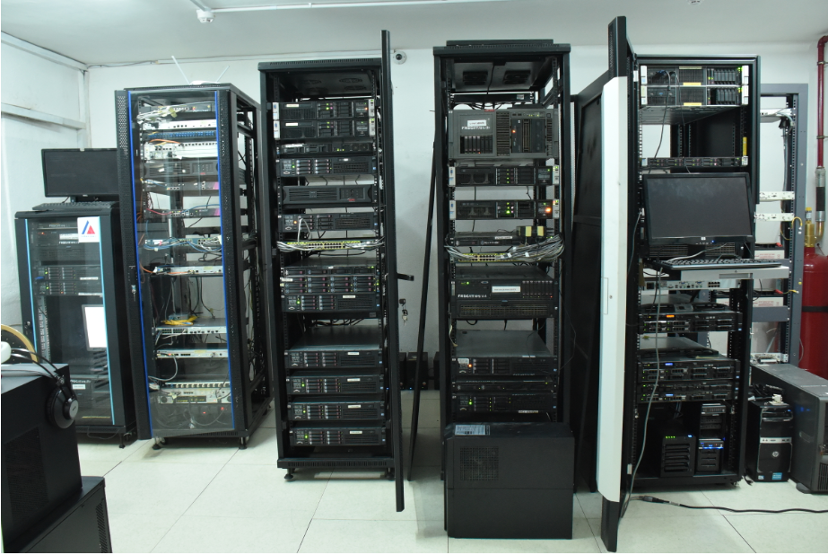
ROLES/RESPONSIBILITIES – 1/4
Monitoring and supervision of the activities of IT Strategy & Infrastructure Unit:
Daily monitoring of status of all IT Infrastructure across the Corps and generation of situation reports
Compilation and resolution of network related faults and issues
CUG lines provision and management
3

Slide 4

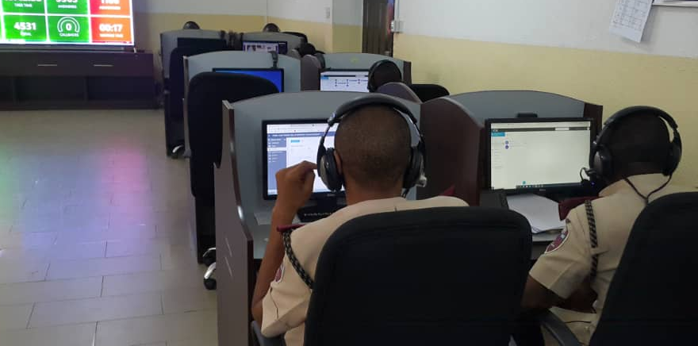
ROLES/RESPONSIBILITIES – 2/4
Monitoring and supervision of the IT Service Management Unit through the following work processes:
Receiving reports of incidents (internal/external calls on crash, congestion or obstruction) and escalating appropriately.
Ensuring preparation of technical specifications for procurement of system hardware.
Ensuring prompt repairs and maintenance of faulty systems and other hardware devices.

Slide 5

ROLES/RESPONSIBILITIES – 3/4
Monitoring and supervision of the Information Security, Risk Management & Control Unit :
Manage and restrict user accounts for email accessibility on a daily basis
FRSC website Content Management
5

Slide 6

ROLES/RESPONSIBILITIES – 4/4
Monitoring and supervision of the Operations of Application & Client Support Unit:
Ensuring proper management of all the existing system applications in the Corps
Ensuring that complaints received from Commands are promptly resolved
6

Slide 7

RECENT ACHIEVEMENTS/ACTION PLAN - 1/4
IT STRATEGY & INFRASTRUCTURE
Provision of 15 mbps Globacom Internet Connectivity at FRSC Academy Udi Enugu
Upgrade of Galaxy Backbone Internet Connectivity bandwidth in RSHQ from 20mbps to 155Mbps
To be cascaded to zonal, sector, unit commands, FRSC plants, Print Farm and institutions
Upgrade of Globacom Internet Connectivity at RSHQ from 3mbps to 45mbps
Deployment of Glabacom Internet Connectivity at 33 FRSC Critical Sites (ongoing)
Migration of VSAT from old platform (Hughes) to a new platform Newtech a product of Nigcomsat managed by Galaxy Backbone
  To encourage local contents
  Optimize performance
  Cost reduction
7

Slide 8
RECENT ACHIEVEMENTS/ACTION PLAN - 2/4
INFORMATION SECURITY, RISK MGT & CONTROL
Active Directory – Addition of systems to the Active Directory
All systems to be added to the domain
    For access control
    Management of IT resources
    Blocking of USB ports
IT Security - Cyber Security/ checkpoint
8

Slide 9
-
RECENT ACHIEVEMENTS/ACTION PLAN - 3/4
APPLICATION & CLIENT SUPPORT
Design and development of the following web based applications: Stakeholders portal, Revamp of PSS portal and Upgrade of Duty Room web portal to accommodate new modules
Automation of activities of Departments / Corps offices - FRSC Academy portal and generation of e-Certificate licence for DSSP (ongoing)
    Increase in productivity
    Promote accuracy and integrity of data

Slide 10
-
RECENT ACHIEVEMENTS/ACTION PLAN - 4/4
IT SERVICE MANAGEMENT
Call Centre Enhancement/Upgrade: 3CX Call Centre Solution for answering calls and Customer Relationship Management (CRM) for capture of incidents.
Establishment of IT Service Desk

Slide 11


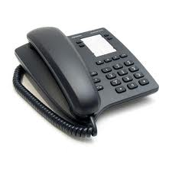
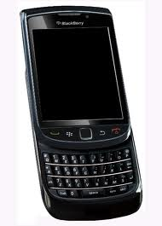
Thank you
Phone Only
SMS Only
Call toll free on: 122
0700 – CALL - FRSC
0700 – 2255 – 3772
080 7769 0362
www.frsc.gov.ng

