Slide 1
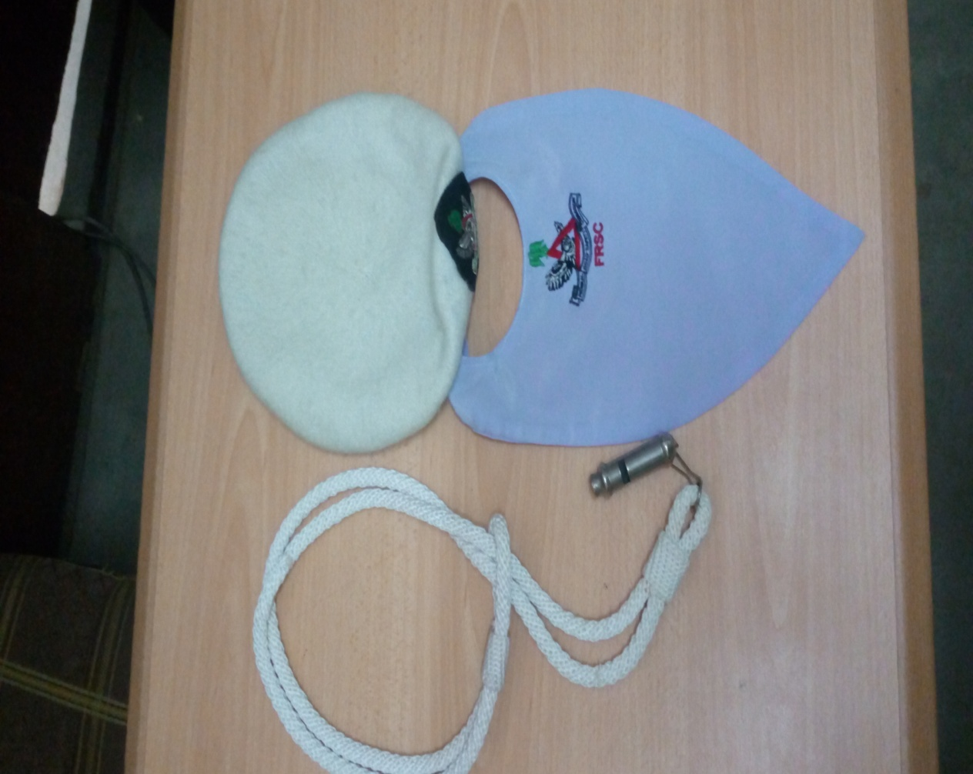


CORPS PROVOST FUNCTIONS
Presented by
CC Ibrahim Abubakar pjsc (CP)
During
One(1) Day Capacity Building Programme for Principal Officers in RSHQ.
Held
Monday 24th May, 2021
@ RSHQ Abuja
FEDERAL ROAD SAFETY CORPS

Slide 2
INTRODUCTION
The Corps Provost reports directly to the Corps Marshal and is saddled with the responsibility of supervising the Corps Provost Office, Operationally and Administratively, and ensures physical security in protection of lives and properties of the Corps by deploying Officers and Marshals for guard duties in all the beats in RSHQ office premises and residential quarters in Abuja and its environs. Ensuring that Provost staff are posted to all Commands and installations in conjunction with Corps Secretary and Admin and Human Resources.

Slide 3

MAINTAINS SECURITY OF FACILITIES
i. Ensures guards are posted to the various FRSC facilities.
ii. Ensures Duty Officers (DOs) are detailed to supervise the guards.
iii. Ensures proper handing/taking over of Duty beats by duty Officers and Marshals.
iv. Conduct weekly Duty Officers briefs.
v. Deployment of Provost to scheduled Corps Functions

Slide 4

MAINTENANCE OF DISCIPLINE
Ensures that staff turnout is acceptable.
ii. Carries out disciplinary procedure on erring staff
iii. Ensures disputes involving staff are settled
iv. Reports of disciplinary cases are published weekly
Ensures that staff turnout is acceptable.
ii. Carries out disciplinary procedure on erring staff
iii. Ensures disputes involving staff are amicably settled
iv. Reports of disciplinary cases are published weekly

Slide 5
ORGANIZES CORPS MARSHAL’S PARADE
i. Ensures Quarter Guard is mounted for Reviewing Officer/VIPs
ii. Ensures Officers and Marshals are formed up for inspection and address.
iii. Escorts Reviewing Officer to the parade
iv. Publishing list of Reviewing Officers
v. Report of parade is maintained weekly.

Slide 6
ORGANIZES CORPS MARSHAL’S PARADE
1 | Ensures Quarter Guard is mounted for Reviewing Officer/VIPs
2 | Ensures defaulters are securely confined in the Guardroom or Mess.
3 | Ensures cases of breach of security are adequately investigated
4 | Forwarding of report of purported investigation to CM.

Slide 7
ARREST/INVESTIGATION OF DEFAULTERS
1 | Ensures arrest of defaulters.
2 | Ensures defaulters are securely confined in the Guardroom or Mess.
3 | Ensures cases of breach of security are adequately investigated
4 | Forwarding of report of purported investigation to CM.

Slide 8
  ACCESS CONTROL
ORGANIZES CORPS MARSHAL’S PARADE
i. Ensures that visitors to RSHQ are screened and issued visitor’s Tags.
ii. Ensures that staff visiting RSHQ on weekends are checked

Slide 9
GENERAL ADMINISTRATION OF THE PROVOST OFFICE
1 | Ensures that complaints among FRSC staff and members of the public are promptly treated
2 | Prepares Weekly Security Tips
3 | Monthly Regimentation guard

Slide 10
COMMANDS ADMINISTRATION
1 | Ensures that all Commands have Provost Operatives to oversee security and discipline
2 | Ensures collation of reports from field Commands.

Slide 11
WORK TARGET FOR YEAR 2021
Minimize Absenteeism and Late Coming amongst members of Staff corps wide
Ensure that Improper Dressing among Staff is brought to its barest minimum corps wide.
Propose to the Management the need
for training and retraining of Provost
Personnel

Slide 12
ARREST/INVESTIGATION OF DEFAULTERS
1 | Ensures arrest of defaulters.
2 | Ensures defaulters are securely confined in the Guardroom or Mess.
3 | Ensures cases of breach of security are adequately investigated
4 | Forwarding of report of purported investigation to CM.

Slide 13
CHALLENGES
1 | Inadequate training and retraining of Provost personnel negatively impacts on the productivity as most Provost staff do not have basic requisite knowledge of Provost responsibilities which they are meant to enforce
2 | Indiscriminate posting of operatives out of Provost Office
3 | Lack of drivers for the Corps Provost Office’s operational vehicle
4 | Inadequate operational/protective devices such as Handcuffs, Pepper spray, Stun gun etc

Slide 14
RECOMMENDATIONS
CHALLENGES
1 | There is need for training and retraining of Provost personnel for improved performance
2 | Posting of Provost staff should be done with recourse to the provost office to avoid creating a gap in service delivery.
3 | Careful enlistment of credible, competent and disciplined personnel into the Provost Office

Slide 15
RECOMMENDATIONS cont...
RECOMMENDATIONS
RECOMMENDATIONS
4. | Provision of personal protective devices/kits for guard duty operatives such as Bullet proof vest and general body amour to protect against attack by insurgents.
5. | Adequate posting of staff to Corps Provost Office to meet up with the increasing demand for guard duty beats.
6. | Posting of drivers to Corps Provost Office to enhance effective monitoring and supervision of guard duty beats.

Slide 16
CONCLUSION
For efficient security management and enforcement of discipline, Provost Office requires a lot of cooperation and collaboration with all the Departments, Corps Offices, Special Unit and other sister agencies.
We should all remember that security and discipline is our collective responsibilities.

Slide 17


THANKS FOR YOUR ATTENTION
INTERCOM
CUG
– CALL – FRSC - CP
55068
080 7769 0060
c.provost@frsc.gov.ng

