Slide 1



CAPACITY BUILDING PROGRAMME FOR SENIOR OFFICERS IN RSHQ
CORPS SAFETY ENGINEERING OFFICE
BY
ACM RINDOM T KUMVEN, MNSE, SRDP, RE(coren), fwc
CSEO RSHQ
THURSDAY 20TH MAY, 2021

Slide 2

INTRODUCTION
In 2009, the Corps Marshal in his wisdom discovered that for the Corps to effectively prevent and minimize crashes on Nigerian roads, there is need to restructure and professionalize engineering activities in the Corps.
By so doing, CM decided to restructure the Department of Engineering and Technical Services in order to remove support services and professionalize the Engineering services in the Corps.
This situation gave rise to the constitution of a Committee to develop a framework for the restructuring in order to create a professionalized Engineering Department. The Department was established as “Safety Engineering Department (SED)” in 2009.

Slide 3
The Department which is now known as “Corps Safety Engineering Office (CSEO)” was established to offer professional support to the Corps, road authorities, transport operators and the general public in areas of vehicle fitness inspection, traffic engineering, traffic management and RTC investigation aimed at improving public safety on our roads.
The mandate of CSEO as enshrined in the FRSC (Establishment) Act 2007 cut across the Five Pillars of UN Decade of Action which are carried out through the three following Units below:
Traffic Engineering (TE)
Vehicle Inspection and Certification (VIC)
Crash Investigation and Analysis (CIA)
Location; kilometre section or chainage of the road
Length of the road
Age of the road; gives an ideal of the life span of the road
Traffic composition; density or percentage of LGVs & HGVs
General speed of traffic; average speed of the traffic

Slide 4
Functions of cseo
. Conduct road safety audit and inspection of new and existing roads and other related schemes across the country.
. Making appropriate recommendations of countermeasures to road authorities on works and devices aimed at eliminating road safety threats.
. Carry out road traffic crash investigation and analysis in a professional and scientific manner needed for the recognition of scope of road safety problems.
. Providing necessary inputs for creating public awareness on road traffic crashes and consequence.
. Developing appropriate frameworks and coordinating the implementation of vehicle inspection and certification through partnership with the Federal, States including the FCT.
. Providing other professional road safety engineering services

Slide 5
Salient achievements of cseo
In 2009, to kick-start professional and scientific crash investigation in the Corps, a set of 35 Officers were trained on crash investigation by North Western University, USA. After this first training, CSEO has been able to carryout train-the-trainer programmes in order to extend the coverage of professional crash investigation in the Corps. The Office further developed guidelines for road traffic crash investigation for the Corps in 2009.
In 2014, the Office developed a Model Law for Motor Vehicle Administration across the country which was adopted by all the States of the Federation. The Model Law served as a standard for which all the States used for the establishment of their State Traffic Management Agencies.
In 2016, the Office developed a National Guideline for Road Safety Audit and Safety Impact Assessment for Nigeria. The Guideline was submitted to Directors of Engineering, National Council on Works for approval.

Slide 6
Salient achievements of cseo
Currently, CSEO in collaboration with the technical committee for Speed Limiting Device (SLD) has accredited and certified 87 companies as Vendors for supply, installation and maintenance of SLD in vehicles across the country.
Three Officers of CSEO have acquired Global Certification on Safe Road by Design. The Officers are being addressed globally as Safe Road by Design Practitioners (SRDP). Equally the three Officers have also acquired another global certification as Road Safety Audit Team Leader (RSATL).
From 2020 to date, the Office has investigated a total of 98 road traffic crashes and also conducted 20 road safety audit which recommendations of countermeasures were forwarded to relevant road authorities for appropriate actions.

Slide 7
Salient achievements of cseo
In 2018 and 2020, the Office carried out joint road safety audit with Engineers of FMW&H along critical highways in the country. The results of the audit revealed the signage requirements for the highways audited which was forwarded to the Ministry for procurement from FRSC Signage Plant.
In 2017, the Office carried out signage audit of all Federal Highways in the country with a view to produce the signage requirements of these roads. The result of the audit revealed that a total of 10,632 road signs were required on these highways as at 2017. The report of the exercise was forwarded to the Honourable Minister of Works and Housing which further earned the FRSC Signage Plant to produce standard road signs for contractors of the Ministry.

Slide 8
Salient achievements of cseo
In February 2021, the Office coordinated and facilitated the inauguration of the stakeholders committee for the establishment of Nigeria Road Assessment Programme (NigeriaRAP). NigeriaRAP is meant to domesticate the global best practice tools/techniques of the international Road Assessment Programme (iRAP) for Star-Rating of roads in Nigeria to achieve Targets 3 & 4 of Voluntary targets linked Pillar 2 of UN Decade of Action.

Slide 9
Cseo workplan for 2021
In line with FRSC 2021 Agenda and the Corps Strategic Goals for 2021, the Office designed her work plan for this year. These includes:
A. Training of more crash investigators and re-training of existing ones: Among the first set of 35 Officers trained by North Western University, USA in 2009, many have left the schedule leading to high demand for manpower to carryout the task.
Currently, CSEO secured a training and re-training of more crash investigators by a global recognized ISO certified company on crash investigation and reconstruction. The training will commence once funds are released by the Corps.

Slide 10
Cseo work plan for 2021
B. State-wide Road Safety Audit of critical intersections in all the urban centres for proper road safety management:
the Office has commenced the first phase of road safety audit of urban centres and link roads in four States; Delta, Plateau, Rivers and Anambra. The exercise is meant to establish issues of safety concerns associated with the intersections and road corridors, and also provide their road sign requirements. The results of the exercise will be use for proper road safety management and also forwarded to relevant road authorities (FMW&H, State Government, etc) to take appropriate actions.

Slide 11
Cseo workplan for 2021
C. Organize a training section for Field Commands to equip the personnel with technical capacity to detect SLD functionality in a vehicle:
the Office is intending to conduct command-wide training section for FRSC personnel in the field commands on how to detect the sharp practices by drivers and vendors.

Slide 12
Cseo workplan for 2021
D. Training of CSEO Officers on the use of Star-Rating for Design Tool (SR4D) and Road Safety Screening Appraisal Tool (RSSAT):
the Office intends to train her Engineers on the use of SR4D and RSSAT which are the two tools that are accepted by the World Bank/GRSF and iRAP for carrying out Star-Rating of roads and determination of the safety capacity of a given road or traffic scheme improvement.

Slide 13
CseO GAP ANALYSIS
In order to improve performance, the Office has done a gap analysis and identified as follows:
A. Inadequate manpower to conduct crash investigation of all fatal crashes across the country.
B. Untimely and inadequate data reporting of RTC from field commands.
C. Slow response to crash scene wherein crash evidences are tampered with before arrival. This usually leads to scanty report rendition of RTC by some crash investigators.

Slide 14
CseO GAP ANALYSIS
D. Poor implementation of recommendations arising from crash investigation by relevant road authorities.
E. Scanty and unprofessional report rendition of road safety audit conducted by some field commands.

Slide 15
WAY FORWARD/RECOMMENDATIONS
The Office being the engineering hub of FRSC with necessary prowess, recommend as follows:
A. Training and re-training of more crash investigators is germane in order for the Corps to have adequate manpower to investigate all fatal crashes as stated in the FRSC 2021 Agenda.
B. In recent times, it is observed that our personnel are being knocked down in the course of their duty wherein the drivers need to prosecuted. To this vein, such crashes require professional investigation which can be used for prosecution of the case in court.

Slide 16
WAY FORWARD/RECOMMENDATIONS
C. The non implementation of some recommendations of road safety measures emanating from the Corps to road authorities calls for a great concern. It is pertinent that the Corps follow-up her recommendations to road authorities for proper implementation.
D. It is highly important that the Corps conduct road safety audit of work zones or road construction sites to ensure that any construction company handling any road project compliances with the work zone safety leaders.

Slide 17
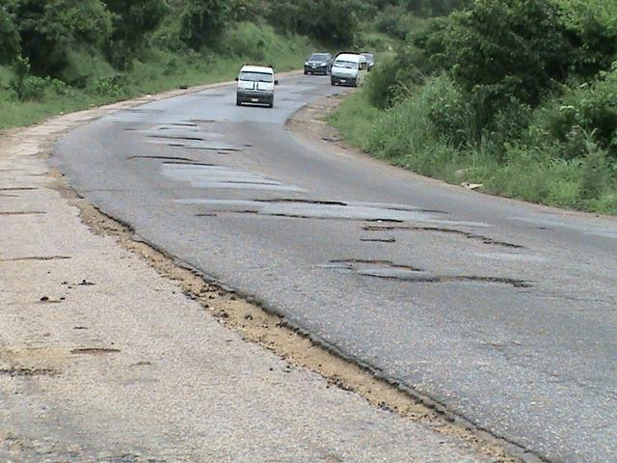
THANK YOU FOR LISTENING
Typical road safety problem

Slide 18
THANK YOU FOR LISTENING

