Slide 1

FEDERAL ROAD SAFETY CORPS
CORPS BUDGET OFFICE
CBO FUNCTIONS AND WORK PLAN FOR 2021
Presented by:
ACM Sunday A. Iyamah fwc

Slide 2
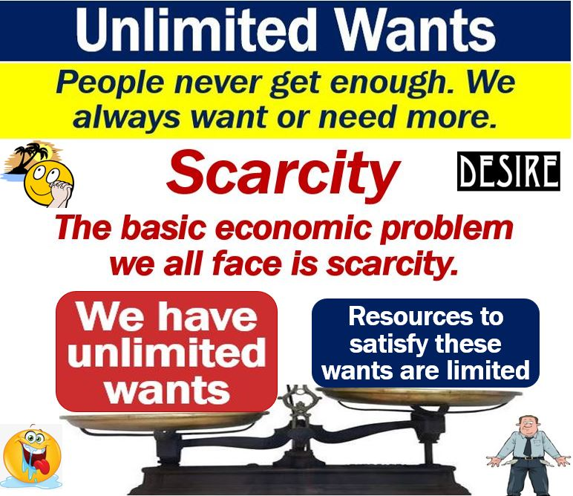
INTRODUCTION
<https://marketbusinessnews.com/financial-glossary/unlimited-wants/>

Slide 3
INTRODUCTION(CONT’D)
Budget helps to prioritize needs and wants as a result of scarce resources for optimum growth and development.
The Corps Budget Office (CBO), one of the Corps Offices in Federal Road Safety Corps (FRSC), performs the general function of budgeting for the Corps.

Slide 4

DEFINITION OF BUDGET
A budget is an estimation of revenue and expenditure for the purpose of executing a plan over a specified future period of time and it is utilized by governments, businesses and individuals.
. A Ganti, “Budget”, Investopedia, <https://www.investopedia.com/terms/b/budget.asp>

Slide 5
NEED FOR BUDGETING
Budgeting is necessary for proper financial control and management. It enables individual and organizations to plan and execute their goals and objectives. It provides a window for the effective allocation and utilization of manpower and resources for optimal productivity.

Slide 6
TYPES OF BUDGET
There are three types of budget. That is
1. Surplus budget: Revenue > Expenditure: This refers to a situation where the expected revenue is greater than the proposed expenditure..
2. Balance budget: Revenue=Expenditure: This is when total revenue is equal to total expenditure.
3. Deficit budget: Revenue< Expenditure. This is situation where revenue is less that expenditure.
This presentation would be centered on FGN Budget Life Cycle and CBO functions and work plan for 2021 as well as highlighting Challenges and recommendations.

Slide 7
AIM
The aim is to discuss CBO Job function in line with the FGN budget life cycle with a view to highlighting the work plan for 2021.

Slide 8
SCOPE
1. FGN BUDGET LIFE CYCLE
2 CBO FUNCTIONS AND FGN BUDGET LIFE CYCLE
a. BUDGET CALL CIRCULAR
b. PREPARATION AND SUBMISSION OF BUDGET
c. BUDGET FOLLOW UP
d. BUDGET DEFENCE
e. BUDGET MONITORING AND EVALUATION
BUDGET PERFORMANCE ANALYSIS
3. SUMMARY 2021 CBO WORK PLAN
4 CHALLENGES
5 RECOMMENDATION

Slide 9
FGN BUDGET LIFE CYCLE AND CBO FUNCTIONS
The FGN runs a budget life cycle running from January to December and all MDAs, including FRSC, are aligned to this budget life cycle.

Slide 10
Federal government of Nigeria budget life cycle
BUDGET CALL CIRCULAR/ PREPARATION AND SUBMISSION
BUDGET DEFENCE AT NASS
BUDGET PASSED BY BOTH NASS
THE PRESIDENT ‘S ACCENT AND SIGNING OF THE BUDGET(APPRIOPRIATION)
BUDGET EXECUTION/MONITORING AND EVALUATION
1
5
2
BUDGET FOLLOW UP
4
3

Slide 11
CBO 2021 WORK PLAN AND THE FGN BUDGET LIFE CYCLE)
The CBO, in carrying out her functions, aligns with the FGN budget life cycle.
Therefore CBO, in 2021 work schedule, has since requested Field Commands, Departments, Corps Offices and Units to submit their inputs in preparation for the 2022 Corps Budget Proposal.
This is in anticipation of the Budget Call Circular from Budget Office of the Federation (BOF) for the commencement of the FGN 2022 Budget life cycle.
Meanwhile, the Call Circular for 2022 Personnel Budget has just been received.

Slide 12
BUDGET CALL CIRCULAR
Once the Medium Term Expenditure Framework (MTEF), Fiscal Strategy Paper and MDAs’ expenditure ceilings have been approved by the Federal Executive Council, The BOF, under the supervision of the Minister of Finance, issues a Call Circular. The Call Circular instructs the MDAs to allocate and submit their allotted recurrent (personnel and overhead), capital ceiling across their existing and new projects, programmes and other initiatives. Preparation of Budget proposal is always preceded by a budget Call Circular.

Slide 13
PREPARATION AND SUBMISSION OF BUDGET
The President’s Executives Order on Budget requests all MDAs to submit their Medium Term Revenue Framework (MTRF) and MTEF on or before the end of May of the year, while the budget proposal is expected to be submitted on or before the end of July of the year.
Prepared Corp budget proposal is always submitted through Office of the Secretary to the Government of the Federation (OSGF) to BOF by the Corps Marshal (CM).
The CBO is awaiting the Call Circulars for the year 2022 Budget Proposal. However, Corps has since submitted the Corps’ input to BOF for the FGN MTNDP (2021-2025) and has received the Call Circular for the preparation and submission of personnel budget.

Slide 14
PREPARATION AND SUBMISSION OF BUDGET(cont’d)
However, The CBO, in line with her 2021 Work Plan, has commenced the compilation of approved projects and programmes by the CM to be captured in the 2022 Capital Expenditure as well as collating inputs from Department, Corps Offices, Special Units and field Commands.

Slide 15
BUDGET FOLLOW-UP AND FRSC
Budget follow-up is a sine-qua-non for MDAs that desire a robust or favorable budget appropriation.
It is a way of leveraging on the good relationship between MDAs and relevant Budget stakeholders.
FRSC has a good working relationship with all the relevant stakeholders in BOF, OSGF and NASS especially at the strategic level.
The CBO has paid familiarization visits to the relevant desk officers in OSGF and BOF in other to strengthen this relationship.
CBO would continue to do so in her 2021 Work Plan.

Slide 16
BUDGET DEFENCE AND FRSC
The submission of the budget is always followed by budget defence at both houses of the NASS at the instance of the Committees supervising FRSC.
It is the responsibility of CBO to prepare a budget defense document for the exercise whenever CM is invited to defend the 2022 Corps budget proposal. This is part of CBO work Plan for 2021.
Whenever The FGN budget, after debates, is passed by the National Assembly and accented to by the President; it becomes a budget appropriation for execution.

Slide 17
BUDGET MONITORING AND EVALUATION
BOF monitors the execution of the approved projects and programmes in the appropriated budget in all MDAs including FRSC.
The CBO, with the approval of CM, has monitored the execution of 2020 projects, 2020 Annual Budget Performance and the 1st quarter 2021 budget performance.
Budget Monitoring and Evaluation is part of CBO 2021 work Plan.
This is also carried out in preparation for the visits of the monitoring team from BOF.

Slide 18
BUDGET PERFORMANCE ANALYSIS
It is pertinent to note that it is not every fund that is appropriated that is released by the FGN to MDAs, including FRSC, on a given budget line item. Moreso, it is not every fund released by the FGN that is expended by MDAs.
The performance of the Corps Budget Appropriation is being assessed by the CBO on quarterly and yearly basis in relation to appropriation, releases and expenditure.
The CBO, in her 2021 Work Plan, has since assessed the performance of the 2020 Annual Budget and 1st quarter 2021 budget based on appropriation, releases and expenditure.

Slide 19
SUMMARY OF CBO 2021 WORK PLAN
FEDERAL ROAD SAFETY CORPS
2021 CORPS BUDGET OFFICE ACTION PLAN
S/NO | ACTIVITIES/MONTH | JAN | FEB | MAR | APR | MAY | JUNE | JULY | AUG | SEPT | OCT | NOV | DEC
1 | BUDGET MONITORING AND EVALUATION
2 | BUDGET PERFORMANCE
3 | PREPARATION OF TEMPLATE
4 | DISTRIBUTION OF TEMPLATE
5 | COLLECTION AND COLLATION OF INPUTS AND ASSETS
6 | FRSC REVENUE AND MTEF
7 | PERSONNEL BUDGET
8 | BUDGET PREPARATION/ SUBMISSION
9 | CALL CIRCULAR
10 | BILATERAL DISCUSSION
11 | BUDGET DEFENCE

Slide 20
CHALLENGES
Delay in the submission of inputs from Field Commands, Departments, Corps offices and special units.
Outrageous submission by Fields commands, departments, corps offices and special units.
Delay in receiving inputs from F&A, TSD and CPRO for budget performance report every quarter.
Obsolete and very low capacity printer and no photocopier.
Inadequate desktop and laptop computers.

Slide 21
RECOMMENDATION
All Departments, Corps Offices, Special Units and Commands to always submit their input on time.
All commands to always submit realistic estimates.
F&A, TSD and CPRO to assist CBO in sending the required inputs for analyzing budget performance on time.
There is the need to allocate a high capacity printer and photocopier to CBO.
There is the need for two (2) desktops and two(2) laptops to be allocated to CBO.

Slide 22
REFERENCES
1. A Ganti, “Budget”, Investopedia, March 18, 2021 <https://www.investopedia.com/terms/b/budget.asp> accessed 18 May 2021
2. J Ikard, “,Abundance or Scarcity, Which is it?”, Sept’18 < https://www.johnikerd.com/post/abundance-or-scarcity-which-is-it> accessed 18 May, 2021.
3. OSGF, “Presidential Executive Order on Budget” <https://www.osgf.gov.ng/resources/downloads> accessed 18 May 2021.

Slide 23
THANK YOU

