Slide 1
2021 JOB SCHEDULE AND WORK PLAN OF THE CORPS PBLIC EDUCATION OFFICER
ACM BISI KAZEEM, fsi

Slide 2

THE CORPS PUBLIC EDUCATION OFFICER SERVES AS THE MEDIA RELATIONS MANAGER AND IMAGE MAKER OF THE CORPS
PLANS
Maintains strategic relationship with FRSC
media partners
Initiates and pays courtesy visits to media organizations to build positive synergy between the Corps and the Media.
Undertakes periodic monitoring/evaluation of FRSC relations with media stakeholders (print/electronic) and the general public.

Slide 3
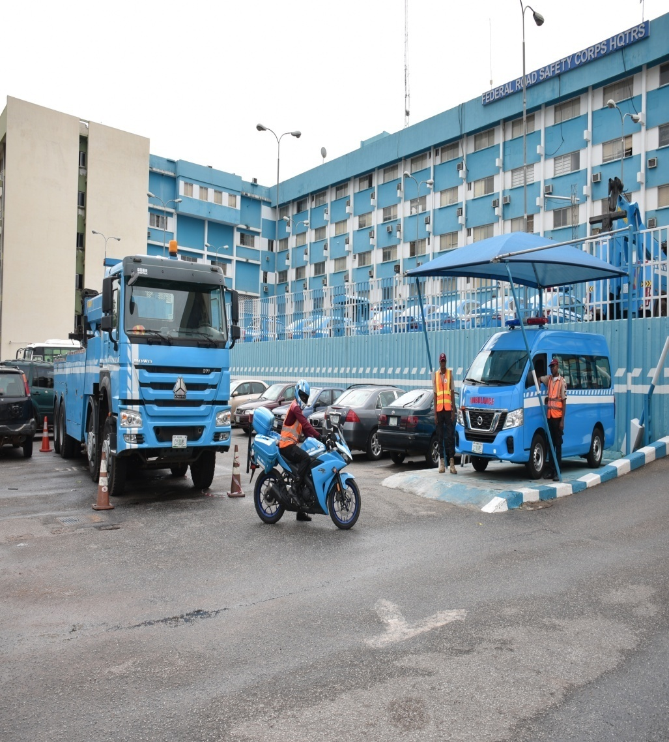
THE CORPS PUBLIC EDUCATION OFFICER ORGANISES MEDIA EVENTS, DESIGNS MEDIA CAMPAIGNS AND WRITES/EDITS SCRIPTS FOR PUBLICITY OF FRSC ACTIVITIES AND ADVANCE ROAD SAFETY ADMINISTRATION
PLAN
Designs media campaigns for the publicity of FRSC activities.
Writes and edits scripts on FRSC activities for Television Commercials and Radio Jingles.
Suggests to the Corps Marshal relevant media campaigns as proposed by external vendors that the Corps should embrace.
Negotiates media slots and spots for airing FRSC campaigns with Media Executives.

Slide 4
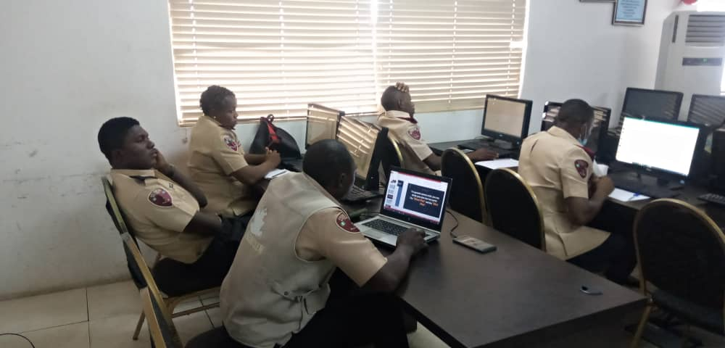
THE CORPS PUBLIC EDUCATION OFFICER SUPERVISES AND COORDINATES THE SOCIAL MEDIA TEAM OF THE CORPS OFFICE TO ENSURE THE ACTIVITIES OF THE CORPS ARE GIVEN MAXIMUM COVERAGE ACROSS ALL SOCIAL NETWORKS
PLAN
Monitors and directs the social media team of the Corps Office to be alert on FRSC stories making rounds in all social networks.
Ensures the Corps activities are captured on all social networks namely: Twitter, Facebook, Instagram, and Youtube.

Slide 5

THE CORPS PUBLIC EDUCATION OFFICER WRITES AND EDITS PRESS RELEASES, REJOINDERS, AND CUTLINES FOR PICTURES OF FRSC EVENTS AND NAN ALERTS TO PROMOTE THE CORPS’ ENFORCEMENT PROGRAMMES AND POSTCRASH CARE PROGRAMMES.
PLAN
Writes Press Releases, Cutlines for Pictures, and Rejoinders to promote FRSC enforcement programmes and post-crash care programmes.
Edits Press Releases and Rejoinders whose origin is from external vendors, to fit into the needs of the Corps and consequently strengthen professionalism and transparency within the system.
Prepares NAN Alerts and forwarding to Media Houses, to inform the Publics on emergency issues like traffic gridlock.

Slide 6
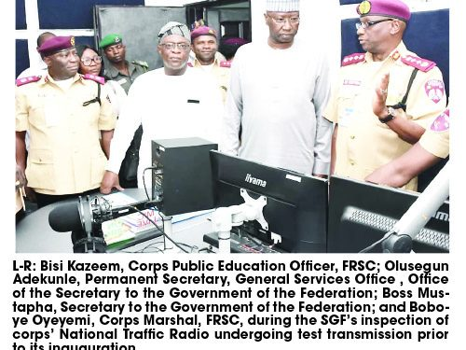
THE CORPS PUBLIC EDUCATION OFFICER SUPERVISES THE OPERATIONS OF THE NATIONAL TRAFFIC RADIO AND THE PERSONNEL’S CONDUCTS
PLAN
Supervises the Staff of the National Traffic Radio and the administrative team of the station to ensure effective service delivery.
Forwards reviews of the activities of the National Traffic Radio to the Corps Marshal for deliberations in areas that must be improved upon.
Recommends to the Corps Marshal all necessary equipment that enables the Station to function effectively.

Slide 7
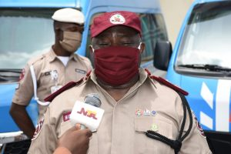
THE CORPS PUBLIC EDUCATION OFFICER COORDINATES PUBLIC EDUCATION (PE) ACTIVITIES
PLAN
Organizes public education programmes and activities such as motor park rallies, road shows, media, schools, churches and mosques advocacy visits, traffic campaigns, traffic offenders lectures, lectures for NDL applicants, Public Enlightenment Lectures for FRSC Drivers, amongst others.

Slide 8
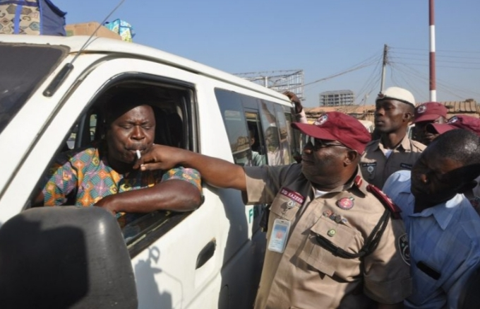
THE CORPS PUBLIC EDUCATION OFFICER COORDINATES PUBLIC EDUCATION (PE) ACTIVITIES cont’d.
PLAN
Ensures collaboration with relevant offices to carry out rallies and other PE activities.
Supervises and monitor all PE activities in Field Commands.

Slide 9
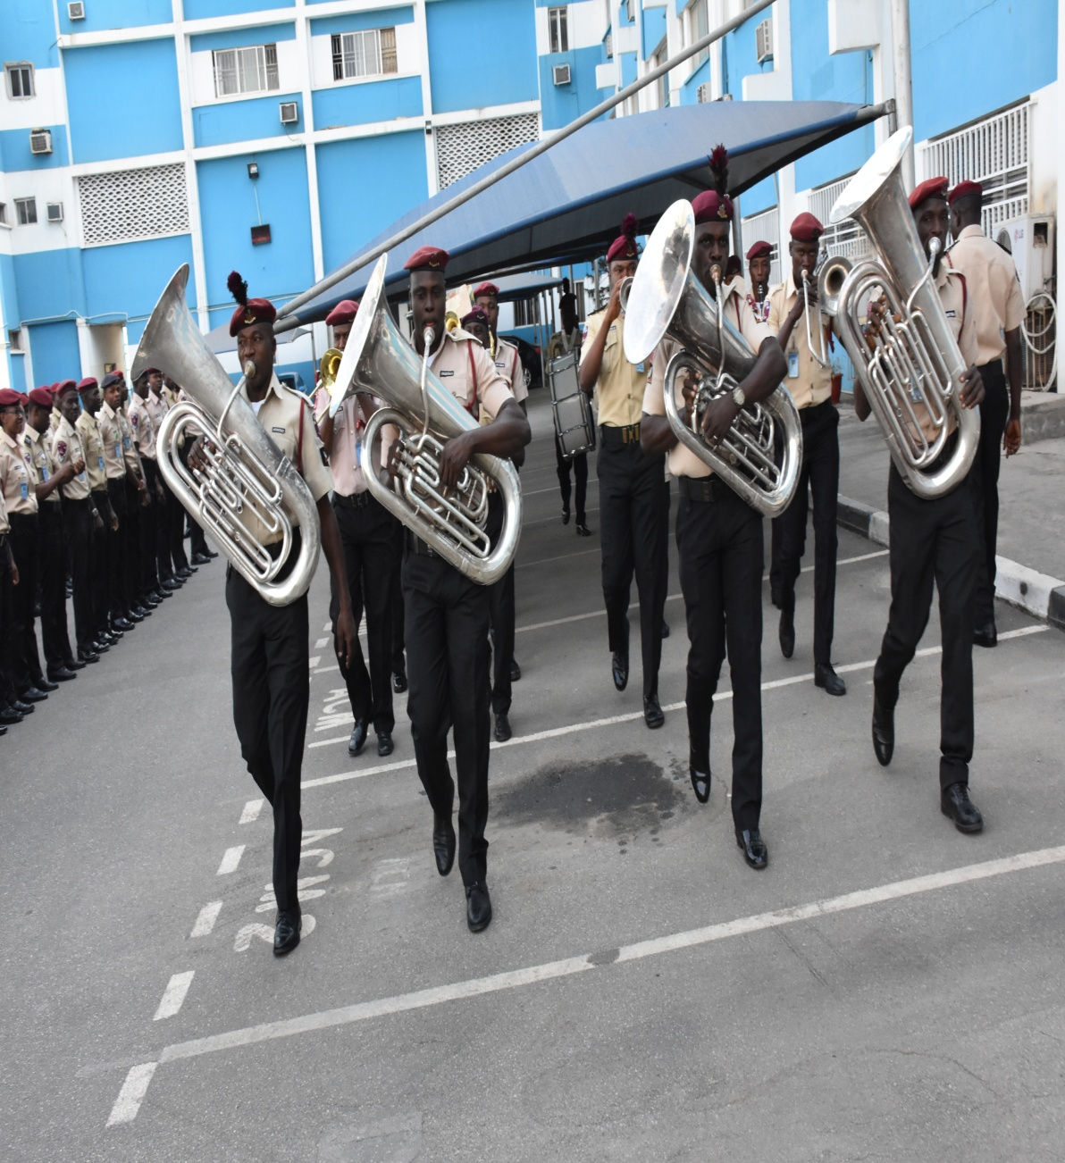
THE CORPS PUBLIC EDUCATION OFFICER COORDINATES FRSC REGIMENTAL BAND
PLAN
Receives request from Departments/Corps offices for use of the FRSC Band.
Ensures Bandsmen are trained weekly for skills improvement.
Ensures annual maintenance of musical equipment.

Slide 10
CONCLUSION
The Corps Public Education Office has the mandate to enlighten the motoring public on best road use practice.
The Office uses different media tools (below the line and above the line media), and interpersonal communication to reach out to a mass, heterogeneous, and targeted audience.

Slide 11
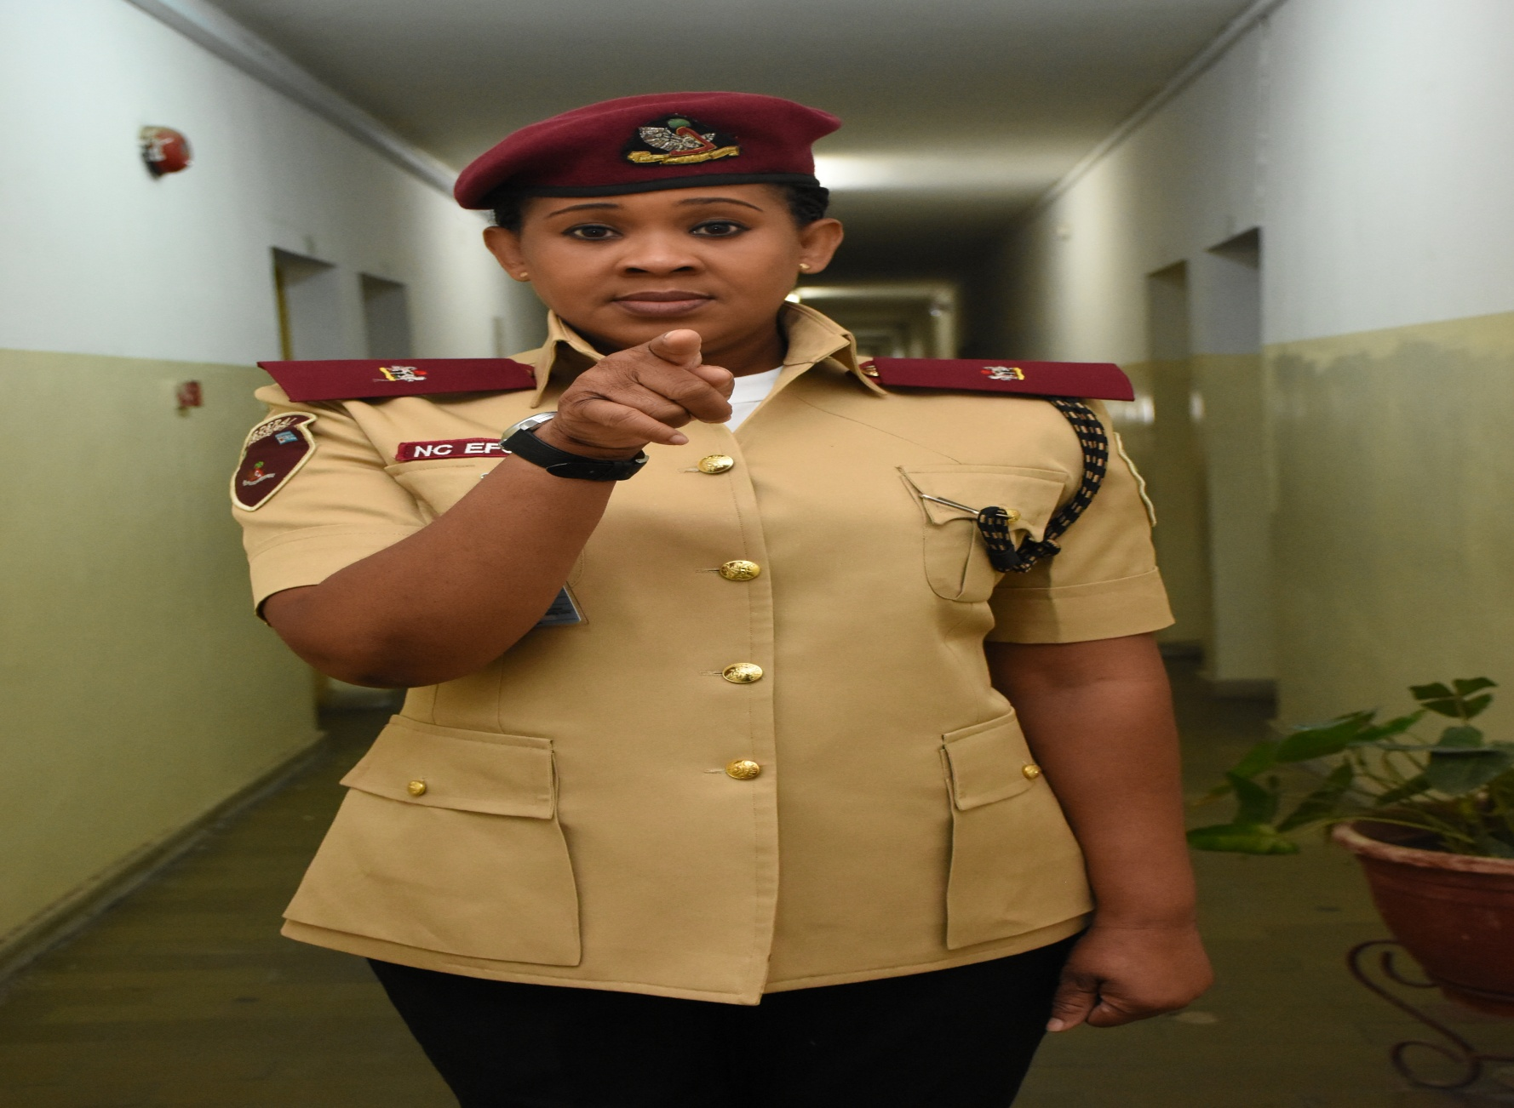
THANK YOU FOR LISTENING

