Slide 1
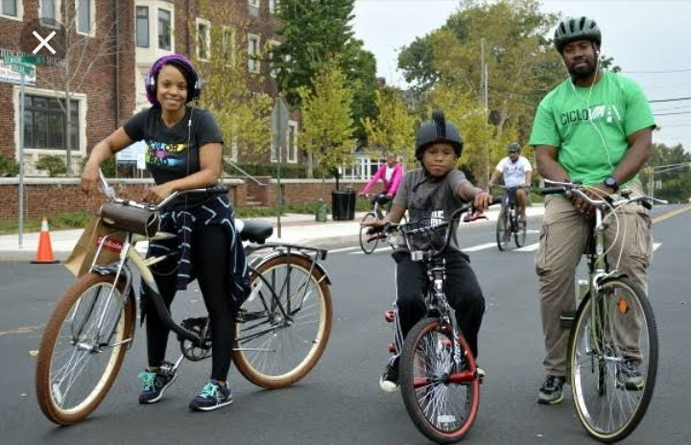
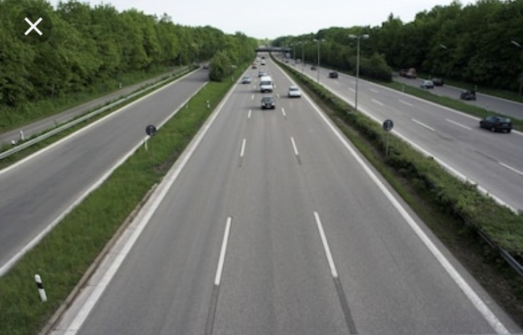
SUSTAINABLE DEVELOPMENT GOALS AND ROAD SAFETY MANAGEMENT

Slide 2
INTRODUCTION:
Sustainable Development Goals is the initiative of the United Nations to developing nations mostly in Africa to attain Seven (17) global goals which includes Education, Agriculture, Climate Change, Equality for all genders, Clean Environment amongst several others.
The Sustainable Development Goals were first named Millennium Development Goals (MDGs) with a target to meet these goals by the year 2000. However, upon the failure of so many third world countries, Nigeria inclusive to meet these targets by the year 2000, they were encouraged to sustain the efforts already put into place towards achieving the set goals, hence, the coining of the name from Millennium Development Goals to Sustainable Development Goals to ensure that the efforts already put into place by these countries are not jettisoned but sustained and improved upon.

Slide 3
AIM:
The aim of this lecture is to acquaint the participants with the knowledge of Sustainable Development Goals and Road Safety Management.

Slide 4
OBJECTIVES:
At the end of this lecture, participants should be able to:
Explain the Sustainable Development Goals.
Discuss the Sustainable Development Goal’s related to Road Safety and its roles.
Identify FRSC partnership towards the Sustainable Development Goals.

Slide 5
The 17 Sustainable Development Goals set by the United Nations
No Poverty
Zero Hunger
Good Health and Well Being
Quality Education
Gender Equality
Clean Water and Sanitation
Affordable and Clean Energy
Decent Work and Economic Growth
Industry, Innovation and Infrastructure

Slide 6
Seventeen Sustainable goals Cont’d
Industry, Innovation and Infrastructure
Reduced Inequalities
Sustainable Cities and Communities
Responsible Consumption and Production
Climate Action (Change)
Life Below Water
Life on Land
Peace, Justice and Strong Institutions
Partnership for the Goals

Slide 7
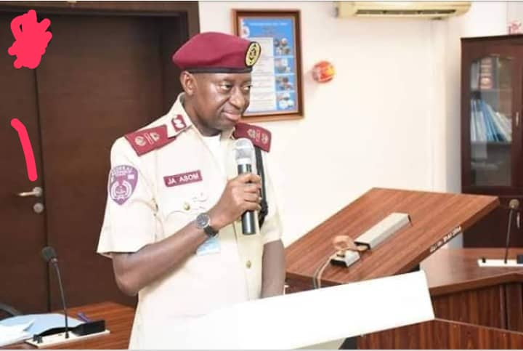
SUSTAINABLE DEVELOPMENT GOALS AS IT RELATES TO FRSC:
FRSC AND FOREIGN COLLABORATION: The Federal Road Safety Corps as a paramilitary agency of the Federal Government is affiliated to several international organizations like the West African Road Safety Organization, (WARSO), the United Nations (UN), African Development Bank (ADB) amongst several others.
Today, as a result of these foreign collaborations, the Corps recently created a Special Duties and External Relations (SDER) department headed by Deputy Corps Marshal Julius Asom whose office oversee all foreign relationship the Corps has with both internal and foreign organizations.

Slide 8
SDG as it relates to FRSC cont’d
NO POVERTY: Economic growth must be inclusive to provide sustainable jobs and promote equality.
ZERO HUNGER: The food and agriculture sector offers key solutions for development and control of hunger and poverty eradication.

Slide 9
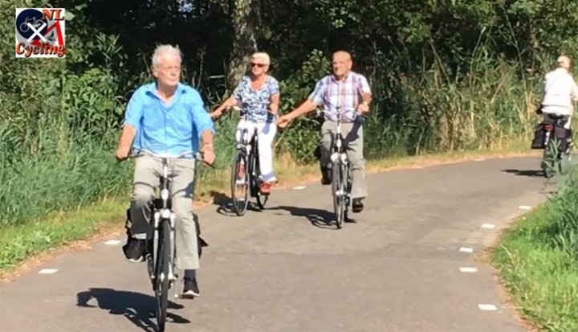
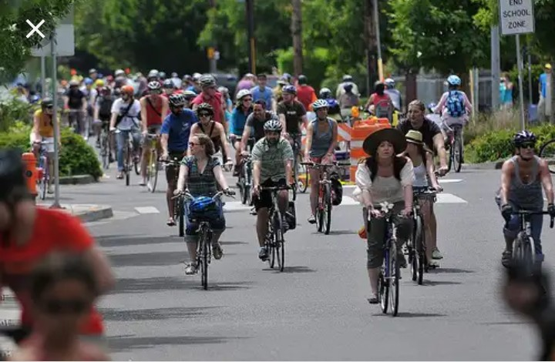
SDG as it relates to FRSC cont’d
GOOD HEALTH AND WELL BEING THE ROAD SAFETY PERSPECTIVE:

Slide 10
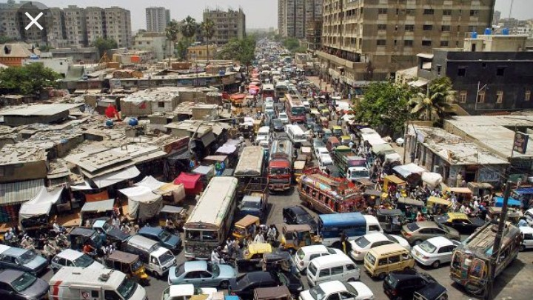
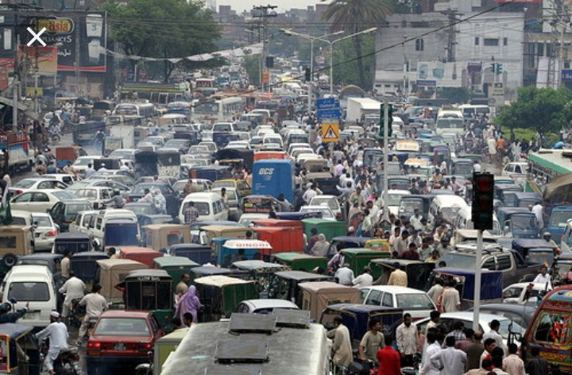
SUSTAINABLE CITIES AND COMMUNITIES THE ROAD SAFETY MANAGEMENT PERSPECTIVE:

Slide 11
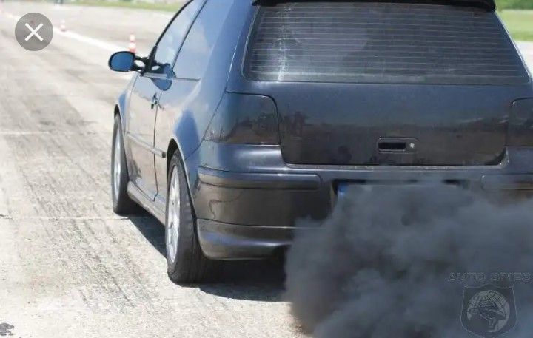
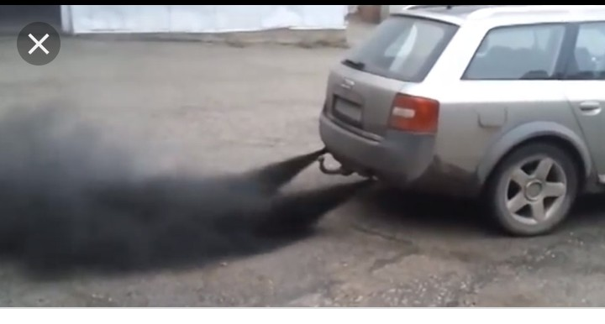
Climate Action (Change)

Slide 12
RESPONSIBLE PRODUCTION AND CONSUMPTION
China's government wants to move towards a ban on gas guzzlers. On 10th September, 2017 XinGuobin, Vice Minister of Industry and Technology told an automotive conference in Tianjin that the government is developing a long-term plan to phase out vehicles powered by fossil fuels. And he quotes, "If China says no more fossil fuels powered cars, global car makers must follow – The Economist magazine.
Denmark in 2019 announced a ban on gasoline or diesel vehicles commencing from 2030 and according to the British Broadcasting Corporation, the United Kingdom will in 2040 effectively have zero emission.

Slide 13
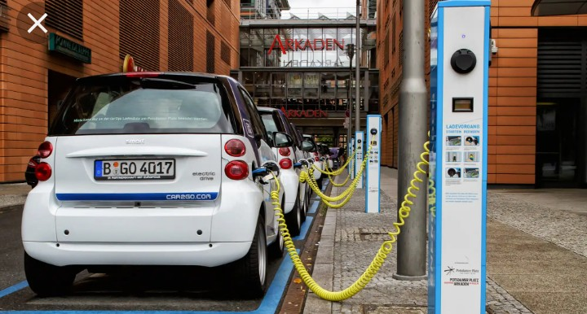

RESPONSIBLE PRODUCTION AND CONSUMPTION cont’d

Slide 14
S/N | NAME OF COUNTRY | YEAR OF BAN/REMARKS
1 | Britain | 2040
2 | France | 2010
3 | Germany | No date for ban fixed yet
4 | India | 2030
5 | Norway | 2025
6 | United States of America | The United States does not have a federal law about the ban but eight (8)
7 |  | states led by the state of California is leading the pack
8 | China | 2030
9 | Japan | 2030

Slide 15
S/N | NAME OF COUNTRY | YEAR OF BAN/REMARKS
7 | Canada | 2030
8 | Australia | 2030
9 | Denmark | 2030
10 | Ireland | 2040
11 | Netherland | 2030
12 | Portugal | 2030
13 | Korea | Not yet known
14 | Spain | 2030
15 | Costarica | The ban already in force
16 | Nigeria | ???

Slide 16
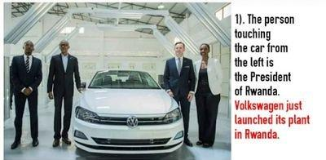
RESPONSIBLE PRODUCTION AND CONSUMPTION cont’d

Slide 17
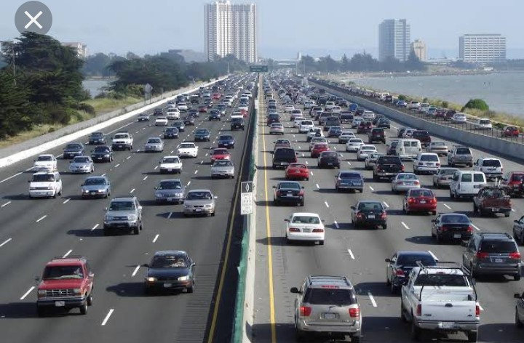
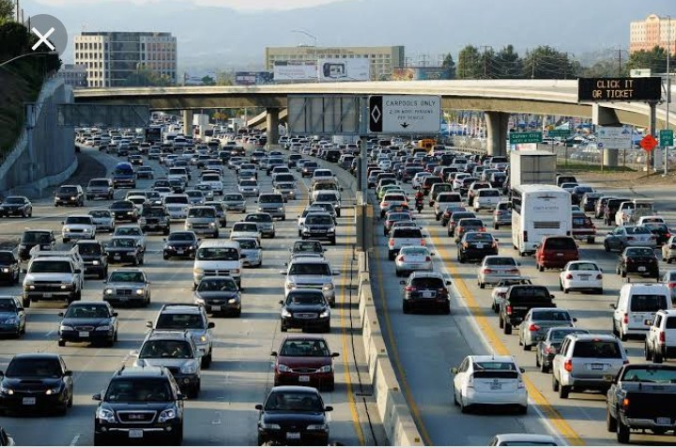
LIFE ON LAND AND ON THE ROADS, THE ROAD SAFETY APPROACH:

Slide 18

PARTNERSHIP FOR THE GOALS:
One of the tripod visions of the Corps Marshal Boboye Oyeyemi is CONSULTATION. To this end, the Corps is strongly consulting far and wide to attain to her goals and aspirations.

Slide 19
CONCLUSION:
It is certain that the sustainable Development Goals is a sure step towards attaining a better way of life mostly for developing countries like ours. It is a plus that the Federal Road Safety Corps has strongly keyed into the SDGs especially in areas that concerns our safety on the roads. It is still in fact that the business of road safety is a collective business and not that meant only for the FRSC.
It is my sincere belief that every individual has one role or another to play towards achieving these developmental goals and participants are called upon to at any point in time, ensure that they work towards making our roads not only safe but healthy for the benefit of mankind.

