Slide 1


FEDERAL ROAD SAFETY CORPS ACADEMY, ENUGU
SCHOOL OF PROFESSIONAL STUDIES
OPERATIONS DOCUMENTS AND PATROL DEVICES/EQUIPMENTS

Slide 2
INTRODUCTION

Slide 3
INTRODUCTION
Road traffic crash is presumed to be one of the most causes of grief and poverty as many have died, while some live with injuries arising from such, others lose major sources of their livelihood among others.

Slide 4
Introduction Cont.
Many reasons have been given for this unpleasant picture, such as increase in the number of vehicles on the road, poverty, indiscipline, will of God, lack of political will to enforce law and inadequacies of law enforcers, ignorance etc.

Slide 5
Introduction Cont.
The attendant hardship caused by RTC is one of the reasons that have led to the continuous need to maintain sanity on the highways and other roads in Nigeria.

Slide 6
Aim
The aim of this presentation is to keep staff abreast of the inevitability of Operational documents and patrol devices/equipment as an element of mastering their jobs and as well equip them with knowledge and skill for effective service delivery.

Slide 7
Objectives
The participants at the end of this discussion should be able to:
Define Operational document and Patrol devices/equipment.
Enumerate Operational document in FRSC
List the different patrol devices/equipment.
Identify the different patrol devices/equipment.

Slide 8
BODY OF DISCUSSION

Slide 9
Body of Discussion
Operational documents are those documents that empower the Corps and its Operatives in carrying out smooth operations of the Corps’ activities. It aids effective administration of Corps’ patrol operations. This includes:
Federal Road Safety Commission (Establishment) Act 2007
FRSC Regulations on Discipline, 2013 as amended.
National Road Traffic Regulations 2012
Road Maps

Slide 10
Body of Discussion
Operational documents are those documents that empower the Corps and its Operatives in carrying out smooth operations of the Corps’ activities. It aids effective administration of Corps’ patrol operations. This includes:

Slide 11
Body of Discussion Cont.
FRSC Anti-corruption Publications
FRSC Condition of Service
FRSC RTSSS document
1999 Constitution of the Federal Republic of Nigeria.
Public Service Rules
Financial Regulations
Federal Road Safety Corps Educational Policy
DSSP Policy
Special Marshals’ Guidelines. Etc

Slide 12
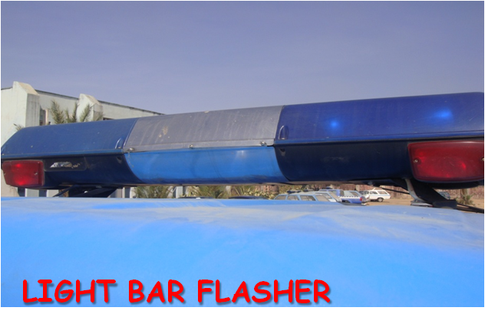
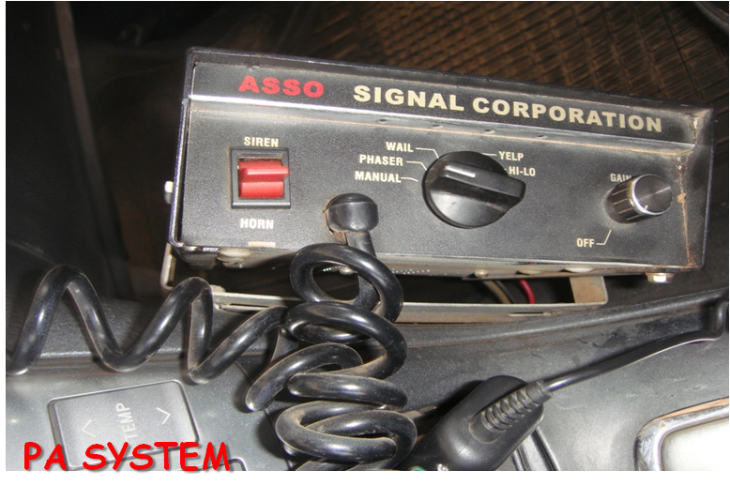
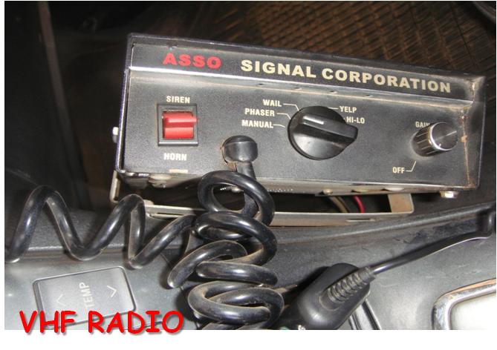
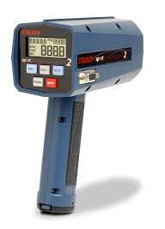
Body of Discussion Cont.
Patrol Devices/equipment: are those equipments that enhance conduct of patrol operations. It includes Authority device, Rescue device, protective device, Auxiliary device, Defensive device and Stationery items.

Slide 13
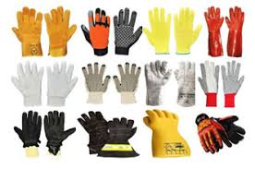

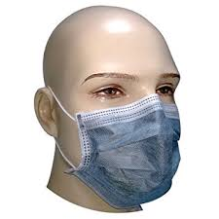
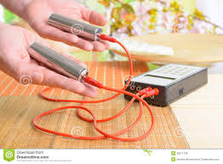


Body of Discussion Cont.
Protective devices are items that shield Operatives from possible danger in discharging of their statutory duties. E.g

Slide 14
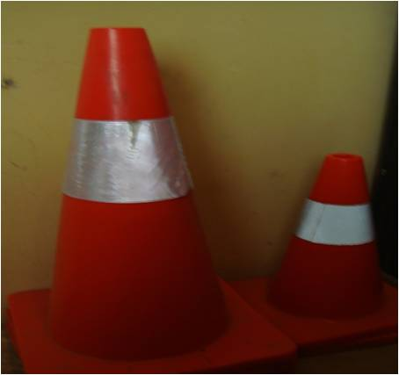
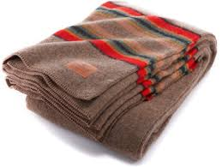
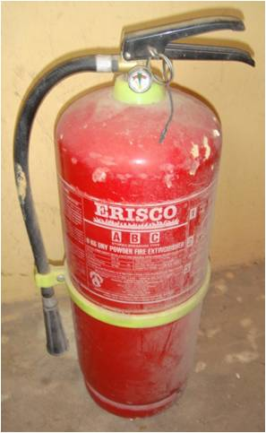
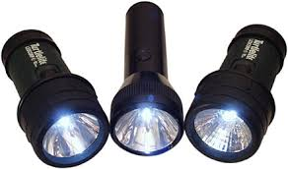
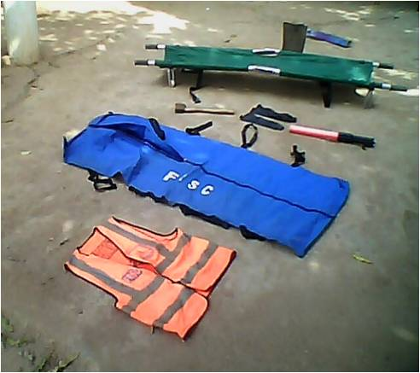

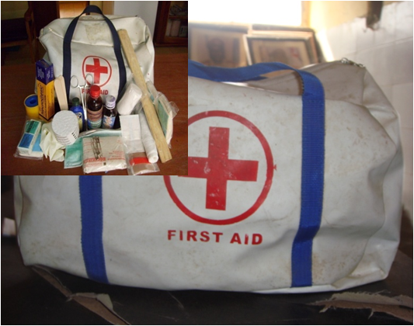
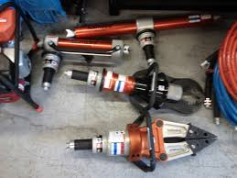
Body of Discussion Cont.
Rescue devices are those devices that are used in rescue activities. It includes:

Slide 15

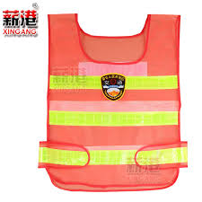


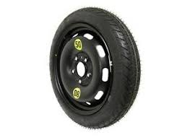

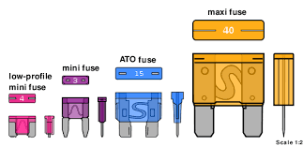
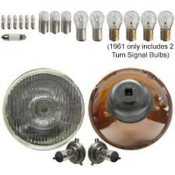
Body of Discussion Cont.
Auxiliary Device

Slide 16
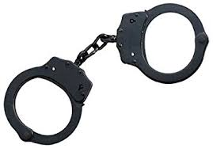
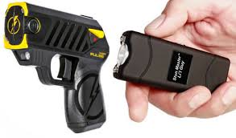

Body of Discussion Cont.
Defensive devices: These are devices that patrolmen use for self defence in the event of attacks. E.g

Slide 17
Body of Discussion Cont.
Stationery items: This are writing materials needed to record incidences of operational activities:
Notice of Offence sheet
DO NOT MOVE stickers
Field Report form
Biro and Jotter
Recovered items form
Corpse Identification form
Crayon and Chalk

Slide 18
The List of FRSC Operational Publication
Find below the list of some FRSC operational publication:
FRSC Establishment Act, 2007
Notice of Offence Sheet
DSSP Policy
FRSC RTSSS Document
National Road Traffic Regulations (NRTR) 2012
Operational Manual

Slide 19
FRSC Operation Documents and Templates
Radio Message Form
Revenue Receipt Form
Field Report Form
Offender Register
Notice of Offence Register
Multiple Offender Register
Fine payment Register
Recovered Property Inventory
Special Patrol Summary
Vehicle Impoundment Register

Slide 20
FRSC Operation Documents and Templates Cont.
Daily Incident Report Register
Tow permit
Cash Declaration Form
Wanted Offenders’ Register
RTC Causality Information
Pre-Patrol Briefing Of Patrol Operatives
Assessment of Team Leaders Monthly Bookings Week
Reporting Zonal/Sector Operators And Field Commands’ Management Meetings

Slide 21
FRSC Operation Documents and Templates Cont.
Daily Incident Report Register
Tow permit
Cash Declaration Form
Wanted Offenders’ Register
RTC Causality Information
Pre-Patrol Briefing Of Patrol Operatives
Assessment of Team Leaders Monthly Bookings Week
Reporting Zonal/Sector Operators And Field Commands’ Management Meetings

Slide 22
CONCLUSION

Slide 23
Conclusion
FRSC as the lead agency in traffic management and a World class organisation had over the years continued to improve its mode of operations and reporting systems in line with international best practices. It is expected that the above narrations and submissions regarding documents, devices and equipments employed by the Corps in carrying out its duties, participants will find them worthy in the course of this programme.

