Slide 1

OVERVIEW OF FRSC IT PLATFORMS

Slide 2
AIM
The aim of this presentation is to discuss and acquaints participants on the overview of FRSC IT platforms and how the Corps deploy the various platforms/tools in her quest for enhanced operational activities in real-time mode.

Slide 3
OBJECTIVES
At the end of this lecture participants should be able define a portal as well as the workability and benefits of:
FRSC Vehicle Tracking System.
FRSC Dashboard.
Offender’s Register System.
National Vehicle identification System (NVIS).
Road Traffic Crash Information System (RTCIS).
FRSC Social media Platforms (facebook, twitter, Youtube etc).
Road Transport Safety Standardization Scheme(RTSSS).
Driving School Standardization Programme (DSSP).
Information Verification Portal (IVP).

Slide 4
INTRODUCTION TO ICT
ICT stands for "Information and Communication Technologies." ICT refers to technologies that provide access to information through telecommunication. It is similar to Information Technology (IT), but focuses primarily on communication technologies. This includes the Internet, wireless networks, cell phones, and other communication mediums.

Slide 5
ADVANTAGES OF ICT
*Enhanced Communication
*Enhanced Data Storage & Processing
*Enhanced Productivity
So, the main importance of ICT in any organization is to effectively achieve the goals and objectives of the organization, typically to improve the financial position and performance, as well as to determine her pace in a competitive environment.

Slide 6
WHAT IS A PORTAL?
 A portal is a gateway or a main entry point on the internet to a specific field-of-interest or an industry. A portal provides at least four essential services:
Search engine(s).
Email.
Links to other related sites.
Personalized content.

Slide 7
FRSC TRACKING SYSTEM
The Call Centre is equipped with a tool called “The Vehicle Tracking System”. This system provides tools for tracking FRSC Vehicles like Patrol Vehicles, Ambulances, Tow Trucks and some Official Vehicles for effective management and deployment. With the aid of the FRSC Tracking System, response time has reduced 15 minutes since deployment of vehicles is easier. Furthermore, the Tracked Vehicle device monitors movement of FRSC vehicles nationwide and with the aid of the FRSC Tracking System, Distance covered by a vehicle at a particular time can be determined; number of trips made by a vehicle, also fuel consumption of a vehicle and number of times a vehicle over speed in a particular time can be generated.
It helps in deploying FRSC Patrol vehicles, Ambulances, Tow-Trucks and Motor Bikes in case of RTC or traffic congestions.

Slide 8
Colour code on FRSC Tracking System
Green – Indicates moving Vehicle.
Red – Indicates Vehicles stopped less than 15minutes.
Orange – Indicates Vehicles stopped more than 15minutes.
Yellow – Indicates Vehicles in a location without GPS signal.
Exclamation mark – Indicates situation when occupants of a Patrol vehicle are in distress.
For better illustration, see the screen shot of the tracked vehicles.

Slide 9
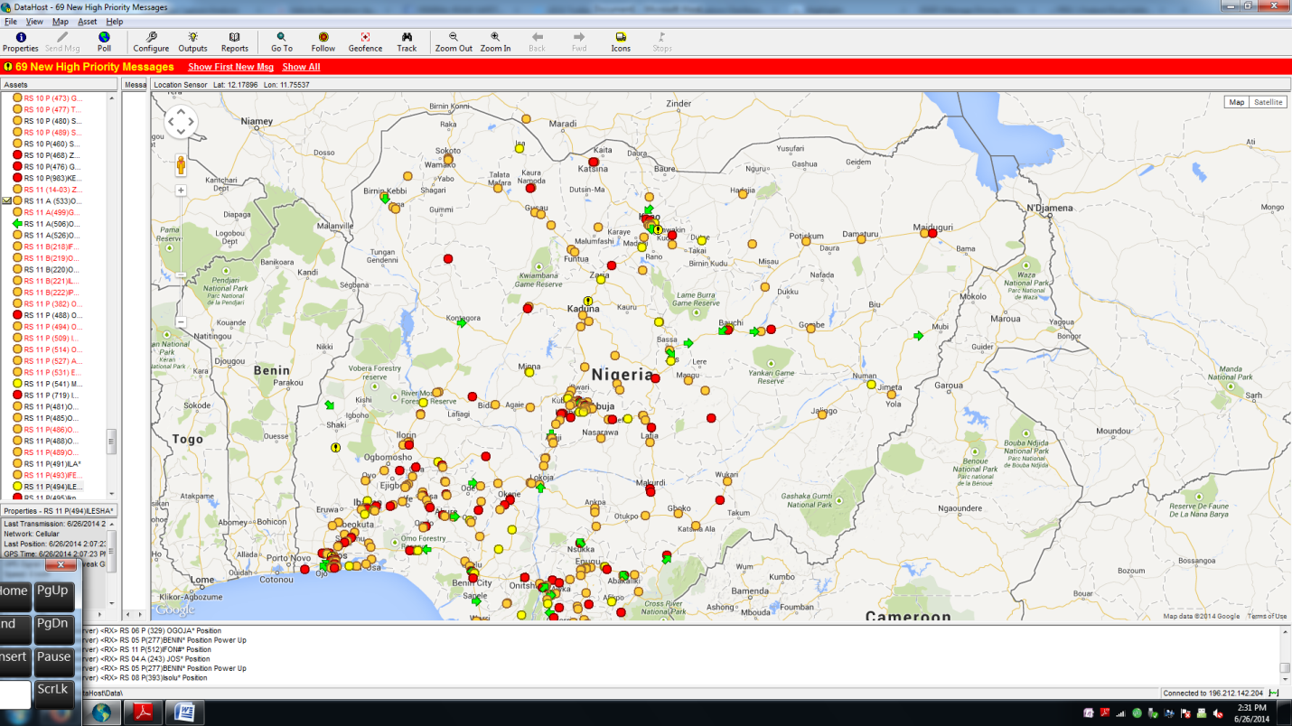
Colour code on FRSC Tracking System (Contd)

Slide 10
FRSC WEB PORTALS
Over time, the Corps has taken IT approach in making sure that quality services are rendered to the public at any given time through the following portals stated below;-

Slide 11

Facebook,Twitter,Youtube,Instagram
www.facebook.com/frscnigeria,
www.twitter.com/frscnigeria,www.youtube.com/frscnigeria,
www.instagram.com/frscnigeria .
FRSC official website www.frsc.gov.ng
National Vehicle Identification Scheme (NVIS) www.nvisng.org
Nigeria Driver's Licence (NDL) website www.nigeriadriverslicence.org
FRSC Dashboard www.frsc-intranet.org
e-Payment Platform www.frscfinescollection.com
Offender's Register System www.frscfinescollection.com.ng
Road Traffic Crash Information System (RTCIS) www.frscrtcis.com.ng

Slide 12
Road Transport Safety Standardization System www.frsc-rtsss.org
DLC Monitor www.dlcmonitor.frsc.gov.ng
Duty Room Information Management System www.dutyroom.frsc.gov.ng
Driving School Standardization Programme www.frsc-dssp.org
Annual Performance evaluation Reports System www.frscapers.com.ng

Slide 13
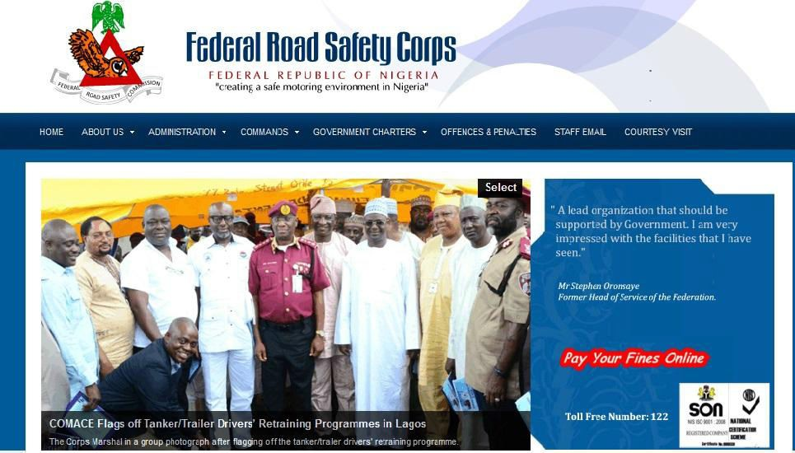
 www.frsc.gov.ng: FRSC official website.
The Corps main website.

Slide 14
The National Vehicle Identification System web application is designed to automate the processes involved in the Number Plate Production and Vehicle Registration. This portal was introduced to harmonise all mode of vehicle licensing and registration. The solution is integrated with Nigeria Insurers Association Database (NIA) which enables the capacity to generate an online Proof of Ownership certificate. The same platform through the unique chassis number of vehicles helps to trigger alert when a stolen vehicle is about to be re-registered anywhere in the country.
 NATIONAL VEHICLE IDENTIFICATION SYSTEM (NVIS) www.nvisng.org:

Slide 15

 In 2011, The Federal Road Safety Commission in conjunction with the Joint Tax Board (JTB), commenced the issuance of new Number Plates in an attempt to harmonise all existing modes of licensing vehicles nationwide. To this end FRSC introduced an Enterprise System called National Vehicle Identification System (NVIS) which is a unified system designed to automate the processes involved in the Number Plate Production and Vehicle Registration.
 This portal comprises of tri-login users (State Board of Internal Revenue, VIO and FRSC).This platform provides detailed information of all properly registered number plates in Nigeria.
The platform identifies the Vehicle number plate, Chassis number, Owner’s name, Vehicle type, Vehicle make, Policy number and State of registration

Slide 16
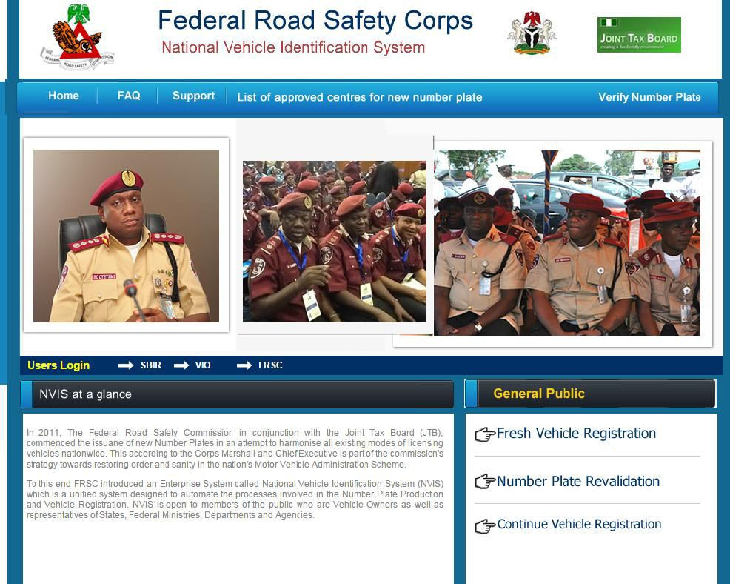

Slide 17
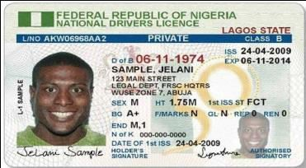
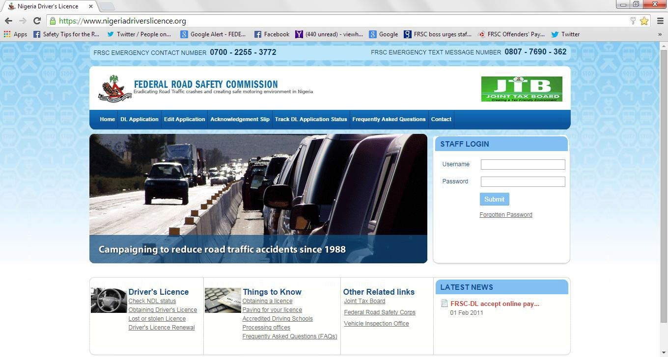
 www.nigeriadriverslicence.org: Nigeria Driver's
License (NDL) website.
Nigerian Drivers License is designed to house the information
of drivers.

Slide 18
FRSC DASHBOARD (www.frsc-intranet.org)
Just like the dashboard of a vehicle shows the status of a vehicle at a glance, the FRSC Dashboard shows all the activities of the various departments and Corps offices Corps from a single point.
In addition, it also shows the comparison between weeks to identify improvement or decline of RTC cases on our roads.
This is done by compiling various reports from all our commands in the twelve zones in Nigeria. For operations, it shows report of Operations activities comparing report of Operations activities in the number of offenders stopped, number cautioned, number of offenders booked and number of offences.

Slide 19
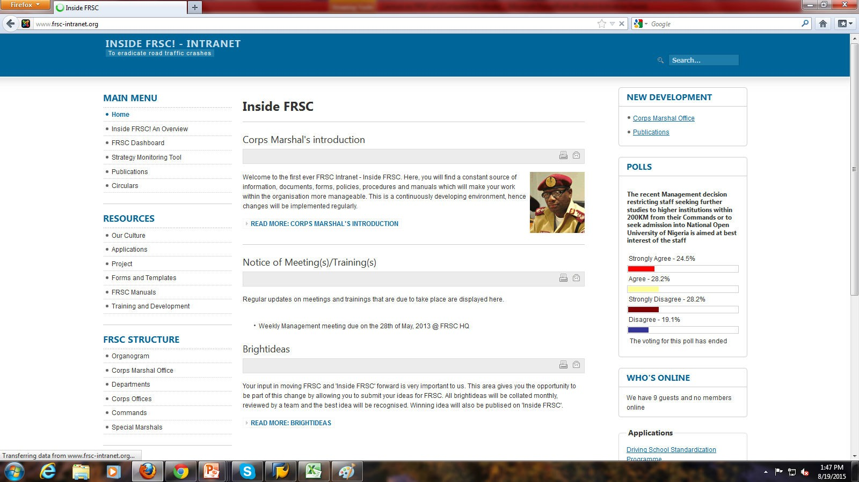

Slide 20
 OFFENDER’S REGISTER SYSTEM www.frscfinescollection.com.ng:
The Offenders register System is both web application and windows application designed to captures offenders data. It is an electronic way of booking traffic offenders.
This is an Automated Payment System for offenders. This portal became necessary due to the unresponsive attitude of some banks in giving us detailed report of offender’s payment. This system was designed to help make payment of fines for the various offences committed on Nigerian roads easier. Offenders can now pay their fines online by using any of the available payment cards in the country. This has in turn increased operational efficiency while removing unnecessary bottlenecks in this process. This portal makes available comprehensive details of all offenders in our various zones in Nigeria.

Slide 21
Other benefits include the ability to identify the offence committed, amount to be paid, date of offence, and the location of offence committed. This information is achieved with the use of E-ticketing tablets and a printer for generating offender’s tickets used by our officers on the road in issuing offenders penalty tickets.

Slide 22
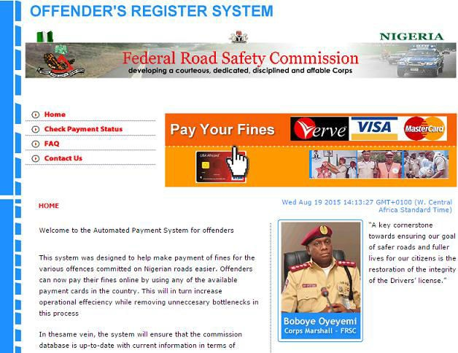
The ticket number when viewed provides offender’s details such as;
Offender’s name and address, Phone Number of Offender, Age group, Driver’s license number, Date issued and Expiry , qualification and date of birth.

Slide 23

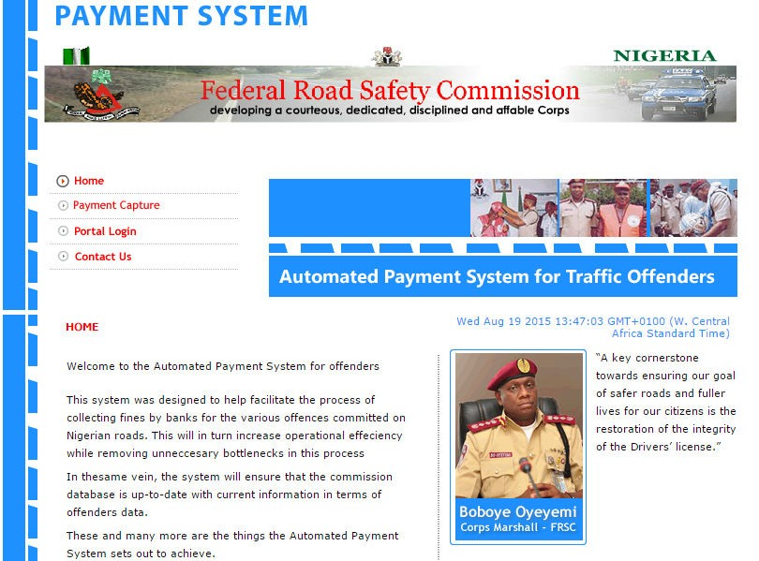

Slide 24
 Road Traffic Crash Information System (RTCIS). www.frscrtcis.com.ng:
The Road Traffic Crash Information System is both web and windows application designed to make the process of capturing detailed data of road traffic crash more efficient, effective and user friendly.
Road Traffic Crash Information System (RTCIS) is amongst the dictates of the Federal Road Safety Corps in the Prevention / Minimization of Accidents on the nation's highway. In addition to Rescue Efforts during Road Crashes Incidents and Continuous Enlightenment programme for Road Users, the commission also advice the relevant government agencies both at the national and state level on ways to minimize these Road Crashes. Aiding the provision of this advisory functions is a databank of statistical data of previous Road Crashes which the commission mines in order to generate decision making reports. This system is designed to make the process of capturing detail data of these crashes more effective, efficient and user friendly.

Slide 25
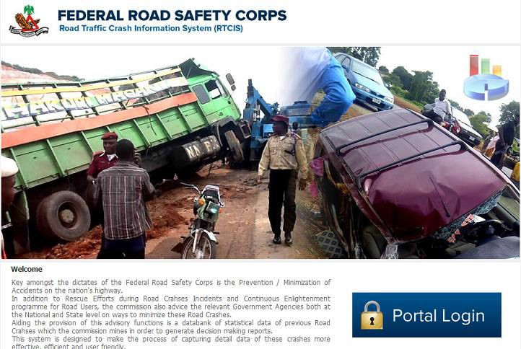

Slide 26

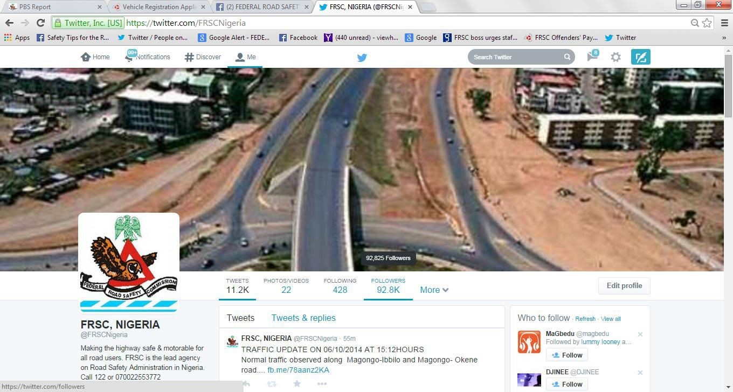

Slide 27
ROAD TRANSPORT SAFETY STANDARDIZATION SCHEME
www.frsc-rtsss.org:
Road Transport Safety Standardization System is a web application designed to bring professionalism into the industry, promote and develop rapid safe, efficient and convenient fleet transportation system in the country.This platform identifies the following:
The list of registered fleet operators.
Registration requirements and procedures.
Availability of company’s registration details.
List of 2014 certified fleet operators.
Upload of passenger’s manifest.
Provides a travel guide route selection
Fleet transport operators by our safety ratings
Contacts of each registered fleet operator’s safety managers.

Slide 28
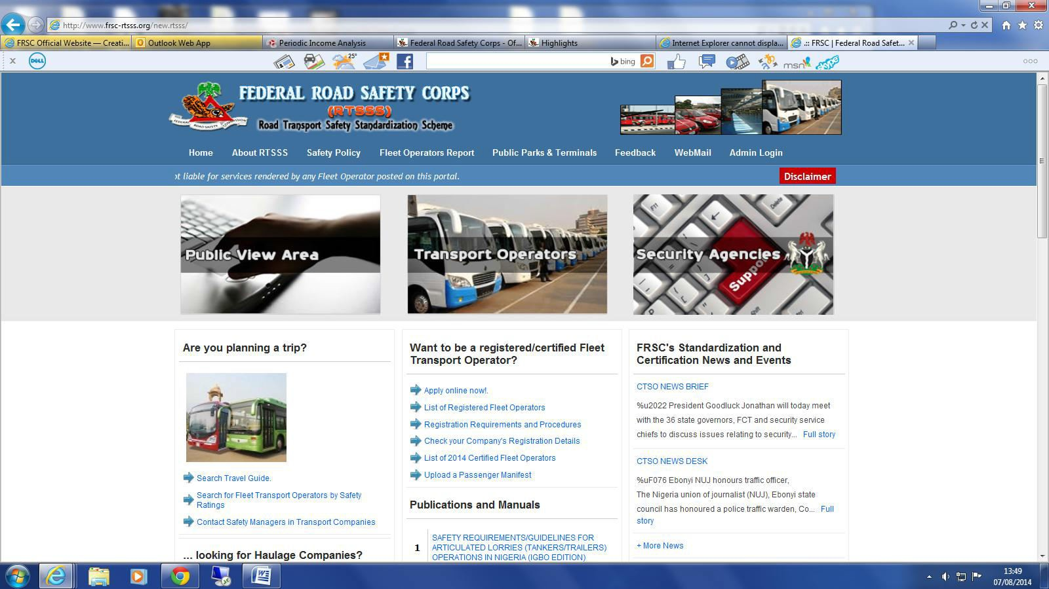
Road Transport Safety Standardization Scheme (RTSSS) was created by law in the National Road Traffic Regulations (NRTR) (2004) Section 115 made pursuant to Sections 5 and 10 (10) of the FRSC (Establishment) Act 2007 provides for the establishment of safety units by all transport operators so as to bring professionalism into the industry, promote and develop rapid safe, efficient and convenient fleet transportation system in the country.

Slide 29

 This platform identifies the list of registered fleet operators, registration requirements procedures, availability of company’s registration details, list of certified fleet operators and uploaded passenger’s manifest.
 It also provides a travel guide route selection, fleet transport operators by our safety ratings and contacts of each registered fleet operator’s safety manager.

Slide 30
The Driving School Standardization Programme (DSSP) is a web application designed to ensure uniform Standards for Driving Schools in Nigeria. This portal provides the list of all certified and registered driving school in Nigeria. It identifies the requirements for establishing Driving Schools, Driving School Certification, Uniform curriculum for Driving Schools, Instructor’s manual, Assessment and grading of Driving Schools.
 DSSP- DRIVING SCHOOL DASHBOARD www.frsc-dssp.org:

Slide 31
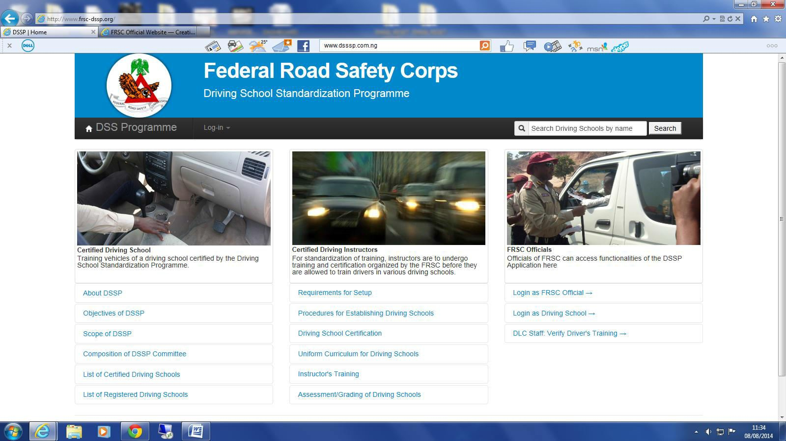

Slide 32

 The Driving School Standardization Programme (DSSP) is a programme aimed at evolving minimum Uniform Standards for Driving Schools in Nigeria.
 DSSP seeks to regulate the establishment of Driving Schools in Nigeria. This will be done through inspections and assessments to ensure that minimum standards are met regarding the Driving School buildings, instructors, facilities and the environment are in conformity with safety guidelines before certification and licensing is granted.

Slide 33
FRSC INFORMATION VERIFICATION PORTAL
(www.frscivp.com.ng)
As part of the commission’s effort at serving the public effectively, FRSC introduced the Information Verification Portal (IVP). The IVP is a gateway to an array of the commission’s databank.
With the IVP the general public as well as corporate entities can now verify information on any of the FRSC’s line of operation application systems databank. The portal provides access to information from the following sources at the moment:
National Drivers’ License System
National Vehicle Identification System
Offenders Register System
Road Transport Safety Standardization System and
Driving School Standardization System

Slide 34
More data sources will be added in future as they become available. Interested persons can use this portal to verify information from any of the aforementioned data sources. This can be done by making use of one or more of the query types under each data source.

Slide 35
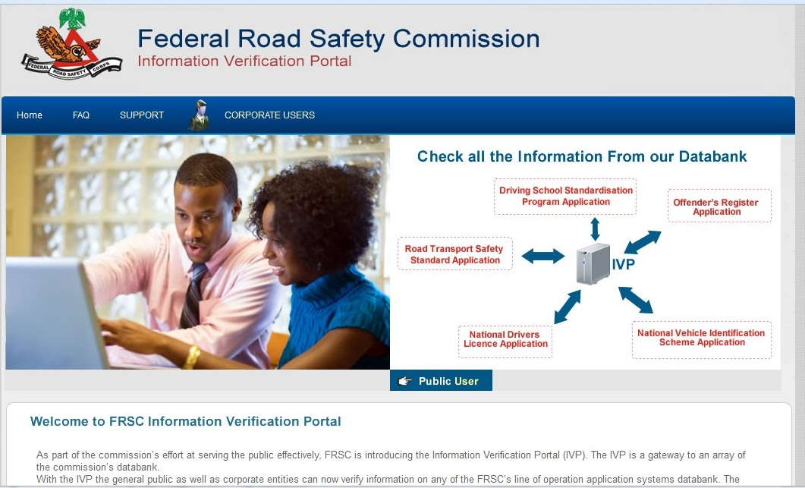

Slide 36
 FRSC APERS: www.frscapers.com.ng:
The system was developed in 2013 as an upgrade of the traditional yearly paper appraisal of Staff. The Report Rendering Process commences with the setting of Key Performance Indicators (KPI) and expected deliverables by designated Supervisors in consultation with the Staff at the beginning of the Performance Management Circle in the reporting year.
 The evaluation process would then follow at the end of the year with individual staff (Appraisee) first assessing and scoring themselves.
Upon completion of the above, the immediate supervisor (Appraiser) would assess and score the staff objectively based on his/her performance in the delivery or otherwise of the set targets for the given year.

Slide 37
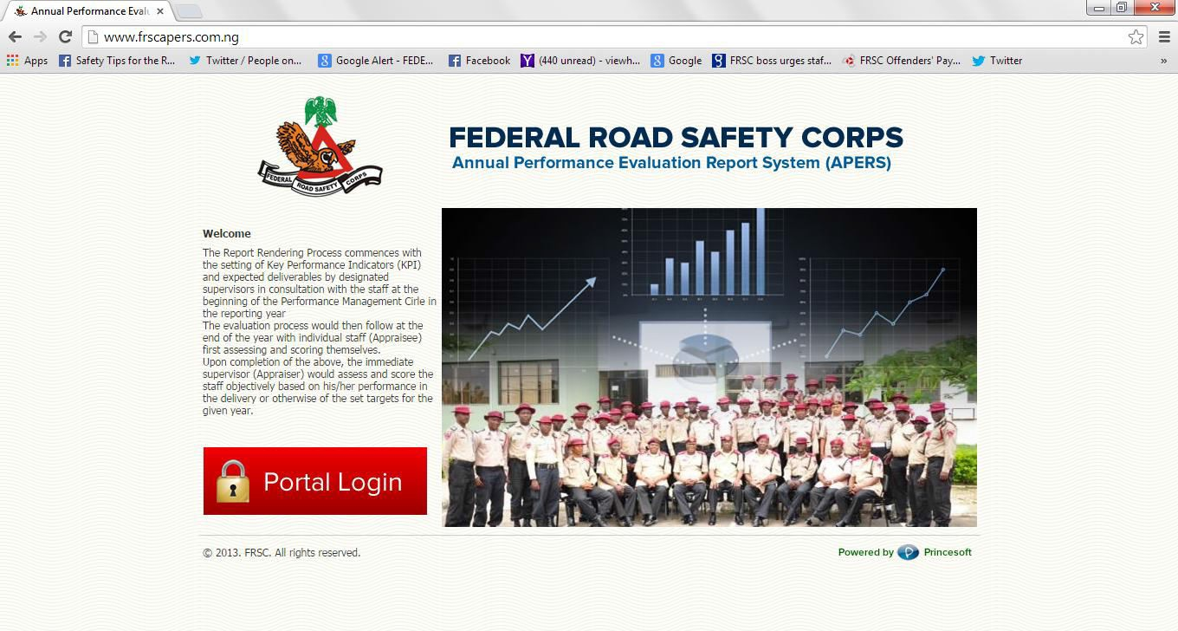
 FRSC APERS: www.frscapers.com.ng:

Slide 38

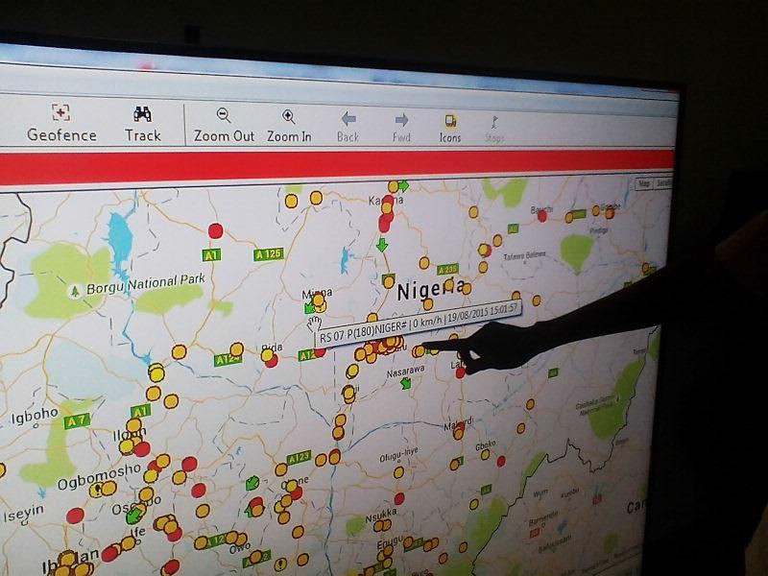

Slide 39
E-BOOKING or TICKETING
This is one of the most recent systems introduced by the Corps in her patrol activities. The e-booking has taken FRSC computerization to the next level. Hardware and software (such as hand-held terminals and associated communication software) have been provided to the patrol men, enabling them to communicate seamlessly with the base stations (Operational Commands). With this arrangement in place, booking and related activities during patrol are accomplished on-line and real-time.

Slide 40
E-BASED EXAMINATION
E-assessment is the use of information technology (use of multimedia) for any assessment-related activity in which FRSC has joined high flying organizations such as banks, oil companies, multi-nationals and the Central Bank etc., by conducting its first ever promotion examination exercise for Officers wholly online (e-based) in 2014.

Slide 41
OTHER ACTIVITIES
Please note that ICT in FRSC is not limited to the activities that interface with the public domain. Memos, circulars and general communication within the FRSC are anchored on the use of IT tools and services offered over the internet. The Corps maintains a robust website with functional portals. Every staff has been assigned an e-mail address created by the Corps in which services such as Payslips, newsletters etc. are posted to each staff every month. Until recently, staff salaries and entitlements are paid by the Corps’ robust salaries and emolument management based on IT platform.

Slide 42
OTHER ACTIVITIES (CONTD)
It is deployed into the following department in the Corps:
TSC
AH&R
CS
FINANCE
BI
While plan is underway to introduce it to :
MVA
PROC
PRS
And others later

Slide 43
PROSPECT AND THE WAY FORWARD
As organizations, both private and governmental strive to leverage on the advantages of operating in IT enabled environments, we see a bright future for IT and allied fields in FRSC core activities.
In fact, FRSC ICT technologies has positioned the Corps in the ongoing integration and collaboration with other agencies as evident in the current harmonization of all government agencies biometric data through the National Identity Management Scheme (NIMS)

Slide 44

 Network: Limited and unavailability of network could be a
challenge because there will be no access/entry.
 Limited knowledge of IT
 Restrictions: A particular site may be restrictive due to
management policy.
 Staff awareness: Low staff awareness.
Lack of Robust It policy
Inadequate IT project monitoring and implementation.
Inadequate capacity building.
Underutilization of some created portals by assigned users thereby limiting its expected potentials to the corps

Slide 45

In actualize one of the Corps strategic goal of Full utilization of the Corps Digital Platform/Systems, Officers and Marshals need to familiarize themselves with all the Uniform Resource Locator(URL) of the Corps.
The FRSC IT platform has earned the Corps a lot of accolades both home and abroad and it is our hope that other areas of our operational activities that are yet to key into the technological drive will be integrated to the platform to achieve a seamless and smart FRSC in the near future.

Slide 46


