Slide 1

BUILDING A SUSTAINABLE & ENDURING FRSC THROUGH MENTORSHIP
Nurturing a culture of successful Leadership in the Corps
Boboye O. Oyeyemi, Ph.D.
2019
Abuja, Nigeria
MFR,mni,NPoM,FNIM,FCIPM,FCILT
Corps Marshal, FRSC-Nigeria

Slide 2

WHAT IS MENTORSHIP?
Mentorship is a professional relationship established between two people, where a more experienced person guides less experienced person through the subject where professional development is desired.
It is a mutually beneficial relationship with intents for replication of ideals and qualities.

Slide 3
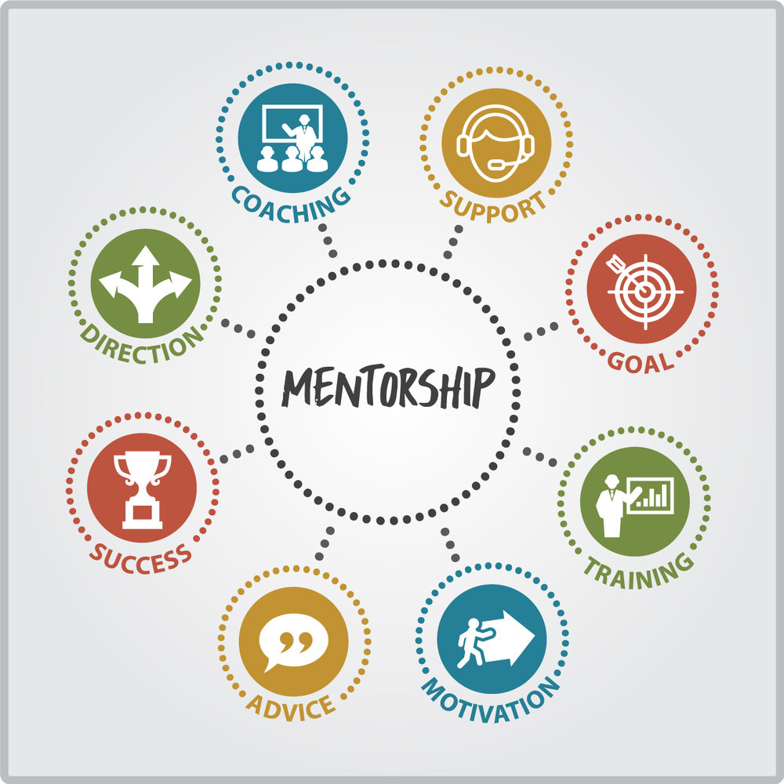
DERIVATIVES OF MENTORSHIP
Mentorship provides the following:

Slide 4

THE MENTORSHIP CHAIN
Mentorship usually involves a Mentor and a Mentee.
The Mentee is drawn and inspired by the qualities and traits exhibited by the Mentor in virtually every aspect of life.

Slide 5

THE MENTORSHIP CHAIN (Cont’d)
A mentor’s position, relative to the mentee, is typically superior in status and power, although some mentors may be peers and others may even be subordinate to the mentee.

Slide 6
THE MENTORSHIP CHAIN (Cont’d)
Mentors who have professional roles that are superior to the mentee can have power to affect the mentee’s career development.
They may be in positions of authority to evaluate the career progress of the mentee or to provide resources and experiences that enhance the mentee’s development. These mentors also can use their power indirectly, by influencing people who are directly responsible for the mentee.

Slide 7
THE MENTORSHIP CHAIN (Cont’d)
True Mentorship
Bad Mentorship
Is mutually beneficial between the Mentor and Mentee.
Brings about mutual Distrust between the Mentor and Mentee.

Slide 8
TYPES OF MENTORSHIP
Formal Mentoring
Formal mentoring relationships develop within organizational structures that are specifically designed to facilitate the creation and maintenance of such relationships
Informal Mentoring
Informal mentoring relationships develop spontaneously and are not managed or specifically recognized as a mentoring relationship within a larger organization. A mentor reaches out to a mentee (or vice versa) and a relationship develops which benefits the mentee’s professional development

Slide 9
ROLES AND CHARACTERISTICS OF MENTORS
Acts as an experienced role model.
Provides acceptance, encouragement, and moral support.
Provides wisdom, advice, counsel, coaching.
Acts as a sponsor in professional organizations, supports networking efforts.
Assists with the navigation of professional setting, institutions, structures, and politics.

Slide 10
ROLES AND CHARACTERISTICS OF MENTORS (Cont’d)
Facilitates professional development.
Challenges and encourages appropriately to facilitate growth.
Provides nourishment, caring, and protection.
Integrates professional support with other areas such as faith, family, and community

Slide 11
ROLES AND CHARACTERISTICS OF MENTORS (Cont’d)
Accepts assistance from mentee in mentor’s professional.
responsibilities within appropriate limits.
Enjoys the opportunity to pass on their wisdom and knowledge.
and collaboration with early career professionals.

Slide 12
WHAT MENTEES NEED FROM A MENTOR
Guidance in a general or specific professional area.
Series of questions or issues.
Broad career development.
Early career development.

Slide 13
WHAT MENTEES NEED FROM A MENTOR (Cont’d)
Ethical and moral guidance.
Assistance in navigating professional settings, institutions, structures, and politics.
Professional identity development guidance.

Slide 14

STRATEGIES FOR EFFECTIVE MENTORING IN FRSC
1
Positive Attitude: Encourage the Mentees to approach life and goals with enthusiasm and to be accepting of self and others.

Slide 15

STRATEGIES FOR EFFECTIVE MENTORING IN FRSC (Cont’d)
2
Valuing:
Encourage the Mentees to examine beliefs and ideals in an effort to establish personal values and goals.

Slide 16

STRATEGIES FOR EFFECTIVE MENTORING IN FRSC (Cont’d)
3
Open-Mindedness:
Encourage the Mentees to keep an open mind to ideas.

Slide 17

STRATEGIES FOR EFFECTIVE MENTORING IN FRSC (Cont’d)
4
Interrelations:
Make the interactions between mentor and Mentee situations of sharing, caring, and empathizing.

Slide 18

STRATEGIES FOR EFFECTIVE MENTORING IN FRSC (Cont’d)
5
Creative Problem-Solving:
Encourage the Mentees to use a creative problem-solving process.

Slide 19
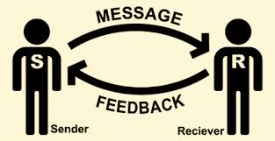
STRATEGIES FOR EFFECTIVE MENTORING IN FRSC (Cont’d)
6
Effective Communication:
Encourage the Mentees to be an attentive listener and an assertive questioner.

Slide 20
STRATEGIES FOR EFFECTIVE MENTORING IN FRSC (Cont’d)
7
Discovery:
Encourage the Mentees to be an independent (Critical) thinker.

Slide 21

STRATEGIES FOR EFFECTIVE MENTORING IN FRSC (Cont’d)
Strengths and Uniqueness:
Encourage the Mentee to recognize individual strengths and uniqueness and to build on them.
8

Slide 22
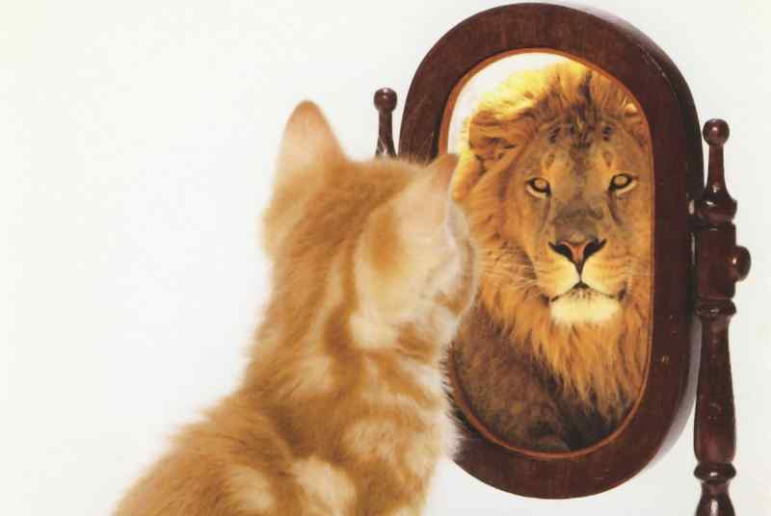
STRATEGIES FOR EFFECTIVE MENTORING IN FRSC (Cont’d)
9
Confidence:
Assist the Mentee in developing
self-confidence.

Slide 23

STRATEGIES FOR EFFECTIVE MENTORING IN FRSC (Cont’d)
10
Awareness:
Stress that an individual be aware of the environment, be intuitive, be problem sensitive, and be ready to make the most of opportunities.

Slide 24

STRATEGIES FOR EFFECTIVE MENTORING IN FRSC (Cont’d)
11
Risk-Taking:
Must be able to take reasonable risk on matters that can advance his/her interest of pursuit no matter the circumstances.

Slide 25
STRATEGIES FOR EFFECTIVE MENTORING IN FRSC (Cont’d)
12
Flexibility:
Share with Mentees the importance of being flexible and adaptable in attitudes and action, looking for alternatives, and seeing situations/persons from different perspectives.

Slide 26
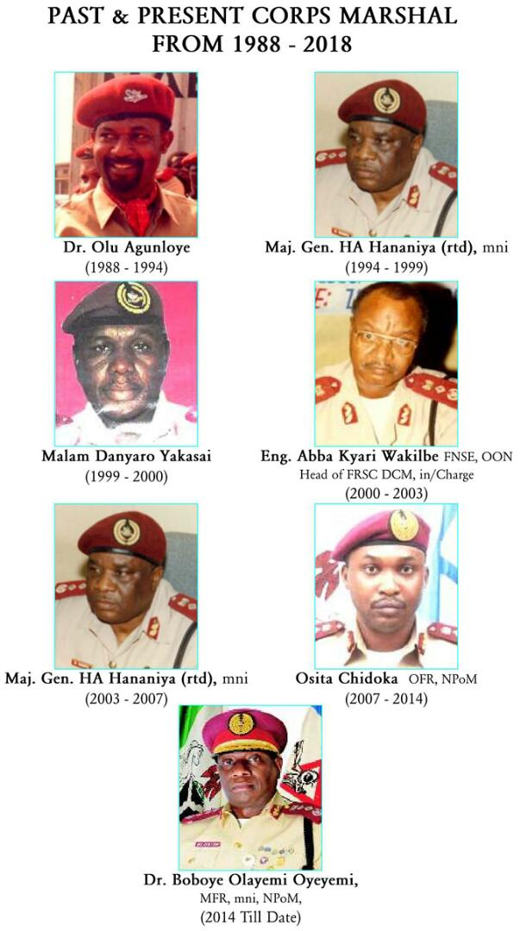
CONCLUSION
Past & Present Corps Marshal From 1988 to Date
It is important for us to know and note that MENTORSHIP cannot be forced on any MENTEE. It is a natural flow of goodly and enviable qualities that followers see in their leaders that make them yearn for.
Let us make ourselves ROLE MODELS for mentorship to thrive in the Corps.

Slide 27

THANK YOU

