Slide 1
LIFESTYLE AND CAREER ISSUES

Slide 2
OUTLINE
-AIM
-OBJECTIVES
-DEFINITIONS
-KEYS TO HEALTHY LIVING
-CAREER ISSUES
-CONCLUSION

Slide 3
AIM
To highlight tips for healthy living and strategies for a successful career

Slide 4
OBJECTIVES
Identify 10 keys to healthy living
Identify 4 strategies that can promote ones career and profession
List 2 things to avoid to record a successful career
Explain the relationship between lifestyle and a successful career

Slide 5
DEFINITIONS OF TERMS
HEALTH: a state of complete physical, mental and social well being and not merely the absence of disease.
CAREER: a persons course or progress through life or a distinct portion of life. An occupation or a profession that usually involves special training or formal education; considered to be a persons life work.
LIFESTYLE: interests, opinions, behaviours and behavioural orientations of an individual, group or culture.

Slide 6
KEYS TO HEALTHY LIVING
Eat healthy: a balanced diet is one that gives the body the nutrition it needs to function properly. Consists of 6 key components
-carbohydrates(45-65% daily calorie requirement)
-Proteins(10-35%)
-Fats and oils(20-35%)
-Vitamins
-Minerals
-Others- fibre (non starch polysaccharide)

Slide 7

KEYS TO HEALTHY LIVING

Slide 8

KEYS TO HEALTHY LIVING

Slide 9
KEYS TO HEALTHY LIVING
Take adequate amounts of water regularly
-Significant percentage of body mass
-Medium for most metabolic reactions
-Regulates body temperature
-Required for proper digestion
-Required for excretion of waste products

Slide 10
KEYS TO HEALTHY LIVING
Reduce intake of alcohol
Forms: beer, wine, spirits
Health Effects:
poor memory, cortical atrophy, retrobulbar neuropathy, dementia, fits, falls, encephalopathy.
obesity, peptic ulcer disease, pancreatitis, varices, oesophageal cancer
Hypertension, Arrhythmias, cardiomyopathy, sudden death in binge drinkers.

Slide 11
KEYS TO HEALTHY LIVING
AM I ALCOHOL DEPENDENT?
C
A
G
E
Contraindications to the use of alcohol
Driving
Hepatitis
Cirrhosis
Peptic ulcer disease
Drugs(antihistamines, metronidazole)
Pregnancy
Carcinoid syndrome

Slide 12
KEYS TO HEALTHY LIVING
Abstain from tobacco and cannabis use

Slide 13
KEYS TO HEALTHY LIVING
About 4000 toxic substances are present in tobacco
Nicotine
Carbon Monoxide
Tar
About 25 diseases caused/aggravated by smoking. e.g.
Lung cancer: 80-90% deaths due to smoking. Incidence 10 times more than non-smokers.
Chronic bronchitis
Emphysema: 80- 95%

Slide 14
KEYS TO HEALTHY LIVING
Cerebrovascular disease
Cancer of tongue, oesophagus, larynx & pancreas, Gastro-duodenal ulcers
Cancer of the cervix and endometrium
Cancer of the urinary bladder
Still births, abortions
Foetal retardation and growth retardation in the children.
Children of smokers are more prone to become smokers later on.

Slide 15
KEYS TO HEALTHY LIVING
Passive smoking
Leads to discomfort, distress to asthmatics
Nicotine is detected in blood and urine of passive smokers.
Passive smoking by adults may lead to Ca-cervix, CA lung, and coronary heart disease.
Cannabis: cannabis sativa plant
contains tetrahydrocannabinol, tar and over 50 carcinogens
Health Effects:
hallucinations
anxiety
paranoia
short term psychosis

Slide 16
KEYS TO HEALTHY LIVING
Avoid unsafe sex
ABSTAIN
BE FAITHFUL
CONDOMS

Slide 17


KEYS TO HEALTHY LIVING
Exercise Regularly

Slide 18
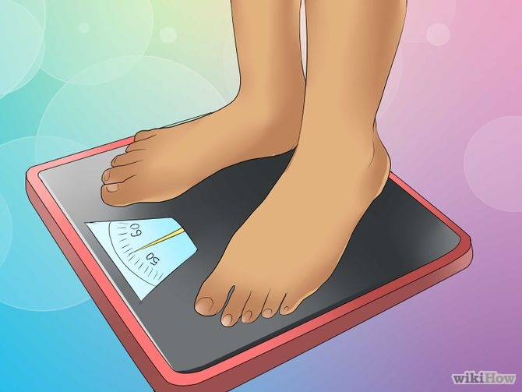
KEYS TO HEALTHY LIVING
Avoid excessive weight gain
Have regular checks on your weight

Slide 19
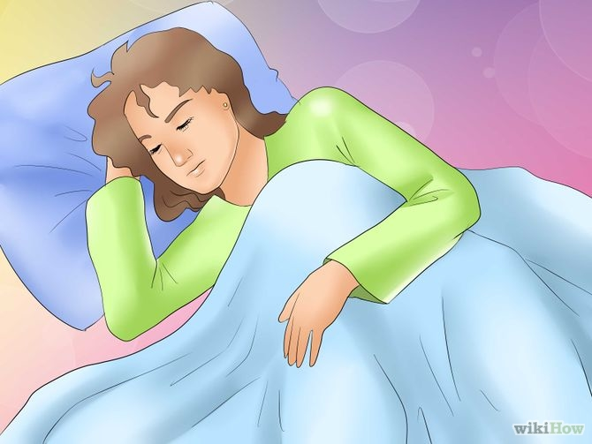
KEYS TO HEALTHY LIVING
Ensure adequate sleep and rest
8hrs/night for adults
“the best bridge between despair and hope is a good nights sleep”

Slide 20
THINGS TO AVOID
Procastination
Practice creative procastination
Indolence
An idle mind is the devils play toy

Slide 21
CONCLUSION
“Seest thou a man diligent in his work, he shall stand before kings; he shall not stand before mean men”.

