Slide 1

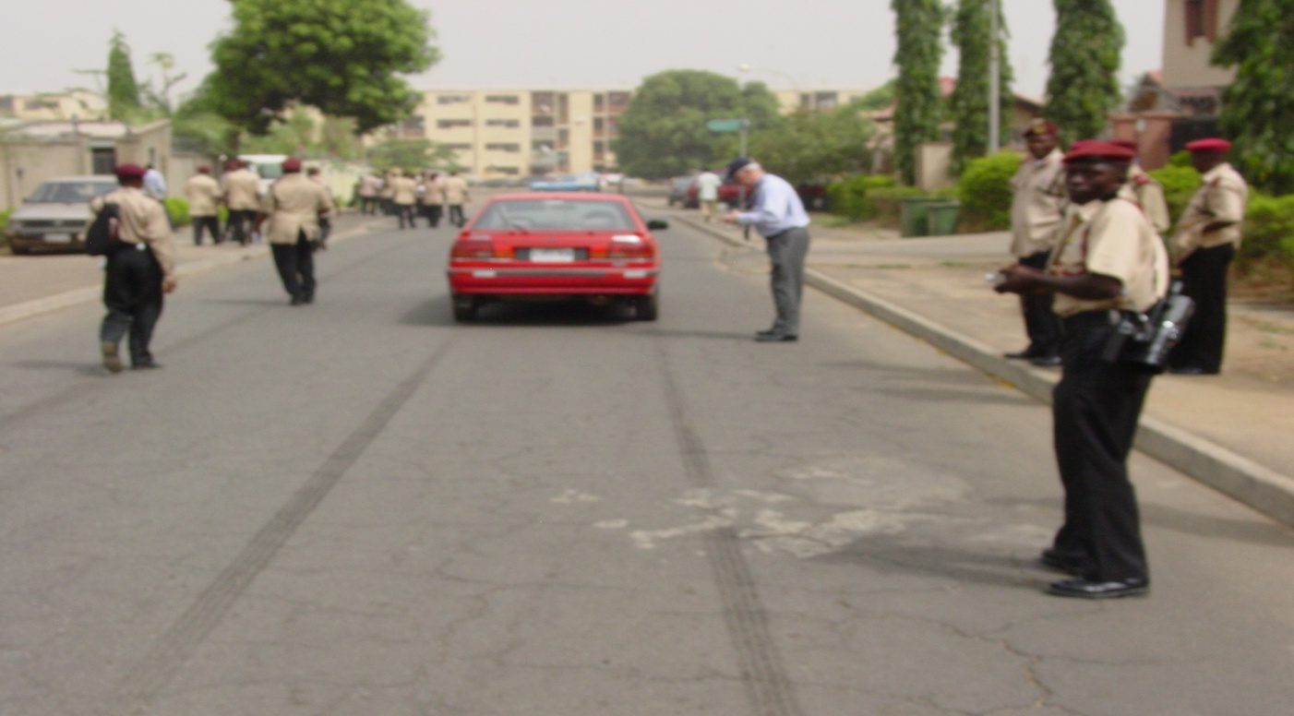
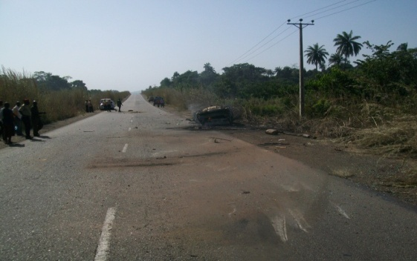
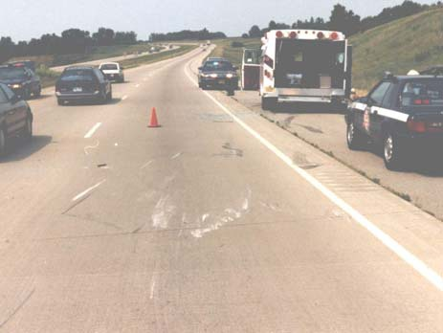
CRASH INVESTIGATION AND DOCUMENTATION
(WHAT A ROAD SHOWS)

Slide 2

PREAMBLE
The Federal Road Safety Corps was established primarily to eradicate Road Traffic Crashes and create safe motoring environment in Nigeria. If this must be achieved, the Corps no doubt must be able to address the question of how do traffic crashes occur? Why do they occur? What should have been done to prevent them?
Experiences have shown that the most appropriate procedure for the determination of main and remote causes of road traffic crashes lies deeply on Road traffic Crash Investigation and analysis.
The potential impact of road traffic collision investigation and analysis is clearly visible in the reduction of crashes and associated hazards in countries that have incorporated results of such findings in their transportation policies.
For Nigeria to successfully meet the burgeoning challenges of Road Traffic Crashes, issue of collision investigation and analysis, among other interventions, must be given the attention it deserves.
Consequently, in FRSC, there is now a paradigm shift from mere accident reporting with its attendant subjective cause estimation to collision investigation and analysis, particularly for RTC with a threshold of six (6) deaths and above.

Slide 3
PURPOSE OF CRASH INVESTIGATION
Collision Investigation and analysis could be seen variously as:
A scientific effort to collect and interpret results.
A systematic look at nature and extent of collisions and loss.
An enquiry into how and why the collision occurred.
A consideration of what can be done to prevent further similar occurrences.
A planning process to explore action to minimize or eliminate reoccurrence.
General, it is a systematic method of inquiry into the facts and circumstances surrounding traffic collision.
The purposes of Crash Investigation are;
To prevent a recurrences of crashes from similar causes.
To determine the sequences of events leading to a traffic crash.
To identify the immediate and underlying causes of an RTC.
To improve operational and safety procedures.
To defend a position for legal argument
To satisfy insurance requirements

Slide 4
CRASH INVESTIGATIVE ELEMENTS AND METHODOLOGY
There is no fixed step-by-step technique for crash investigation. However, having no procedure at all is the beginning of failure. Often an investigator wishes that he could go back and investigate a crash all over again. He may have neglected to look into an important matter or forgotten a vital activity.
Consequently, a general methodology of all that might be done is indispensable. Such a technique could be easily adjusted to meet the prevailing circumstances at any of the five stages of the collision investigation. These stages are;
Responding to the scene of a crash.
Arriving at the scene of a crash.
When the emergency is under control.
When urgent Data-Collection is complete.
When work at the scene is finished.

Slide 5
RESPONDING TO THE SCENE OF A CRASH
Obtain as much information as possible about the crash including the following:
The exact location and time of the crash.
What is involved and type of crash
The extent of injury/damage involved.
Whether the traffic is obstructed/traffic condition.
Whether fire is involved.
Whether a rescue team have been mobilized.
Based on the information received arrange for any needed help.
Assemble the rescue and investigation materials including causality forms (RTC field report forms), statement forms, vehicle examination forms, markers, measuring devices, tape recorders, cameras, GPS and writing materials.
On approaching the scene, be alert for vehicles leaving the scene as possibly carrying witnesses or hit and run drivers. Record registration numbers of any likely vehicles.

Slide 6
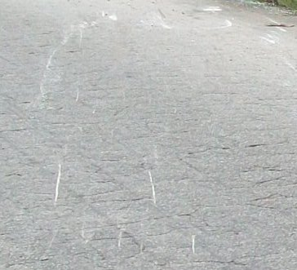
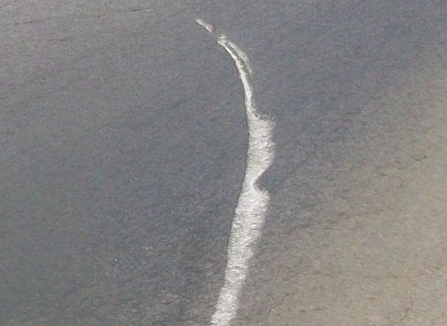
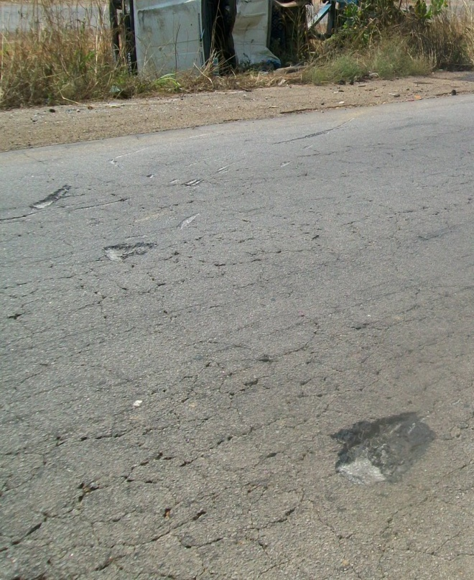
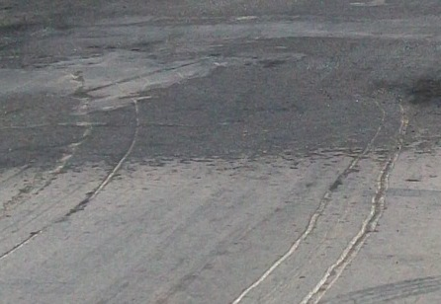
ARRIVING AT THE SCENE OF A CRASH
1.Ensure your safety (ANNEX 1) and that of the scene.
2.Respond to emergencies including caring for the victims.
3.Locate and separate the drivers of each vehicle/witnesses still at the scene.
4.Look for the physical evidence of the crash and have it guarded until it can be examined or located by measurements. This includes:
Position of vehicles at final rest.
Position of pedestrians, motorcyclists, bicycle
riders, ejected occupants (deceased or injured).
Road scars (scratches, scraps, chips, chops
and grooves).(ANNEX 2)
SCRATCHES
CHOPS
CURVED
SCRAP
GROOVES

Slide 7
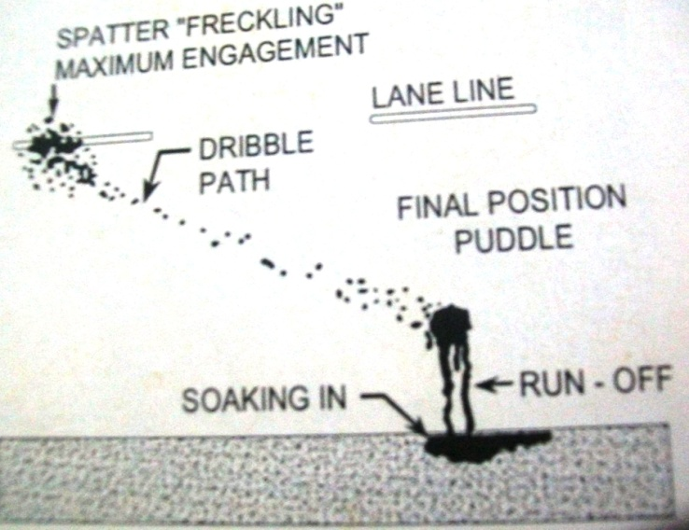
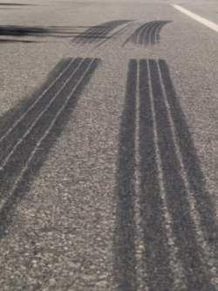
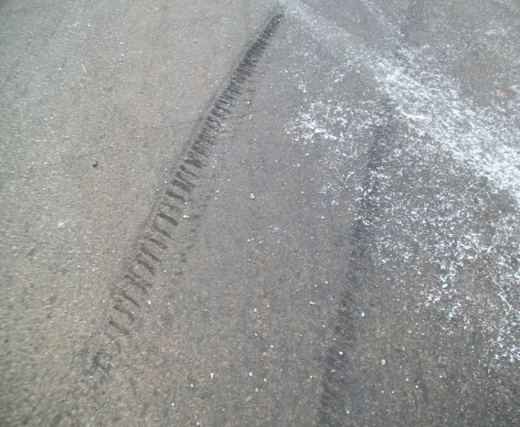
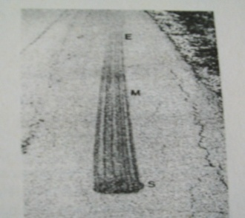
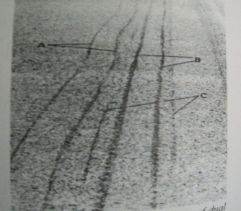
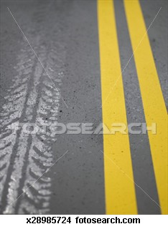
ARRIVING AT THE SCENE OF A CRASH (2)
Debris including dislodged vehicle parts, underbody debris, vehicle liquids, blood,body tissues, personal effects (handbags, hats,glasses etc).
Contact to fixed objects.
Tyre marks such as skid marks, yaw marks, acceleration scuff, flat tyre and imprint (ANNEX 3, 4, 5, 6 & 7)
Dislodged
Vehicle Part
Vehicle
liquids
Contact to
fixed objects
SKID MARKS
YAW MARK
ACCELERATION SCUFF
FLAT TYRE MARKS
IMPRINT

Slide 8
WHEN THE EMERGENCY IS UNDER CONTROL
1. Interview drivers and witnesses applying the following precautions;
Be tactful, patient, specific, positive, objective, open minded, adaptable and employ good communication skill.
Interview involved persons alone and away from others.
Gather identification from the person first.
Allow the person to tell his or her version of the events without interruption.
Be sure to ask the persons exactly where they were (position) when crash occurred.
Pay close attention to any signs or actions that suggests confusion, intoxication, injury, illness or impairments.
Officers may also request persons to provide a written signed statement.
2. Examine the crash site including the roadway features & the physical evidence on the road and record your observations.

Slide 9
WHEN THE EMERGENCY IS UNDER CONTROL (2)
3. Examine the crashed vehicle(s) noting the following;
Gather Vehicle identification data- VIN (ANNX 8), Reg.No., Make, Model, Type
Document Contact and induced damage areas (ANNX 9).
Document Major parts detached.
Examine Tyre and wheel for- flatness, punches, unseated rims, bent flange and struck wheels (ANNX 10)
Examine Lamps/Lamp Switches for - on/off, broken/damage
Examine Steering Wheel for- free turns or tightness
Examine Brake Pedal for- free to floor or tightness
Take the Speedometer Reading
Check Safety belts used
Check for Air Bag Deployment

Slide 10
WHEN THE EMERGENCY IS UNDER CONTROL (3)
4. Take photographs of the scene, physical evidence and the crash vehicle(s) noting the following;
Take photographs before vehicles are moved from their final rest positions.
Take four view (ANNX 11) sequence photographs of the crash scene showing basic landmarks.
Take general story-telling photographs (ANNX 12) of the scene.
Take photographs of the four sides of each vehicle (ANNX 13).
Take matching damage (ANNX 14) parts photographs of vehicle
Take close up or detailed photographs of specific road scars, tyre marks and vehicle damage.
5. Fill the crash investigation Forms

Slide 11
WHEN THE EMERGENCY IS UNDER CONTROL (4)
6. Mark the collision results.
Use a point to mark small objects such as a human body and debris less than 1m across.
Use two points to mark vehicles’ positions, straight tyre marks and straight grooves greater than 1m in length.
Use three or more points to mark large debris area, curved tyre marks and straight tyre marks with angles, crooks and gaps.
Assign different letters to each object marked. For instance, if there are 3 tyre marks, label the first A, the second B and the third C.
use numeric suffixes to denote multiple points for the same object. For example, the letter D may be used to identify a debris area with points along the perimeter designated D1, D2, D3, D4 etc
7. Make a field sketch of the crash scene.

Slide 12
Points to note while making a field sketch.
The sketch should include the result of the crash, roadway features, north -arrow, location, time and date of the crash as well as the name of the sketcher.
Begin by drawing the skeleton of the roadway edges.
Place the north-arrow in an out-of-the-way corner of the sketch.
Represent vehicles, persons, tyre marks and other result of the crash with the standard symbols.
Use alphanumeric to label the features depicted.
N
C
OSOGBO-IKIRUN RD
A1
A2
B1
B2
A3
D1
B3
D2
ILOKO STR
LOCATION:KM3 OSO-IKI RD
DATE:12/05/2010
TIME:0642HRS
MEASURED BY:JU ODINFONO

Slide 13
WHEN URGENT DATA-COLLECTION IS COMPLETE
1. Measure the result of the crash. Using the co-ordinate method of measurement, adopt the following steps;
Choose suitable reference line (RL) and reference point (RP).
Prepare a table of measurement based on the collision result already marked.
Starting at the RP, measure along the RL to a point opposite the feature to be measured.
Measure the distance from the RL to the feature to be measure. Your measurement must be at right angle to the RL.
Record each distance and the direction from the RP and RL. Exact directions are not necessary. Use nominal directions when the RL does not run North-South or East-West.
2.Make additional photograph.
3.Make test skids if needed.
4.Clean up the crash scene
RL=E edge Oso-Iki Rd
RP@N edge Iloko St
N
A1
A2
C
OSOGBO-IKIRUN RD
B1
B2
A3
D1
B3
D2
RL
RP
FEATURE | POINT | N | S | E | W
Skidmark | A1
 | A2
 | A3
Skidmark | B1
 | B2
 | B3
Body | C
Vehicle | D1
 | D2
ILOKO STR
LOCATION:KM3 OSO-IKI RD
DATE:12/05/2010
TIME:0642HRS
MEASURED BY:JU ODINFONO

Slide 14
WHEN WORK AT THE SCENE IS FINISHED
1. Complete factual data on the form if not completed at scene.
2. Notify relative of dead or injured and owner of vehicle.
Prepare and send the F.I.R. via CUG line in the order exemplify below:
FIR; Cmd: RS11.12; Date 29/05/13; Time A: 0010hrs;Time B: 0030hrs; Time C: 0040hrs; RT: Ilesa-Ipetujesa; LTN: Erinmo junctn (7km frm Ilesa); Veh invld 2; (1:Green DAF trailer, reg no XJ255LSD; NDL: nrk16563ab1; NTC: Comm; Dri's Nm: Ahmed Yusuf; 2. White Hyundai bus, reg no XS410GGE; NDL: NA; NTC: BBC Motors; Dri's Nm: Tajudeen Lasisi); Nature: Head on Collisn; Severity: Fatal; Cause: SLV, LOC; ,Ppl inv:6(2MA,2FA & 2FC), No inj:3(1MA & 1FA, 1FC) ,No kil :3(1FA,1MC & 1FC) Victims Nm:Inj(Ajani Alabi,Bunmi Oni,Lola Ajayi) Kil(Iyabo Olayinka,Segun Oyinloye & Taiye Ojo), Actn taken: Victims taken 2 Wesley Guild Hospital, Ilesa; Items recovrd: Nil;
4. Record the basic data on the RTC data register and update the computer database
5. Analyse and reconstruct the crash on paper using physics.
5. Prepare the After-Collision Situation Map
6. Complete report.
7. Present case summary to prosecutor.

Slide 15
ANNX 1
PROTECTION OF THE ACCIDENT SCENE
Park the patrol vehicle in the ‘fend off' position to provide protection to team members and casualties.
Display reflective warning signs 200m before and after the scene.
Divert traffic away from the accident scene.
Mark off the scene with cones, strips and flares (not advisable if gasoline is leaking).
Situation fire extinguisher and fire hose.
Place absorbing power on oil and gasoline pool.
Stabilize the vehicle by placing wooden blocks, wedges, cribs, spare wheel etc under the vehicle.
Disconnect the battery.
Put vehicle in park and hand brake.
Switch off ignition.

Slide 16
ANNX 2
TYPES OF COLLISION’S ROAD SCARS
SCRATCHES- are the thin, light and irregular scars made on road pavement by sliding metal part(s) of vehicles without great pressure.
Scratches are most useful to show where a vehicle turned over on the roadway and the path it followed after the collision.
SCRAPES are the broad and light scars made on road pavement by sliding metal part(s) of vehicles without great pressure.
Scrapes often help in locating the area of maximum engagement
CHIPS are small deep scars where pavement materials have been dug out by strong metal parts such as frames, transmission housing, and control arms which have been forced down on the road.
Chips are nearly always made during maximum engagement and mark a spot on the road where the corresponding part of the vehicle was when maximum engagement occurred.
CHOPS are broad, shallow scars where pavement materials have been dug out by strong metal parts such as frames, transmission housing, and control arms which have been forced down on the road.
Chops are made by vehicle frames and sometimes wheel rims during maximum engagement.
GROOVES are long narrow scars where pavement materials have been dug out by strong metal parts such as projecting nuts, or stud and sometimes by the drive shaft or some other parts dragging on the road.
Grooves show the pathway the vehicle followed after collision.

Slide 17
ANNX 3
SKID MARKS
are tyre friction marks left on the road pavement by a tyre that is
sliding without rotation
CHARACTERISTICS OF SKID MARKS
WHEEL MOTION | SLIDE, NO ROLL
OPERATION | BRAKING
NUMBER FROM 4-TIRED VEHICLE | MOSTLY 4. ALSO 1, 2, 3
RIGHT & LEFT TIRES | EQUALLY STRONG
FRONT & REAR TIRES | FRONT STRONGER
WIDTH | IF STRAIGHT, SAME AS TIRE
BEGINNING | USUALLY ABRUPT
END | USUALLY ABRUPT
STRIATIONS | ALWAYS PARALLEL TO MARK
OTHER DETAILS | OUTER EDGES OFTEN STRONGER
LENGTH | 1 TO 150 M

Slide 18
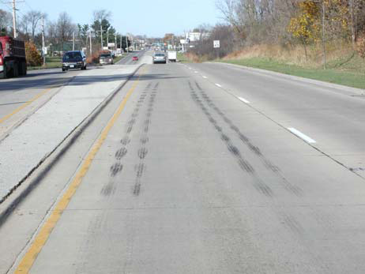
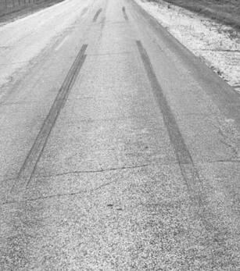
ANNX 3B
SPECIAL SKIDMARKS
SKIP SKIDS
GAP SKIDS

Slide 19
ANNX 4
YAWMARK
are tyre friction marks left on the road pavement by a tyre that is
rolling and side sliping
CHARACTERISTICS OF YAMMARKS
WHEEL MOTION | ROLL AND SIDESLIP
OPERATION | STREERING
NUMBER FROM 4-TIRED VEHICLE | MOSTLY 2 ALSO 1, 3, 4
RIGHT & LEFT TIRES | OUTSIDE STRONGER
FRONT & REAR TIRES | USUALLY EQUAL
WIDTH | VARIES FROM CM TO METERS
BEGINNING | ALWAYS FAINT
END | STRONG
STRIATIONS | ALWAYS OBLIQUE OR CROSSWISE
OTHER DETAILS | SIDE RIB MARKS MAY SHOW
LENGTH | 3 TO 60 M

Slide 20
ANNX 5
ACCELERATION SCUFF
are tyre marks left on the road pavement when sufficient power is
supplied to the driving wheels to make at least one of them spin
and slip.
CHARACTERISTICS OF ACCELERATION SCUFF
WHEEL MOTION | SPIN AND SLIP
OPERATION | SPEEDING
NUMBER FROM 4-TIRED VEHICLE | USUALLY 1 SOMETIME 2
RIGHT & LEFT TIRES | EQUAL IF TWO
FRONT & REAR TIRES | ONLY DRIVEN WHEELS
WIDTH | SAME AS TYRE
BEGINNING | STRONG OR GRADUAL
END | VERY GRADUAL
STRIATIONS | PARALLEL TO MARK
OTHER DETAILS | OUTER EDGES OFTEN STRONGER
LENGTH | 0.1 TO 15M

Slide 21
ANNX 6
FLAT-TYRE MARKS
are tyre marks left on the road pavement by a tyre which is
underinflated or overloaded.
CHARACTERISTICS OF FLAT TYRE MARK
WHEEL MOTION | ROLL, NO SLIP
OPERATION | NONE
NUMBER FROM 4-TIRED VEHICLE | ONLY 1 RARELY TWO
RIGHT & LEFT TIRES | RARELY TWO
FRONT & REAR TIRES | NA
WIDTH | TYRE TREAD EDGE MARKS
BEGINNING | ALWAYS FAINT
END | ALWAYS FAINT
STRIATIONS | NONE
OTHER DETAILS | OUTER EDGES ALWAYS STRONGER
LENGTH | 15M TO 16KM

Slide 22
ANNX 7
IMPRINT
are tyre marks left on the road pavement by a rolling tyre that is
not sliding.
CHARACTERISTICS OF IMPRINT
WHEEL MOTION | ROLL, NO SLIP
OPERATION | NONE
NUMBER FROM 4-TIRED VEHICLE | MOSTLY 1 ALSO 2, 3, 4
RIGHT & LEFT TIRES | USUALLY EQUAL
FRONT & REAR TIRES | EQUALLY CLEAR
WIDTH | SAME AS TYRE
BEGINNING | ALWAYS STRONG
END | ALWAYS STRONG
STRIATIONS | PARALLEL TO MARK IF ANY
OTHER DETAILS | TREAD DESIGN MAY SHOW. OFTEN BROKEN
LENGTH | O.1 TO 15M

Slide 23
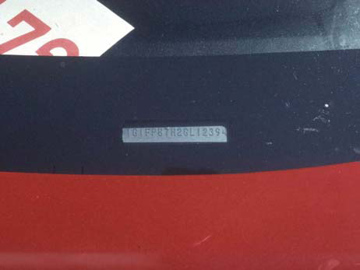
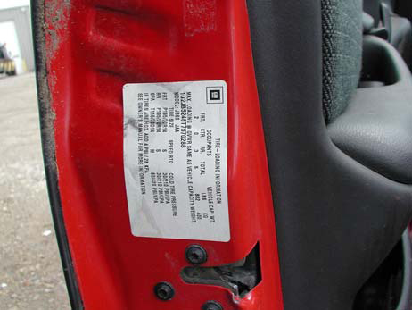
ANNX 8
VIN : 1GTLV13T8PY174834
DIGIT | DESCRIPTION | MEANING
1 | Country of Origin | United States
G | Manufacturer | Toyota
T | Make | Toyota
LV | Line | Camry
1 | Body Style | 2 Dr sedan 2WD
3 | Restraint System | Manual Belts
T | Engine | 3.1 L V6 MFI
8 | Check Digit | Check Digit Valid
P | Year | 1993
Y | Assembly Plant | Wilmington
174834 | Sequence Number | In Range

Slide 24
ANNX 9
TYPES OF VEHICLE DAMAGE IN COLLISION
Characteristics of Contact damage
Closely compacted crumpled body parts.
Scratches in the surface of the metal
Smears of paint due to friction heat
Ragged tears in sheet metal Punctures in sheet metal, fiberglass panels, tyres, plastic lenses & glass.
Characteristics of Induced Damage
Indicated by displacement and folds, bends, creases and wrinkles
Absence of scratches and punctures
Produced by vehicle parts forced back into other vehicle parts
Decelerating collision forces may
24

Slide 25
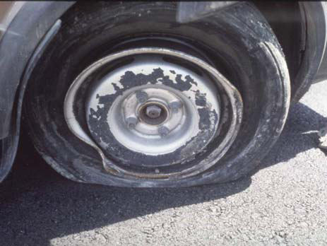
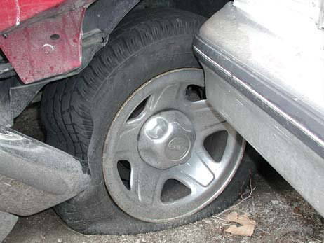
ANNX 10
unseated rims/bent flange
struck wheel

Slide 26
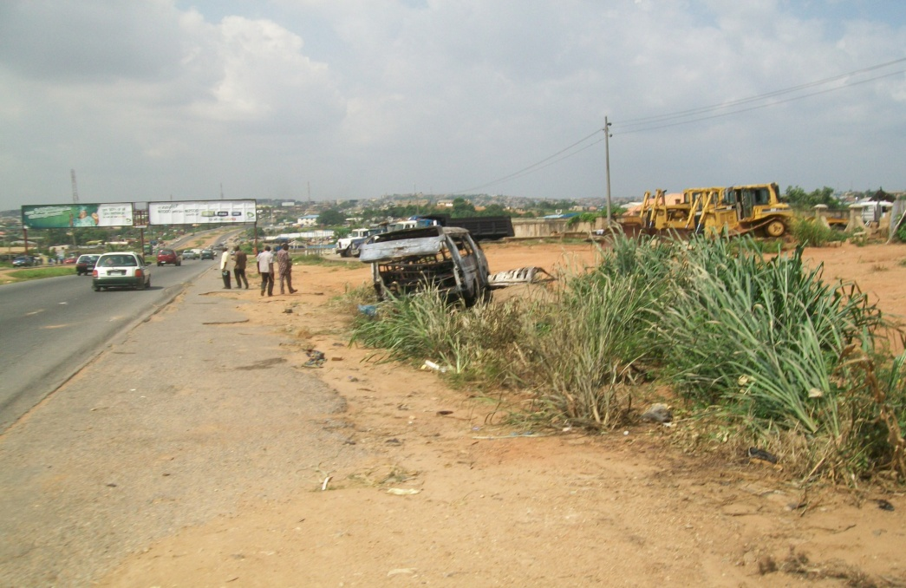
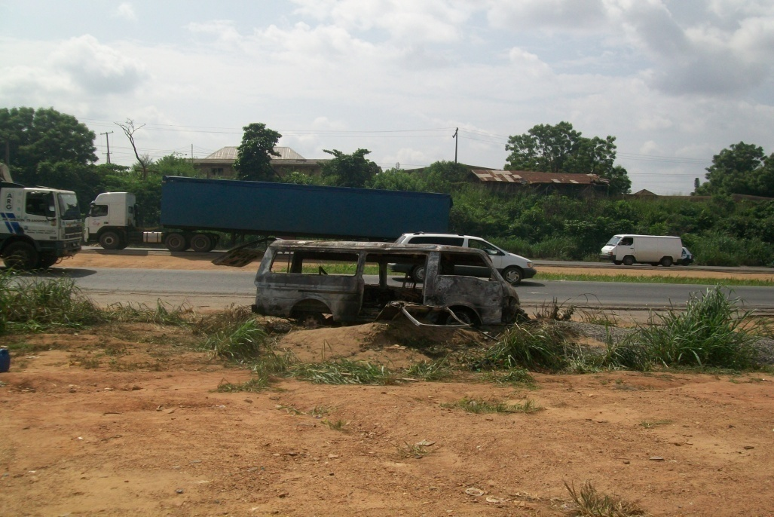
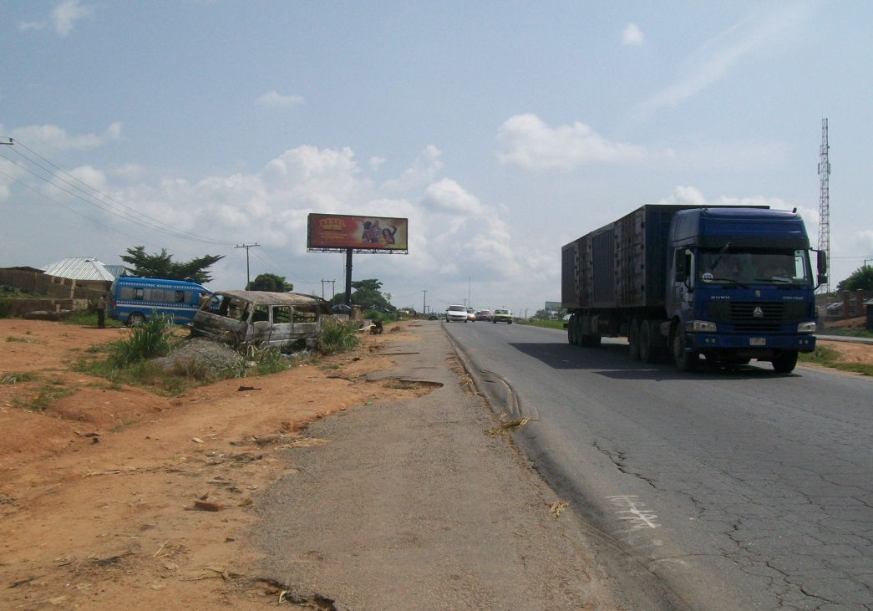
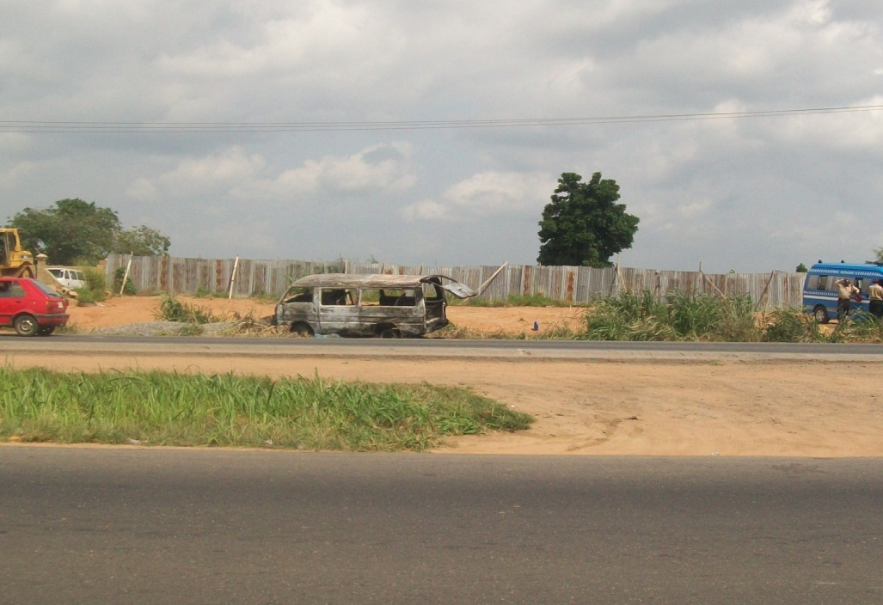
ANNX 11
FOUR-SIDE VIEW PHOTOGRAPHS OF CRASH SCENE

Slide 27
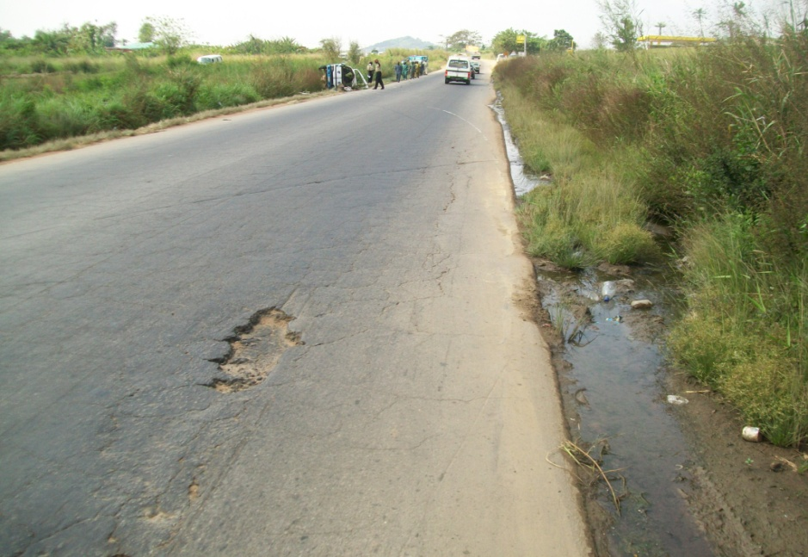
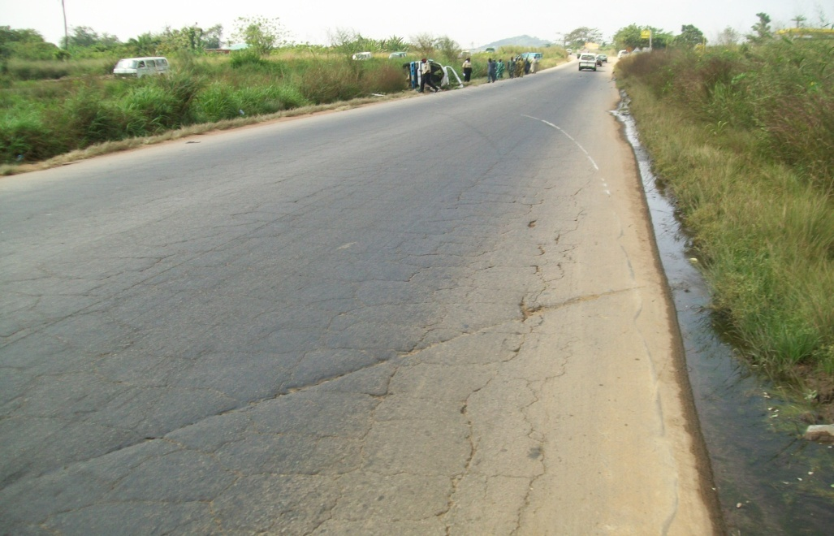
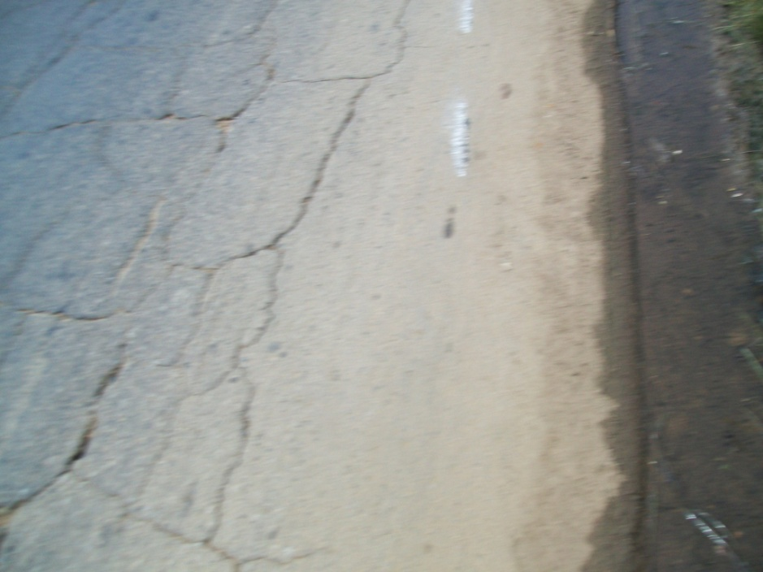
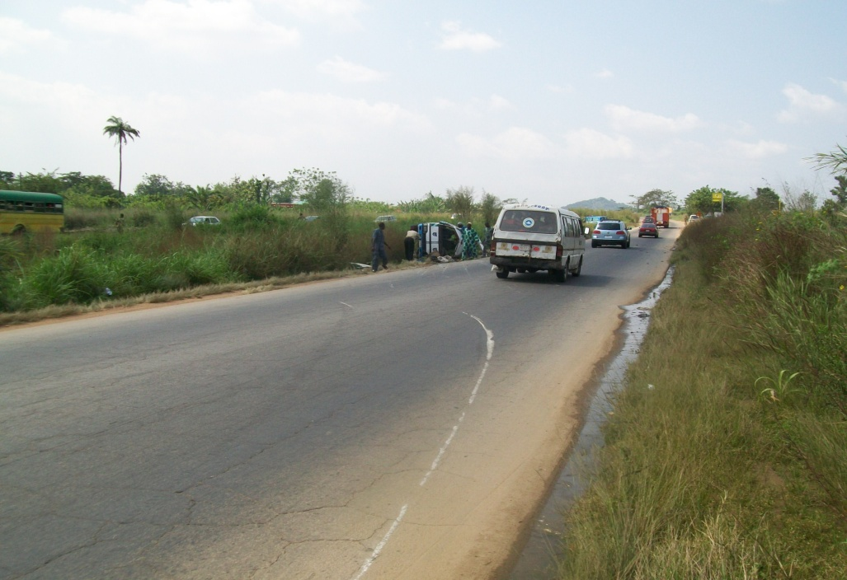
ANNX 12 A
STORY TELLING PHOTOGRPHS

Slide 28
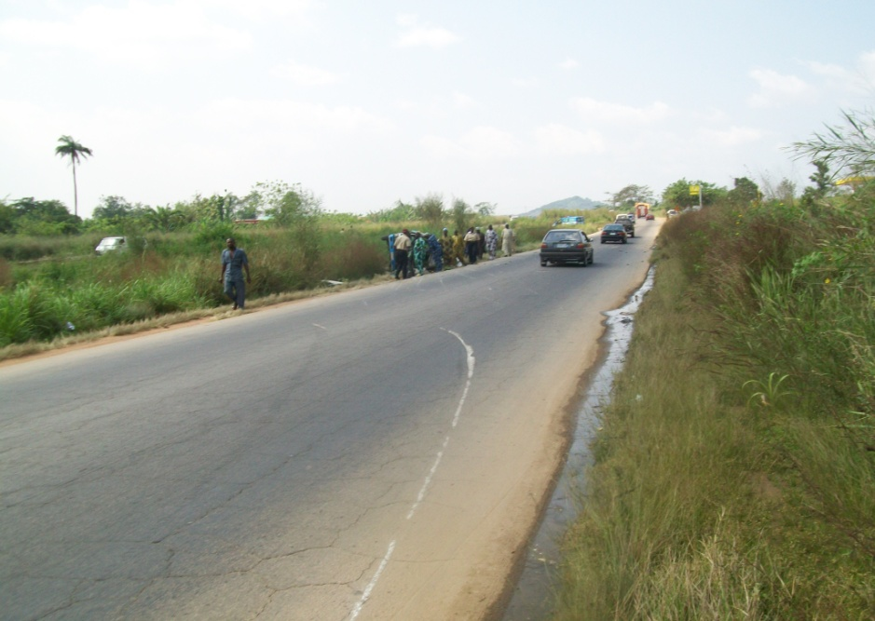
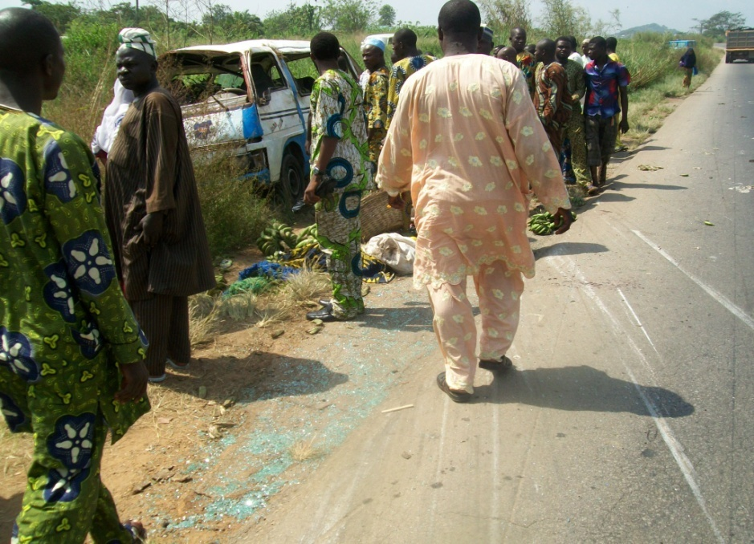
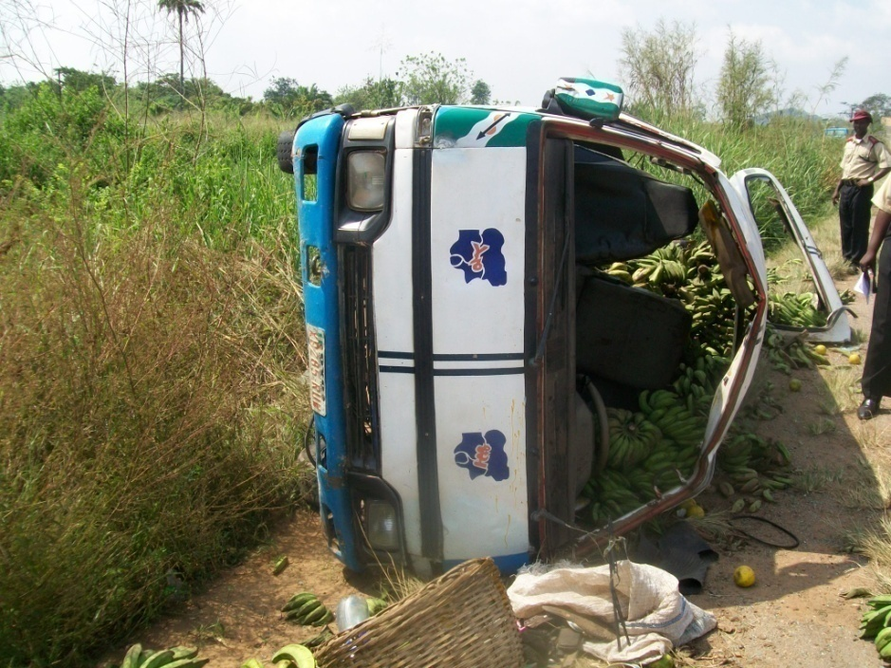
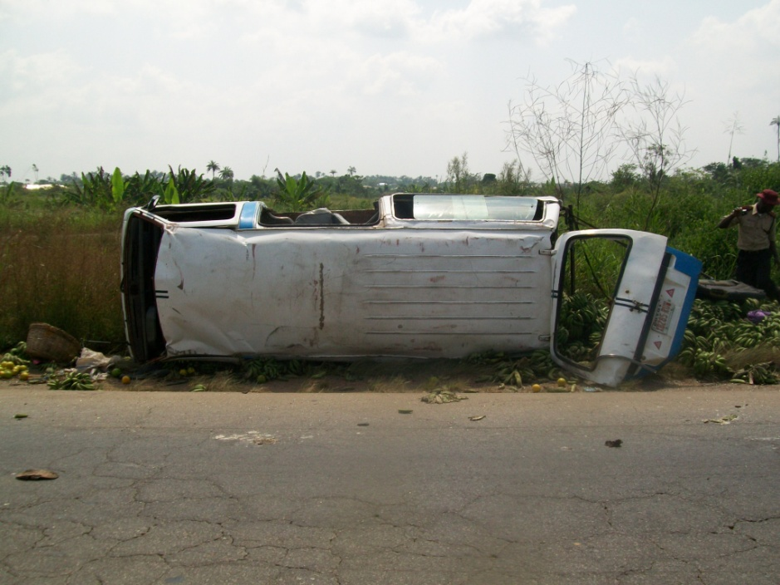
ANNX 12 B
STORY TELLING PHOTOGRPHS

Slide 29
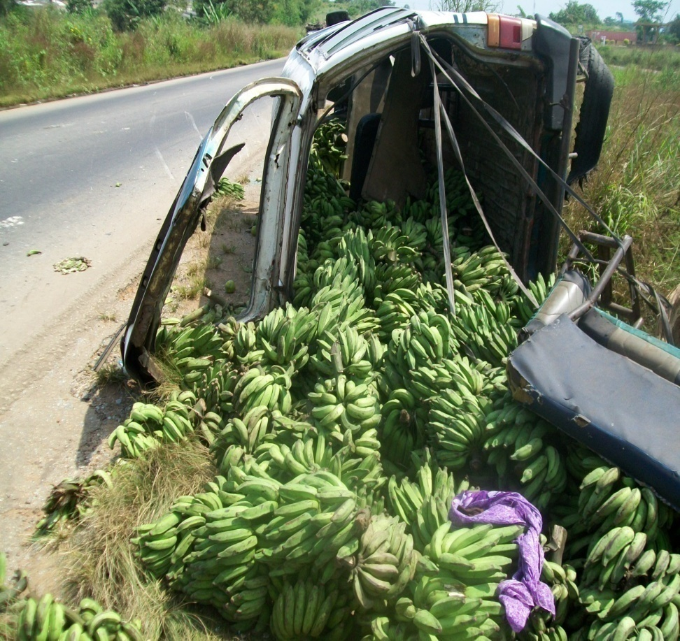
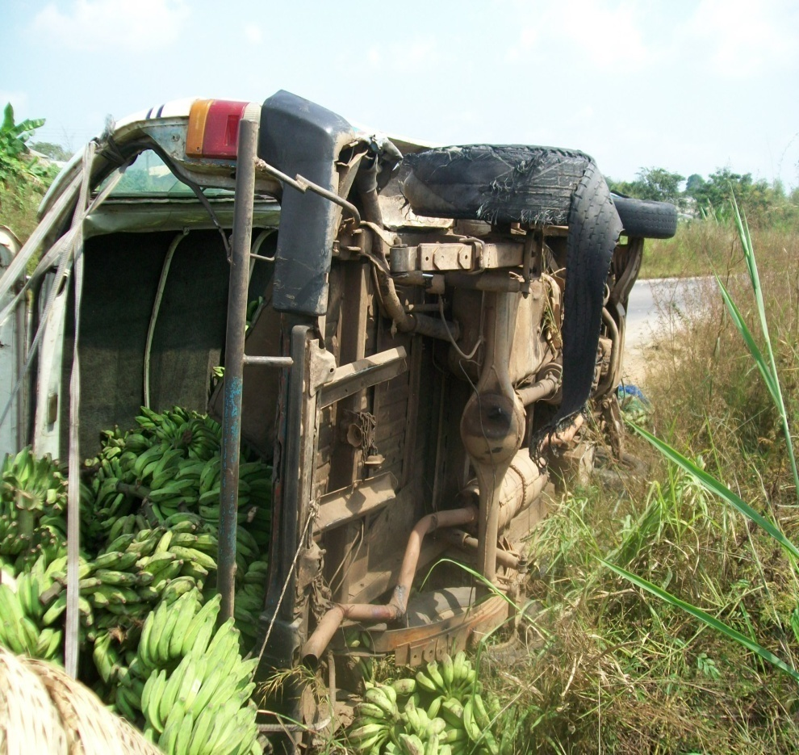
ANNX 12 C
STORY TELLING PHOTOGRPHS

Slide 30
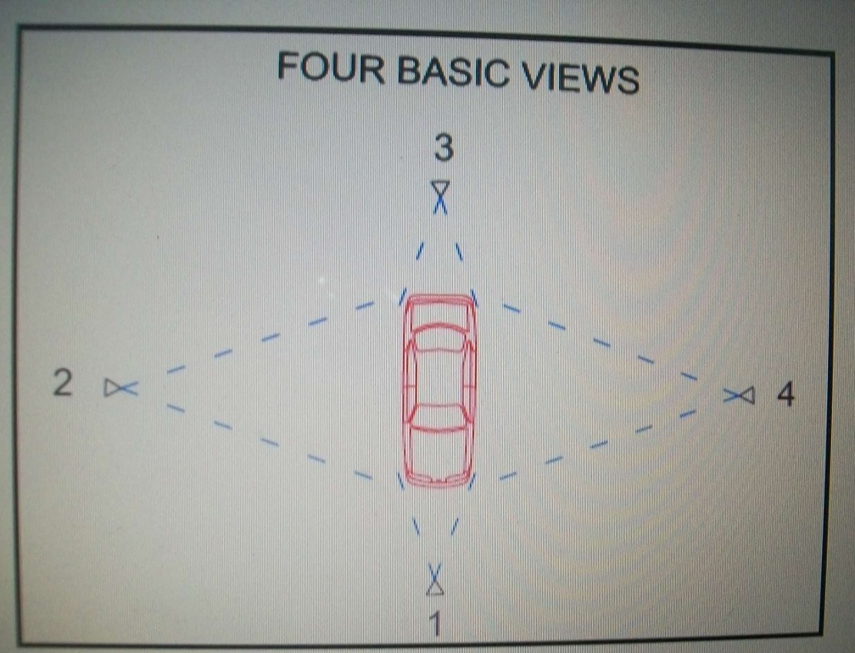
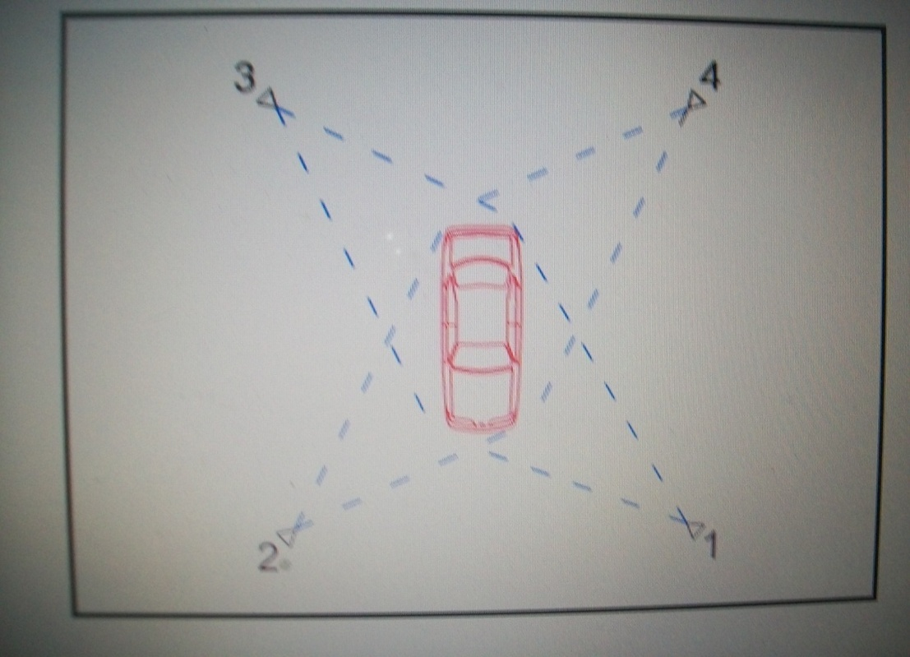
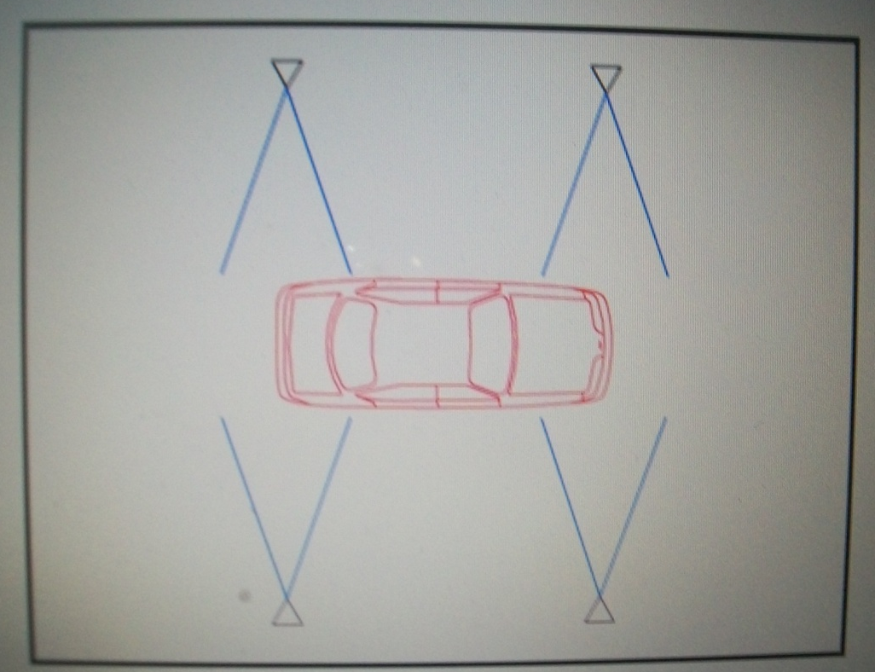
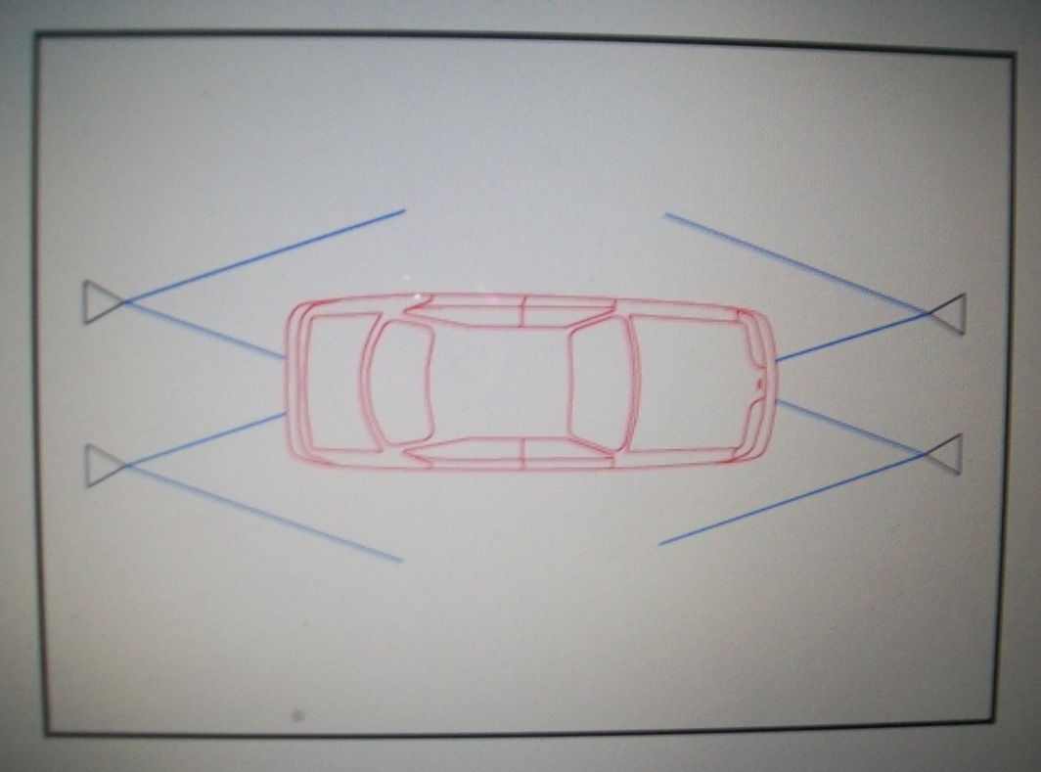
ANNX 13

Slide 31
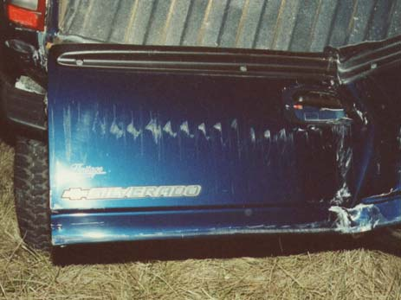
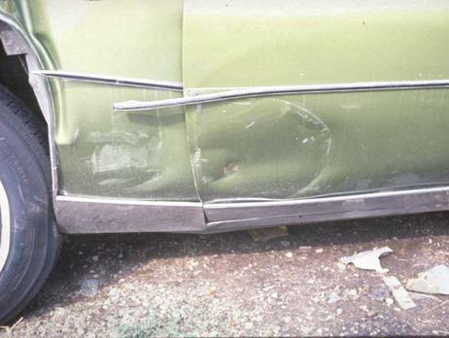
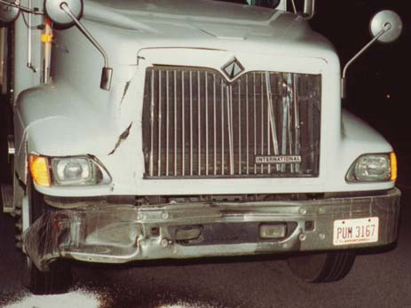
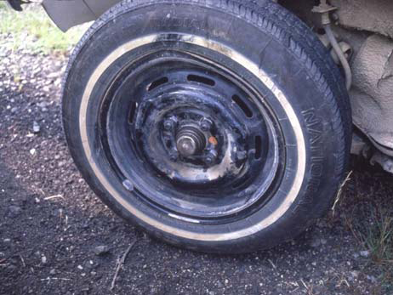
ANNX 14

Slide 32
Federal Road Safety Corps
Corps Safety Engineering Office
COLLISION RECONSTUCTION

Slide 33
WHAT IS COLLISION RECONSTRUCTION?
With the conclusion of data gathering from the scene of a collusion and technical follow-up investigation, collision reconstruction is performed in order to look for contributing and root causes of the collision.
Collision reconstruction is the process of using physics to determine the relative positions of vehicles at different times during the collision sequence.
Information such as the pre-and post impact direction of travel, the length of the pre-impact skid marks, the pre-impact speed of the vehicle, the post-impact distances moved, the friction values for the various surfaces the vehicles travelled over, the point of impact (POI), the principal direction of force (the impact angles or thrust) and the weights of the vehicles are all inputs to the equations used in reconstructing a collision.
Understanding how vehicles behave in collisions is a therefore a very importance step in collision reconstruction.

Slide 34
HOW VEHICLES BEHAVE IN COLLISION?
Study of vehicle movements in collision is often the key to discovering where on the road an impact took place and what the driver actions involved.
Hence, deciding how vehicles came together and finally separated in a collision is the first step in thinking about what happened in a collision.
It is always a matter that requires very careful understanding of the following:
Basic sequence of collision
Contact damage area and deformation
Principal direction of force
Force and rotation.

Slide 35
1.Basic sequence of collision
The basic sequence of collision also known as elements of a collision are made of three events namely;
First contact
Maximum engagement
Separation
First contact: this is the beginning of a collision. At that instant, force begins to develop between the objects.
Maximum engagement: this is the point at which the force between objects in collision is greatest. It is the point of maximum penetration or collapse between objects in collision.
Separation: this is the point at which the force between objects in collision returns to zero. At this instant virtually all the deformation at maximum engagement remains as vehicle damage.

Slide 36
2.Contact damage area
Contact damage is the damage to any part of a motor vehicle by direct contact with some object which is not part of the vehicle
Contact damage area is characterized by
Closely compacted crumpled body parts
Scratches in the surface of the metal
Smears of paint due to friction heat
Ragged tears in sheet metal
Punctures in sheet metal, fiberglass panels, tyres, plastic lenses & glass.
The matching of contact damage parts of two vehicles often shows how they came together in collision.

Slide 37
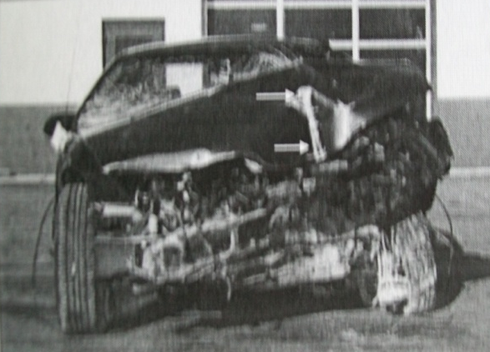
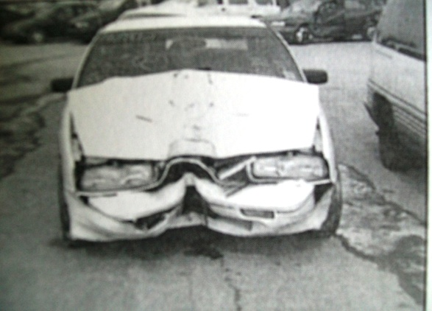
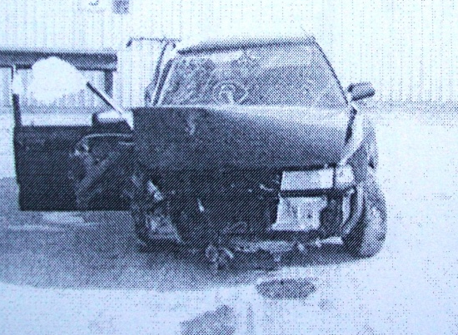
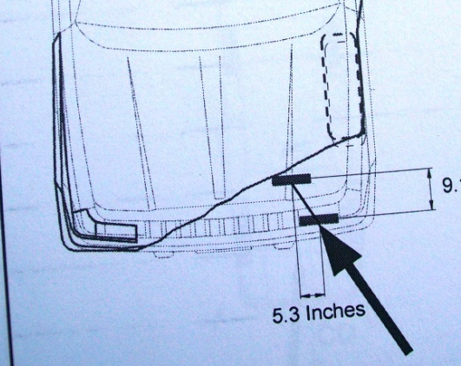
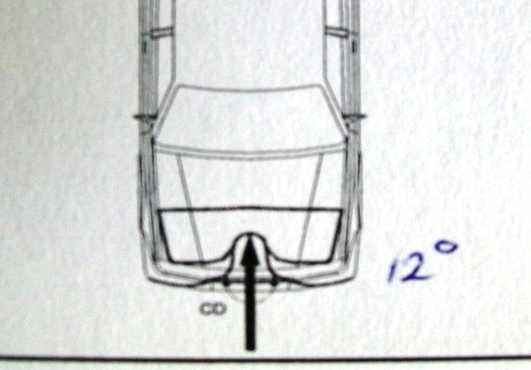
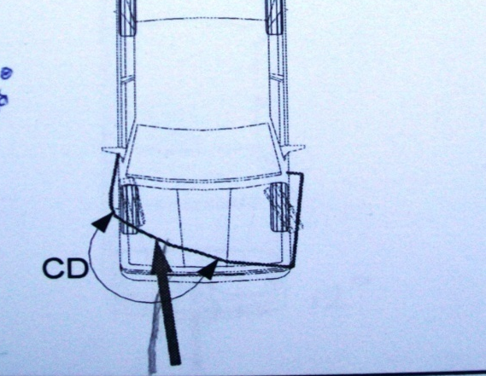
3.Principal direction of force (PDOF) During an impact, there are forces that occur between vehicles and these vary in position and time.
The PDOF also called thrust is the summation of these forces over the contact duration expressed as a vector.
During an impact, there are forces that occur between vehicles and these vary in position and time.
PDOF is indicated by contact damage and crush resulting from the impact. It is usually at the mid of the damage area.
PDOF is determined by the direction that specific parts were moved in impact.

Slide 38
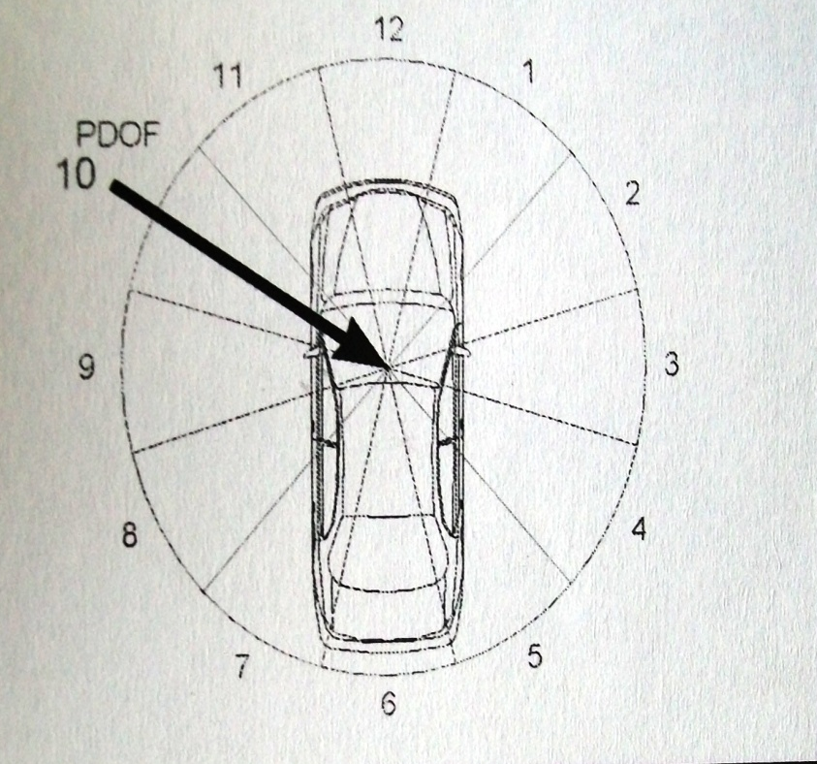
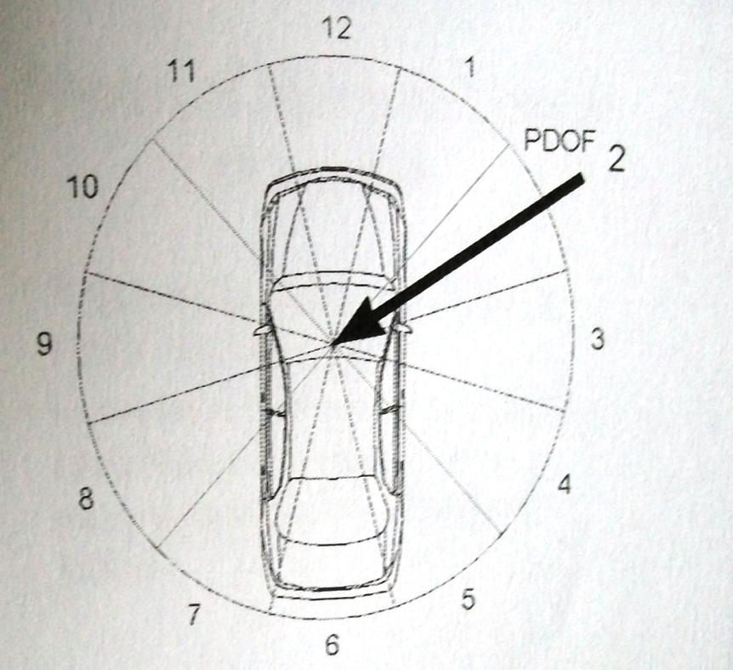
3.Principal direction of force (PDOF) cont,
There are two ways to describe PDOF name;
Degrees from the lengthwise axis of the vehicle
Hour number from a clock face with 12 ‘O clock at the front and its centre at the application point.

Slide 39
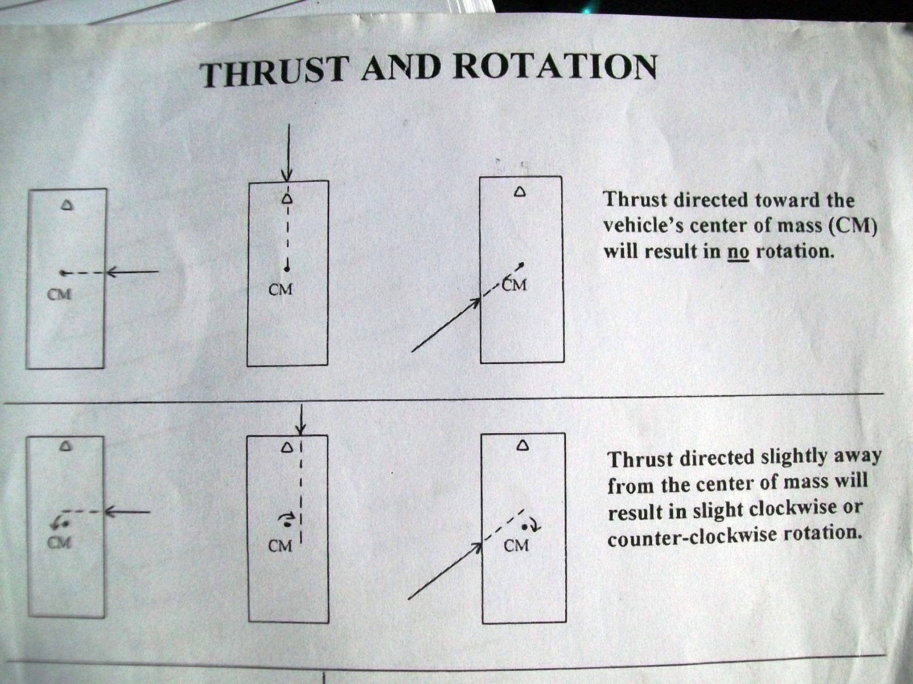

4.PDOF AND ROTATION

Slide 40
COLLISION RECONSTRUCTION TECHNIQUE (THE SYSTEMATIC PROCEDURE)
The processes which have been explained up to this point can be summarized and reviewed as the following steps in a typical collision reconstruction.
Draw vehicle outline to scale
Show deformation
Indicate the contact damage area
Locate the greatest penetration and estimate the principal direction of force
Determine the eccentricity of the force and rotation direction, if any.
Place the vehicles together at maximum engagement
Compare the direction of rotation and its rate for each vehicle. Adjust positions of original outlines to represent first contact positions.
Show the vehicles at separation.
Place the vehicle outlines on a scale map over the corresponding roadway evidence.
Determine how each vehicle moved from maximum engagement to final rest.
Account for all signs of the collision on the roadway.

Slide 41
Federal Road Safety Corps
Corps Safety Engineering Office
COLLISION INVESTIGATION: (REPORT WRITING)

Slide 42
INTRODUCTION
A traffic collision investigation is only complete when a report is prepared and submitted to the appropriate authorities.
Road Collision Investigation Report (RCIR) should include cause analysis to arrive at the conclusions on how collision happened.
Report should be rendered in both soft and hard copies.
Report should be sent two days after the conclusion of the investigation through approved e-mail addresses to Safety Engineering Department, RSHQ.
The hard copy should be sent through the normal approved channel of communication to Corps Marshal and Chief Executive.

Slide 43
ROAD COLLISION INVESTIGATION REPORT FORMAT
Cover page
Time & date
Command
Location
Investigator
vehicle(s) & driver(s)
Abstract
No of people involved
No injured
No killed
Causes
Date of investigation
General information
Crash scene
Environmental factors
Vehicle involved and occupants
Seatbelt availability and use
Tyre examination
Lamb examination
Vehicle damage analysis
At-scene physical evidence
Accident scenario
Measurement
General scene measurement
Non-fixed objects
Evidence from the road
Vehicle dimensions
Summary & conclusion
Recommendations
Attachments.

Slide 44
ATTACHMENT
Attachments to RCIR include all necessary materials and forms used in the investigation such as;
Photographs
After-collision situation map
Road Traffic Collision Report Form
Interview notes
General vehicle examination forms
Vehicle collision damage record
Tyre and wheel examination record
Lamb examination record

Slide 45
Federal Road Safety Corps
Corps Safety Engineering Office
ROAD TRAFFIC CRASH DATA RECORD KEEPING AND MANAGEMENT

Slide 46
INTRODUCTION
One of the fulcrums of road safety administration is data management. This is due to the fact that data are the basis for all scientific endeavours including road safety planning and decision-making. Collecting good quality crash data plays a vital role in supplying objective information on issues associated with road traffic crashes so that some analytical understanding of the problems and hence solutions can be obtained. Making decision on the basis of poor quality crash data is risky and may lead to disastrous results, as the situation may be distorted and hence all subsequent analyses and decision making will rest on a shaky ground.
The Corps had invested heavily on information technology and standardization of crash data report formats to aid intelligence based decisions in line with global best practices. The approved crash data report formats in the Corps as at today include the following:
First Information Report (FIR)
Weekly Sitrep (For CMO)
Weekly Sitrep (For HOD SED)
Monthly Report (For CMO)
Monthly Report (For HOD SED)
Crash Investigation Report format
The FRSC Management has taken note of partial compliance to these formats, filling of non-factual information as well as discrepancies in data being sent to the zonal headquarters and RSHQ on daily, weekly and monthly basis. Management consequently has warned that any further non-compliance to the approved report formats and discrepancies in crash data would be viewed seriously.
Against this background, this paper is to update our knowledge of the aforementioned report formats, how to use and keep them for future purposes.

Slide 47
FIRST INFORMATION REPORT
The FIR is a daily report of crash (whether minor, serious or fatal) to the CMRO, DCM Ops, and CMO via text messages. The report is forwarded within one hour of the occurrence a crash or at most one hour after completion of the rescue operation. The report contains all necessary details of the crash in the following order:
Command
Date
Time A (Time of the Crash)
Time B (Time of Report of the Crash)
Time C (Time the rescue team arrived the scene)
Route/location (Specific location in km)
Vehicle involved (number, make, model and registration number)
Name of Company
Nature of Collision
People involved (number, gender and age)
Cause of crash
No injured (number, gender and age)
No killed (number, gender and age)
Driver’s Name/licence number
Victim’s Name
Remarks
E.g
FIR.Cmd:Rs11.1,Date:19/01/13,Time A:0640hrs,Time B:0645hrs, Time C: 0653hrs, Rt:0sogbo-Ikirun,Ltn:Powerline (2km 4rm Osogbo),Veh:2 (Tyt Hiace XB903YRE & Honda Accord CQ719AAA),NOC: Osun line & Pvt, Nature: Head-on Collision, Ppl inv:6 (2MA, 2FAd & 2FC),Cause: Wov,No inj:3 (1MA, 1FA & 1FC) ,No kil :3 (1FA, 1M C & 1FC),Drivers: Adebayo Tunde (NdL-nrk16563ab1) & Ahmed Yusuf (NDL-N/A),Victims:Inj (Ajani Alabi,Bunmi Oni,Lola Ajayi) Kil (Iyabo Olayinka,Segun Oyinloye & Taiye Ojo), Remarks: victms taken 2 LAUTECH hosp & mor.)

Slide 48

WEEKLY SITREP (FOR CMO)
The weekly Sitrep is a record of all road traffic crashes reported within the week in hard copy and Soft Copy.
The approved format for the Rescue weekly Sitrep is as follows:
A | B | C | D | E | F | G | H | I | J | K | L | M | N | O
S/N | CMD | TIME A | TIME B | TIME C | ROUTE/ LOCATION | VEHICLES INVOLVED NO/MAKE | NAME OF COMPANY | PEOPLE INV | CAUSES | NO INJ. | NO KILLED | DRIVER’S NAME/ LICENCE NO. | VICTIM’S | REMARKS
1
2
3
4
5
6
The period covered in the report is from 0000hrs of Friday to 2359hrs of the next Thursday.
The deadline for submission of the weekly Sitrep to the Zonal Headquarters is Fridays by 0900hrs.

Slide 49
WEEKLY SITREP (FOR COSEN)
The SED RTC Weekly Sitrep is a record of all road traffic crashes reported within the week in Softcopy.
The approved format for the SED weekly Sitrep is as follows:
WEEK .. (……….) RTC SITREP
 |  |  |  |  |  |  |  | VEHICLE INFORMATION |  | RTC TYPE |  |  | CASUALTY DETAILS |  |  | MORBIDITY PROFILE |  |  |  | FATALITY PROFILE
 |  |  |  |  |  |  |  |  |  |  |  |  |  |  |  | MALE |  | FEMALE |  | MALE |  | FEMALE
DATE | CMD | TIME A | TIME B | TIME C | ROUTE | LOCATION | CAUSES | No. | MAKE, MODEL & REGISTRATION NUMBER | F | S | M | CAS | KILL | INJ | < 18 | > 18 | < 18 | > 18 | < 18 | > 18 | < 18 | > 18
Total
The period covered in the report is from 0000hrs of Friday to 2359hrs of the next Thursday.
The deadline for submission of the weekly Sitrep to the Zonal Headquarters is Fridays by 0900hrs.

Slide 50
MONTHLY REPORT (FOR CMO)
The rescue monthly report is a record of all road traffic crashes reported within the month in hard copy. This is done by proper filling of the RTI Casualty Information Form Summary.
The deadline for the submission of the rescue Monthly report by Unit Commands to the Sector Commands is the 3rd day of the succeeding month while that of Sector Commands to the Zonal Headquarters is the 5th day of the succeeding month.
The RTI Casualty Information Form Summary should be accompanied with either the original or legible copy of the Revised Field Report Form (RTC FORM 01/000001) of each recorded crash.

Slide 51
FIELD REPORT FORM (RTC FORM 01/000001)
The Field Report Form is used to document the details of each crash at the scene. The form has the following variables;
Command, Route, Location, Co-ordinate
Date ,Time of crash, Report Time, Arrival Time,
Cause (s) of RTC, Weather Condition, RTC Type, Road Type, Description of location
Vehicle Information, Type of Collision ,Driver(S) Details, Casualty information
Items recovered, Name of crash victims, Type of injury sustained First aid administration
Initial referrals, Patrol/rescue team leader, Photograph of crash scene
Team Leader comments/remarks
Hospital follow up/additional dearth after

Slide 52
COSEN RTC MONTHLY REPORT.
The SED RTC Monthly Report is a record of all road traffic crashes reported within the month in hard and Softcopy.
The approved format for the SED RTC Monthly Report is as follows:
RS11.1 OSUN SECTOR COMAND'S RECORD OF CRASHES ON NIGERIA ROAD IN JUNE 2013
S/N | DATE OF ACCIDENT | TIME | ROUTE | SPECIFIC LOCATION OF CRASH IN KM | PROBABLE CAUSE(S) OF ACCIDENT | NO OF PERSONS INVOLVED |  |  | NO OF PERSONS INJURED |  |  | NO OF PERSONS KILLED |  |  | MAKE/TYPE OF VEHICLE(S) INVOLVED | MAKE/TYPE OF VEHICLE(S) INVOLVED
 |  |  |  |  |  | M | F | C | M | F | C | M | F | C |  | BC | MC | TC | CAR | SUV | P/UP | BUS | TRK | TRL
 | TOTAL
The deadline for the submission of the SED RTC Monthly Report by Unit Commands to the Sector Commands is the 3rd day of the succeeding month while that of Sector Commands to the Zonal Headquarters is the 5th day of the succeeding month.

Slide 53
CRASH INVESTIGATION FORM
This is the form used to document the details of crashes with a threshold of Six (6) deaths and above.
The form contains the following variables;
Reference no, Command, Municipality, State Code, Co-ordinate Points, Route, Location of Crash, Date of Collision, Day of Collision, Time of Crash, Cause(s) of crash, No of Vehicle(s) Involved,
No of Occupants, No of Pedestrians, Crash Type, Type of Collision, Non-collision Attributes, Collision attributes, Type of injury sustained, Location of most severe injury, Type of most severe physical injury, First Aid Administration,
Road Type, No of lanes, No of carriageway, Road divider, Road segment speed, Should width, sight distance, Road alignment, Road surface condition, Road character, Road features, Light Condition, Weather condition,
Driver(s) details, Vehicle(s) details, Crash victims details,
Initial Referrals, Patrol Team/Rescue Leader ,Crash Investigation Officer,
Hospital Follow up/additional death after,

Slide 54
Points to note for efficiency data management
Every command should maintain an RTC data Register in hard copy and computer database system.
All RTC Cases should be properly recorded in the RTC data Register and subsequently updated in the computer database.
All RTC whether minor, serious or fatal must be reported to the Zonal Rescue Officer via CUG line 08077690484 within one (1) hour of occurrence.
All DIOs, PRS Officers, SED Desk Officers and Rescue Officers in each command must work hand in hand to ensure uniformity of data collected.
There should be weekly and monthly reconciliation of RTC data by the Rescue, SED and PRS officers of the same command to guide against discrepancy in reports before being forwarded to the Zonal Office.

Slide 55
Thank You
For listening

