Slide 1

COURTESIES AND ETIQUETTES OF A PARAMILITARY OFFICER

Slide 2
INTRODUCTION
Para-military comportment and decorum implies standard and acceptable ways of doing things in accordance with laid down rules and regulations. Para-military ways of life is strictly structured and regimented, all Officers and other rank are to imbibe all these rules and regulations and ensure they live by them. This decent ways of doing things may be written, or not. However, all Officers and men are required to comport themselves in decent manners at all time no matter the provocation or the stress they may be going through as contrary behavior to all these are viewed seriously.

Slide 3

AIM
The aim of this paper is to enable participants understand best practices and the acceptable ways of doing things in a regimented organization in maintaining high level of decency and discipline.

Slide 4
OBJECTIVES
At the end of the lecture, participants should be able to:
Define comportment and decorum.
List and explain the attributes of comportment and decorum.
Identify and explain at least five characteristics of good work ethics .
Mention and explain at least six etiquettes as a guest.
State at least six taboos in Para-military agencies.

Slide 5
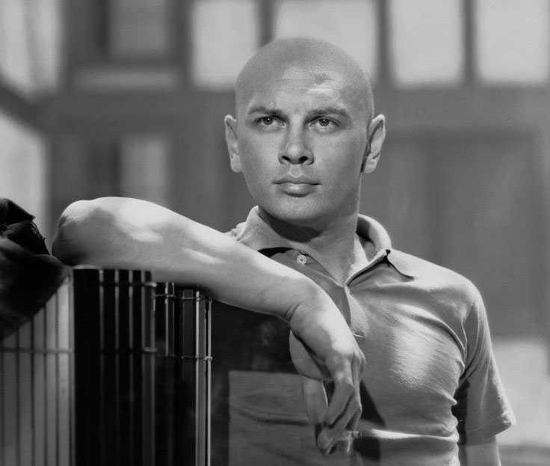
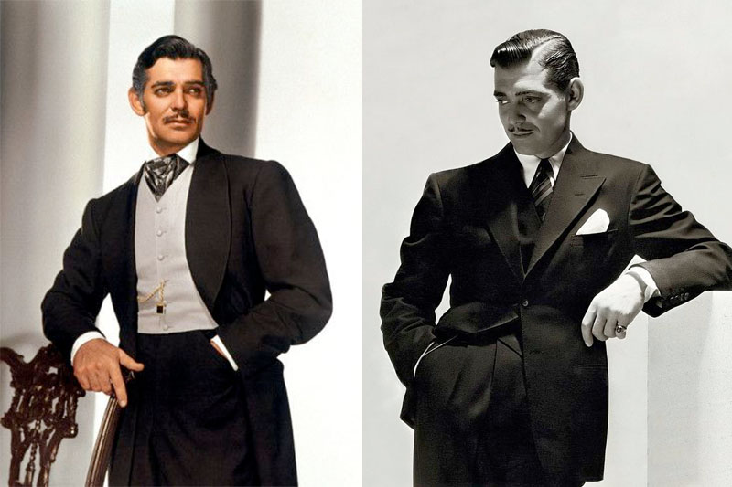
DEFINITION OF TERMS
Comportment: This is the way or manner in which one conducts oneself. It is also deportment (formal), carriage (formal), demeanor, style, manners, attitude and behavior. Comportment also has to do with the way somebody behaves. Your comportment is the way you act, especially when you behave well. As paramilitary personnel, we are ambassadors of our various Services, thus our behavior speaks volumes of the agency to which we belong.

Slide 6
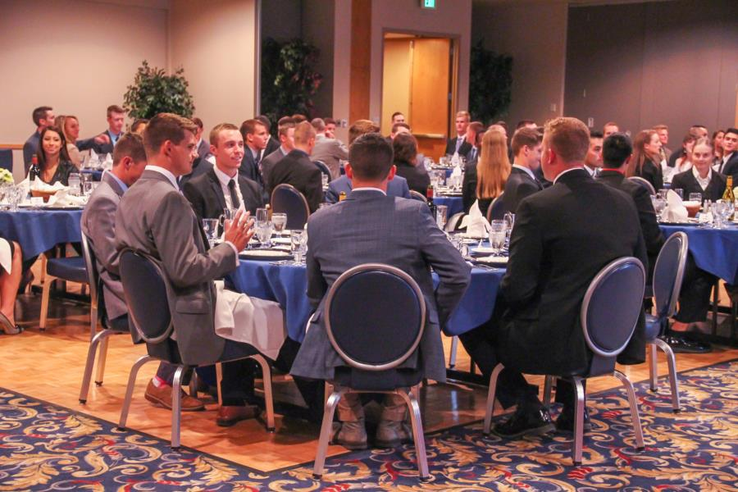
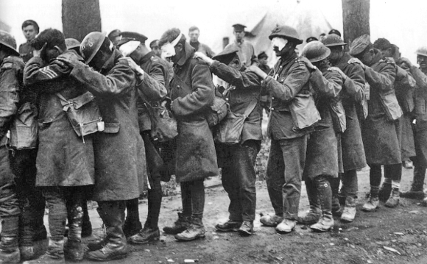
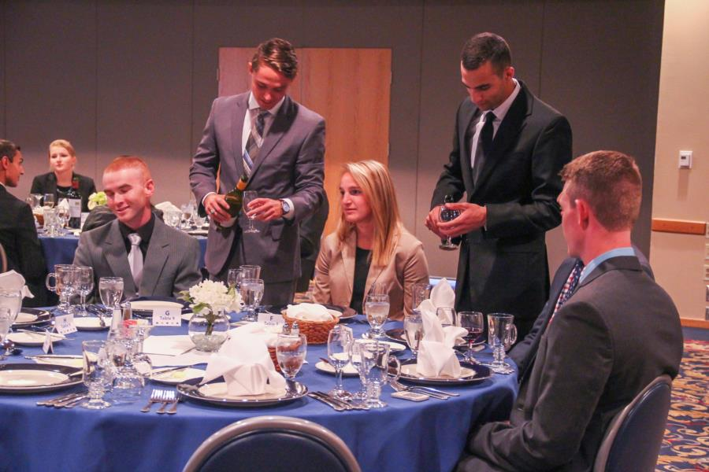
DEFINITION OF TERMS CONTD
Decorum: This is a behavior in keeping with good taste, propriety and dignity that is appropriate to a specific occasion. Decorum has to do with good behavior, propriety, modesty, correctness, appropriateness, restraint, politeness, tact, gentility. Dictionary. Com defines decorum as an observance or requirement of polite society.
All Paramilitary personnel are expected to exhibit a very high level of comportment and decorum in keeping with the job ethics and as gentlemen.

Slide 7
DEFINITION OF TERMS CONTD
Subordinate: A person under the authority or control of another within an organization. The subordinate is lower in rank or position.
Superior: A person higher in station, rank, degree, importance, etc in an organization.
COURTESY: Dictionary. Com (2013) defines courtesy as an excellence of good manners or social conduct or polite behavior. It is also a courteous, respectful or considerate act or expression. For instance it is courteous for a male Officer to allow a female Officer (same rank) to sit down when seats are not enough; provided it does not lead to familiarity.

Slide 8
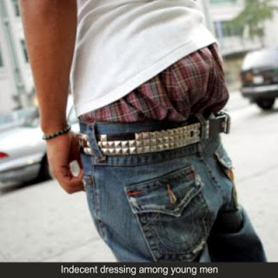
ATTRIBUTES OF COMPORTMENT AND DECORUM
Comportment and decorum can be expressed in staff conduct within and outside the office in the following ways:
Behavior and Conduct: Personnel’s behavior must be exemplary wherever he finds himself. Polite behavior of a gentle man is required of him. He should be friendly and considerate but careful and firm with all.
Dress, Appearance and Carriage: The standard of dressing and appearance of uniform personnel determine in part their level of discipline. Personnel must therefore be smart and well turned out at all times. In using civil clothes, flashy and multifarious colored materials are to be avoided. Good materials and a good tailor will help meet acceptable standards. Remember, “People address you the way you are dressed”.

Slide 9
ATTRIBUTES OF COMPORTMENT AND DECORUM CONTD
Indebtedness: Personnel shall pay all just financial obligations in proper and timely manner especially those inspired by law such as Federal, State or Local taxes or rate, Mess bills, etc.
Savings: All personnel are encouraged to imbibe the culture of saving and to put aside at least some reasonable percentage of their income as savings monthly. They are also advised to take advantage of the available facilities such as mortgage scheme and insurance. The Corporative Scheme which has come to stay in FRSC is also an avenue for saving.

Slide 10
ATTRIBUTES OF COMPORTMENT AND DECORUM CONTD
Insolvency: It is decent to live within one’s means. Personnel should be able to regularize their expenditure to avoid being ‘Hard-up’. All personnel are to refrain from lending and borrowing money. It is forbidden for Officers and men to borrow from subordinates or beyond their financial ability to pay. A Personnel in financial embarrassment is a security risk to the organization and to the nation as he can easily be compromised. Failure to live within one’s means can lead one to bankruptcy and must be avoided.
Public Funds: All staff has responsibility for the funds in their care. They shall ensure safekeeping of the funds. They must keep accurate records of financial transactions and present them for audit when required

Slide 11
ATTRIBUTES OF COMPORTMENT AND DECORUM CONTD
Private Accounts: Every personnel shall keep records of their private account, by filling their cheque counter foils .They are required to always ask for their monthly statement from their banks.
Dud Cheque: It is dishonoring to write a cheque above the amount one has in the bank. All who serve shall avoid issuing dud cheque which may lead to trial.
Utterance and Sounding off: Good manners are determined through people’s utterance. A disciplined personnel does not talk frivolously and must be careful with what he says. He must talk less, listen more and see most.

Slide 12
ATTRIBUTES OF COMPORTMENT AND DECORUM CONTD
Exhibitionism: Exhibitionism means drawing attention to oneself in public places e.g. through shouting, whistling and loud laughter. These are acts of bad manners and must be avoided.
Apologies: Apologies at appropriate time show good manners. For instance, if you interrupt a speaker, you should say ‘I am sorry’. Personnel must endeavor to apologize when there is breach of etiquette occasioned by their own action or inaction .However, apologize only when you are manifestly wrong. Also personnel must weigh the consequences of their actions and be ready to face the outcome.
Keeping Bad Company: It is unacceptable for personnel to be seen among people of questionable character as they are assessed by the type of company they keep. All who serve shall be men of honor and integrity and as such, they must strive to maintain the good image of their organization by avoiding bad company.

Slide 13
ATTRIBUTES OF COMPORTMENT AND DECORUM CONTD
Pocketing: Pocketing one’s hands in uniform does not portray one as disciplined .It makes the Officer or Marshal look arrogant. It is a slight and disrespect to address parade with hands in your pocket.
Lying: This is a dishonest act punishable by law. The image of the liar is tarnished and it is difficult to know when he tells the truth. A liar is prone to many other types of misconduct such as stealing, cheating, etc.
Hand shake: The superior will initiate handshake with the subordinate by stretching out his hand first. The subordinate will respectfully accept the hand in a gentlemanly manner. The subordinate will not slap the superior’s hand nor squeeze it. It is an ungentlemanly behavior to slap or squeeze the hand of your superior.

Slide 14
WORK ETHICS AND ETIQUETTES IN THE WORK PLACE:
Work ethics according to Wikipedia is value based on hard work and diligence. It is also a belief in the moral benefit of work and its ability to enhance character. Workers exhibiting a good work ethic in theory should be selected for better positions, more responsibility and ultimately promotion. Workers who fail to exhibit a good work ethic may be regarded as failing to provide fair value for the wage the employer is paying them and should not be promoted or placed in positions of greater responsibility.
When you have a good work ethic, you are dedicated to job that you deem valuable. You hold yourself to high standards of responsibility. You keep yourself accountable for getting work done right and on time. Having a solid work ethic means you understand that productivity, organizational skills, being reliable and possessing good character are all attributes that successful people share.

Slide 15
CHARACTERISTICS OF GOOD WORK ETHICS
Certain characteristics are required of every individual to promote the good work ethics of an organization. Such characteristics include:
Honesty: stealing personal property, sabotaging a coworker’s idea and making it your own are all ways that dishonesty creeps into the workplace. Employees with strong work ethics refrain from lying or cheating to make others look bad in the hopes of making themselves appear smarter. Instead, they take responsibility for mistakes, own up to failures and keep the lines of communication open with everyone involved.
Refrains from gossip: Workplace gossip can be destructive. When employees gossip about their peers, bosses or even clients, it is considered a deviant behavior. An employee with good workplace ethics refuses to engage in gossip or even listen to it. This person will encourage others to mind their own business, or else address the person or situation head- on so that assumptions and badmouthing can stop. Doing so helps eliminate resentment among coworkers and helps keep morale high.

Slide 16
CHARACTERISTICS OF GOOD WORK ETHICS CONTD
Values Diversity: Paramilitary personnel with good work ethics understand the importance of a diverse workplace. When you value everybody’s contributions regardless of age, ability, gender or race; it gives room for more creativity and better problem solving approach. Diversity in the workplace contributes to successful client interactions as all staff will have a sense of belonging to the progress of the organization.
Corporation: This is an essential ingredient of good work ethic. While work may not always be satisfying or enjoyable, you see the bigger picture and do what is necessary for the team and the organization. Instead of debating every issue and finding reasons why things cannot get done, you use strong conflict resolution skills to solve problems and manage the workload.

Slide 17
CHARACTERISTICS OF GOOD WORK ETHICS CONTD
Respect others: An employee with strong work ethic is rarely late to work or any other official function. He respect everyone’s time, from superiors to subordinates and clients. He is also polite, conscientious of people’s feelings and considerate of workers in a shared workspace. In addition, someone with a strong work ethic uses time wisely so that deadlines are met. Out of respect he will hear and consider everyone’s opinion.
Observes proper office manners: The worst thing, one can do to any organization is to portray it as not having personnel with good manners. Therefore, personnel should endeavor to observe the following:
  Never seat with your feet on your work desk as this gives visitors a bad impression of the organization.
  When a superior who is not your immediate superior enters your office you are obliged to stand up until asked to sit down.

Slide 18
CHARACTERISTICS OF GOOD WORK ETHICS CONTD
  Never keep somebody standing in your office unnecessarily unless he or she is there on disciplinary ground.
  If refreshment is available, such as coffee or tea offer your visitor.
  Never lean or seat on someone’s table while talking to him. If a superior you are visiting does not offer you a seat, remain standing. To lean or seat on another person’s desk presumes a degree of familiarity with the person that should never be displayed in public.
  It is best not to eat in your office. Many people believe that because of the pressure of work they must eat in the office, but there are also good reasons why you must not do so under normal conditions. It is not dignifying to eat in your office. Your office is meant for working and not eating. Give yourself a break no matter how busy you think you may be, you can always find a few minutes to step outside your work area. Find a quiet spot and eat your food.
  Be tolerant with your co-workers. Regard them as members of the team who also contribute to the achievement of your corporate goals. Create a cordial atmosphere in your office by allowing the subordinate to sit down as it is disrespectful for him to do so without your permission.
  Set example for others to emulate. If you encounter someone you dislike suppress your intolerance. Allowing other people to annoy you is evidence of your lack of self discipline.

Slide 19
WORK ETIQUETTE
ETIQUETTE: This is the code of ethical behavior regarding professional practice or action among members of a profession in their dealings with each other (dictionary. Com 2013). Work etiquette is a code that governs the expectations of social behavior in a workplace, group or society. It tells the individual how to behave when dealing with situations in a working environment however trivial the situation is. Office etiquette in particular applies to co-worker interaction and communication with colleagues. There is no universal agreement about standard work etiquette because it varies from one work environment to another.
In our day to day activities as Officers and Men, we come across each other and relate at various official levels. Our workplace etiquette ensures that there is minimal friction among staff in ensuring speedy achievement of organizational goals.

Slide 20
WORK ETIQUETTE CONTD
The following are some work etiquettes which will help paramilitary personnel such as FRSC to work in harmony with codes of ethical behavior expected of them in a workplace:
Relationship between superiors and subordinates: The relationship between superior Officers and their subordinate Officers or between Officers and marshals are based upon firm and friendly foundation of mutual respect without any familiarity. Both Officers and Marshals must have the utmost confidence in each other and a profound sense of pride of belonging to the same Corps. This relationship can best be x-rayed in the words of Gen. H. Norman Schwarzkopf “I admire men of character, and I judge character not by how men deal with their superiors, but mostly how they deal with their subordinates, and that, to me, is where you find out what the character of a man is” (1934).
Attitude towards subordinates: It is an accepted custom of the Para-military and in the best interest of good discipline that a superior Officer will not admonish his subordinate Officer in the presence of his men or more particularly personnel under the subordinate’s command or supervision.

Slide 21
WORK ETIQUETTE CONTD
Familiarity with subordinates: It is improper for an Officer to be familiar with subordinates and over socialize with a subordinate. The same applies generally in official dealings with subordinate Officers. Since existing regulations and custom forbid Service personnel from being familiar with their superiors, it is only common decency that the superior should govern his own conduct accordingly. This custom is not snobbery but is dictated by sound psychological principles that have been proved to be valid. Familiarity does breed contempt. This is not to say however, that an Officer should not have interest in the welfare of his men or subordinates. This should be done without familiarity.
Courtesy to Officers’ wives: All Officers must greet Officers’ wives on meeting them; it is a sign of being a gentleman. All Officers irrespective of their rank will greet Officers’ wives. Officers’ wives when greeted are expected to respond accordingly with respect. A formal salute is not compulsory for Officers’ wives.

Slide 22
WORK ETIQUETTE CONTD
Social calls: Social calls are calls by Officers or men on their superiors or colleagues to show solidarity in times of joy or sadness. Social calls foster spirit of togetherness and esprit de Corps among Officers and men. While a neat and presentable mufti could be worn during the occasion, social calls could also be made in uniform. However, it is not appropriate to make social calls in sport outfit as it is ungentlemanly.
Use of sir: As a general rule, sir is used in speaking either officially or socially to any superior. The word is repeated with each complete statement. ‘Yes or no’ should not be used in speaking to a superior without including ‘SIR.’ However ‘SIR’ should not be used at every breath to the point of being slavish.
Use of umbrella: It is unethical for paramilitary personnel to use umbrella while in uniform, Officers and men are to wear rain coats instead.

Slide 23
WORK ETIQUETTE CONTD
Place of honor: The place of honor is to the right. Accordingly, when a subordinate Officer walks, rides or sits with a superior, the subordinate must take position to the left of the superior. The subordinate is to walk in-step with the superior, step back and allow the superior to be the first to use the door when they are entering an office. When two (2) subordinate Officers are walking with a superior Officer they are to flank the superior Officer but the one to the right must make room for the superior Officer to take salute appropriately. When approaching a door, the junior among the two Officers should walk faster and open the door for the superior Officer and also allow the superior Officer to use the door first.
Employment outside FRSC: Service personnel are not allowed to concurrently engage in any other employment or trade except they resign from the Corps or apply for Leave Of Absence. However, serving personnel are allowed to engage in agriculture i.e. crop farming, fishery, livestock etc

Slide 24
WORK ETIQUETTE CONTD
Membership of Association: Serving personnel who are members of professional associations must formally declare their membership in writing to the Corps. Personnel who are members or Officers of non government association or organizations must avoid participating in activities on behalf of the association or organization that are incompatible with the official government position. They are to relinquish their membership of the given association if their position and responsibilities are in conflict with their position as government employees.
Official Knock: In line with paramilitary customs, one rap on the door is considered to be official knock and is the warning for persons in the room to be ready for an official visit. The official knock is used by senior Officers while other Officers and men entering into the same office will knock twice if the occupier of the office is their senior.
Acceptance and Use of Titles: Officers and men shall obtain the written permission of their organizations before accepting any title bestowed on them by non military or paramilitary institutions. The use of chieftaincy title is not allowed for serving personnel.

Slide 25
WORK ETIQUETTE CONTD
Employment by Other Government and Organization: Serving personnel will not be employed under any government and organization other than that of Nigeria except when such employment has been sanctioned by the appropriate authority.
Loyalty to the Corps: Officers and Men shall not ridicule their organization in the presence of civilians. They shall not pass cynical comments on superior Officers and authority; esprit-de-corps must be maintained at all times. Loyalty should not only be pronounced by word of mouth it must be demonstrated. All orders are to be obeyed without questioning or grudges.
Protecting the good image of other Commands: Serving personnel are to protect the good image of other Commands as their own. They shall give appropriate courtesy to other commands and formations and they must not run them down.
Respect for Chain of Command: All Officers and men must always follow the proper chain of command in all the day to day official engagements
Restraint from political activities: Service personnel are not allowed to participate in the affairs of any political organization or party. All forms of political activities including political meetings and speeches are prohibited in Para-military offices.
Sanctity of Marriage and Family Life: The Para-military respects and recognizes the institution and sanctity of marriage and encourages its personnel to uphold it. An Officer must introduce his fiancée/fiancé and obtain the permission of the organization before getting married.

Slide 26
WORK ETIQUETTE CONTD
Dedication to Duty: A good Officer never gives up and never compromises his duty. A good Officer will not abandon his Marshals except if doing otherwise will jeopardize the nation. Dedication to duty requires unrelenting respect and consistent determination to do what is right with pride. All who serve are required to demonstrate the highest level of dedication to duty.
Use of Phones: Most personnel have more contact with the public on the telephone than anywhere else. This is particularly true of Officers and Men who serve in Commands/ formations. It is essential that proper telephone courtesy is observed at all times because failure to do so will give callers wrong impression of your Command/ formation.
  Mobile phones will be switched off during conferences, parades and other official gatherings where living them on might result in distraction of official assignment. Subordinates will switch off their phones before entering a superior’s office. A distraction from the phone will portray lack of courtesy.
  Never shout over the phone during conversations. This could cause distraction to others.
  It is unethical to discuss official matters on phone in the public. This attitude could lead to divulging official information.

Slide 27
COURTESY AND ETIQUETTES AS A GUEST
Many times during your career you will have cause to visit or stay with people or another family as a guest. You should always be appreciative when other people open their homes to you and you should do your best to be a courteous guest during your stay. Always remember the following points:
When staying with someone else you should conform to the habits of that household by keeping the same meal hours, going to bed and rising the same time as they do.
Unless you are specifically invited to stay for a certain number of days, make your stay as short as possible.
Be sure to acquaint your host with your departure plans and leave on time.
If you dine with the family be punctual at meal time.
Keep your room neat always, make your bed every day and be sure that the bathroom is kept tidy after use.
If you are the host, never let your guest take public transportation when you can provide, drive the guest to the nearest terminal.
Show appreciation for the good gesture of your host by verbally expressing your gratitude. This could be reinforced with souvenirs where possible.
It is appropriate to give souvenirs to visitors to your Command or formation. It is in conformity with paramilitary tradition for Officers and men attending foreign institutions to give Nigeria souvenirs to their respective course members.

Slide 28
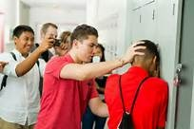
TABOOS
A taboo is a vehement prohibition of an action based on the belief that such behavior is either too sacred or too accursed for ordinary individuals to undertake, under threat of supernatural punishment. Such prohibitions are present in virtually all societies. The word has been somewhat expanded in the social sciences to strong prohibitions relating to any area of human activity or custom that is sacred or forbidden based on moral judgment and religious beliefs. "Breaking a taboo" is usually considered objectionable by society in general, not merely a subset of a culture. The following are taboos in all Para-military organizations:
Discrimination and harassment. All personnel have the right to live and work in an environment free from harassment, discrimination and intimidation. As an Officer, you are required to carry your men and your colleagues along. Note that the assignment you have at hand can be better achieved through good team spirit.
Bullying: Bullying involves forcing other people to do
things against their wish. It entails the use of physical strength
or the abuse of authority to intimidate or victimize others or
to give unlawful punishment. Bullying is an unacceptable
behavior which will undermine trust and respect.
Social Conduct: As personnel, you must not sexually abuse subordinates. Amorous relationship with the spouses and dependants of Officers and men in any form are not allowed.

Slide 29
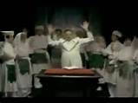
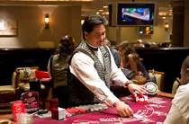
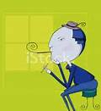
TABOOS CONTD
Cult and secret societies: All personnel are forbidden from
associating with or being members of cult and secret societies.
Gambling: It is ungentlemanly for serving personnel to engage in any form of gambling, except those organized by their Commands/ formations at social functions i.e. Tombola night, WASA, Regimental Dinner, etc.
Drunk and reckless driving: All personnel either in service
or personal vehicles must avoid drunk and reckless driving
and driving under the influence of alcohol.
Smoking: It is against paramilitary discipline for serving personnel to smoke while on parade ground. They must not smoke with headgear on. While it is permissive to smoke outdoors, it must not be done at formal ceremonies. In public places do not light up without asking other persons present ‘Do you mind if I smoke? FRSC forbids her personnel from smoking in any occasion that is organized by the Corps’. It is indecent for paramilitary personnel to be seen smoking while in uniform on the following occasions;
  When saluting.
  Moving outside his office.
  Marching with Officers and Marshals .
  On parade ground.
  Acting as a reviewing Officer.
  At the conference or lecture unless permitted to do so by the senior Officers present

Slide 30
TABOOS CONTD
Cosmetics and Jewelry: Gentlemen do not go around highly scented or with powder puff marks on the face, neck, or ears. It is improper for Officers or men to wear beads, bangles or chains while in uniform. When spraying perfume, Officers should not spray it directly on their uniforms to avoid stains.
Use of Language: Personnel shall not use abusive language on themselves. Mutual respect must exist in all aspect of their relationship.
Respect for ones’ and others families: Personnel are to respect their families. A man or woman should be a partner at home to the wife or husband and not a dictator. There must be mutual respect and concern between and among families. It is unethical to have amorous relationship with wives, husbands, daughters, sons or wards of fellow service personnel. Fighting or any form of violence must be avoided within and outside the family.
Marriage of Officers to Men: If an Officer and the other rank in service want to be married, either of them must relinquish his or her commission or discharge from the organization before marriage. It is unethical and must never be allowed for Officers to marry other ranks. This is to ensure that decorum and a high level of respect exists within the organization.

Slide 31
CONCLUSION
It is not possible to list all acceptable and all unacceptable behaviors. However, any behavior that damages trust, degrades an individual, undermine respect for authority or bring their Services to disrepute are not to be tolerated, while those that will promote the good image of the Organization should always be upheld by all its personnel.

