Slide 1
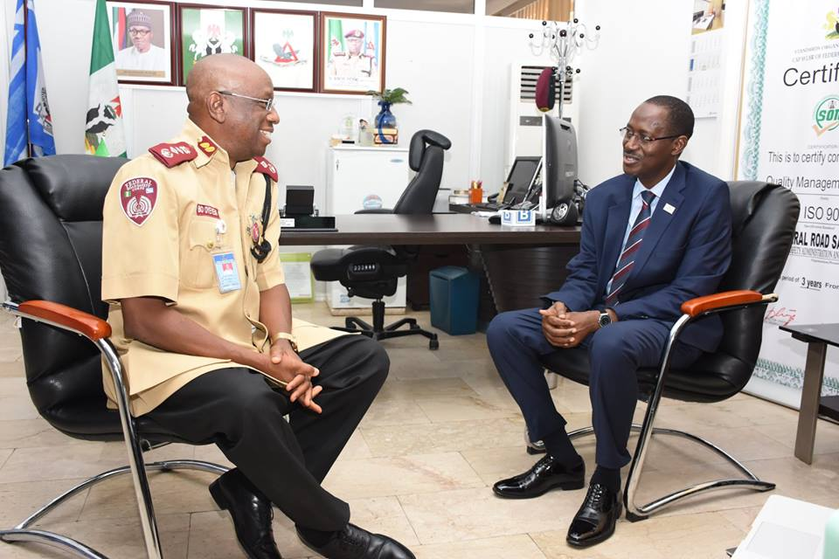
HOW TO MAKE COMMUNICATION EFFECTIVE IN THE CORPS
through basic Principles and attention to Details
With Inputs from:
ADELOLA ADELANI
Boboye O. Oyeyemi, Ph.D.
March, 2019
MFR,mni,NPoM,FNIM,FCIPM,FCILT
Corps Marshal, FRSC-Nigeria

Slide 2
Presentation Outline
What is Communication
Types of Communication
What is Effective Communication
Barriers to Effective Communication
Overcoming Communication Barriers
Communication Skills for workplace Success
Tips for Effective Communication
What does attention to detail mean?
Why Is It Important to Pay Attention to Detail?
How to Improve Attention to Details at Work

Slide 3
What is Communication?
Communication is a very basic and fundamental process for human beings. It is the act of sending information or ideas via speech, visuals, writing or any other of such method. The Communication model has a sender who is sending the message and the receiver who is receiving the message.
The dictionary defines communication as a ‘process by which information is exchanged between individuals through a common system of symbols, signs or behaviors.
FEEDBACK
channel
Source
encoding
decoding
receiver

Slide 4
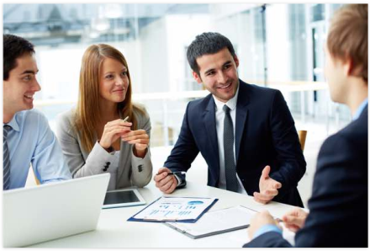
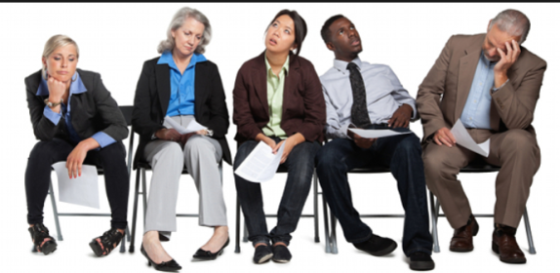
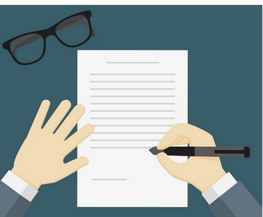
Types of Communication
Basically, there are 5 Types of Communication:
Verbal Communication: Verbal communication can also be referred to as Oral communication. In very simple terms, any communication that happens orally between people is known as verbal communication. The objective of such communications is to ensure that people understand whatever you want to convey.
Non-verbal/Interpersonal Communication: How do you make people feel when you enter the room? Is your body language strong and are you standing straight or are you slouched and tired? Are you clean shaven, looking your immaculate best for a team meeting or are you shabby with shirts that are not ironed? All these are examples of Non-verbal/interpersonal communication.
Written Communication: It involves any type of communication that makes use of the written word. Written communication is the most important and the most effective of any mode of business communication.

Slide 5
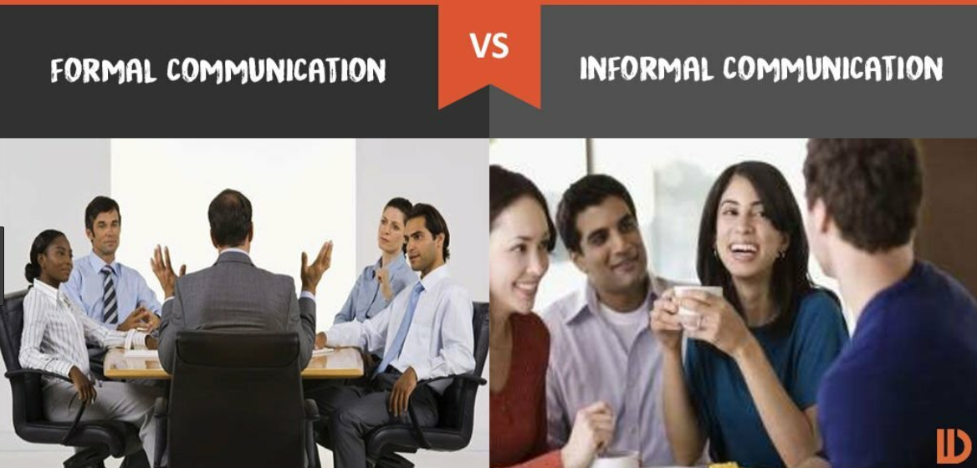
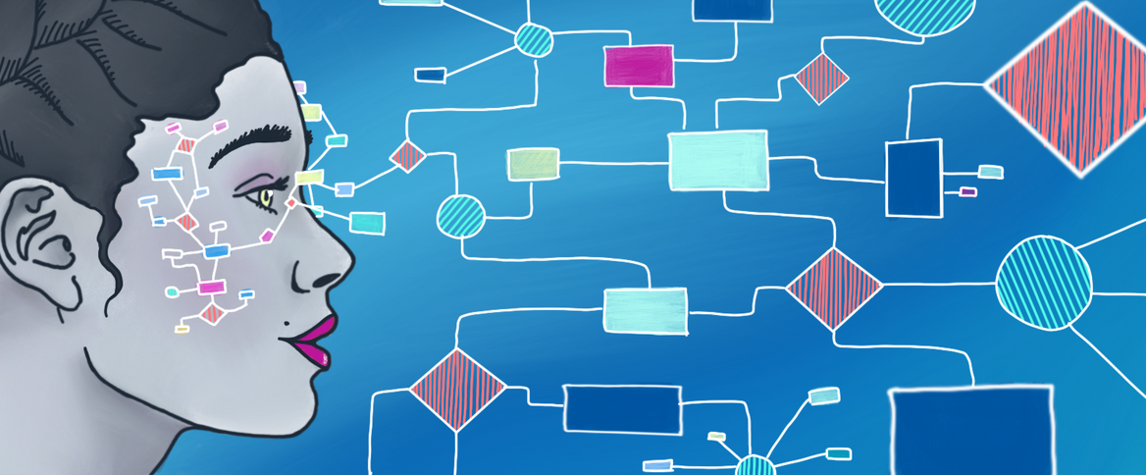
Types of Communication (Cont’d)
Formal/Informal Communication: These are the two types of communication when considering the formality of the communication. Formal communication is the official kind of communication which can be through emails, letterheads, memos, reports and other such kinds of written material. Informal Communication is one where there is nothing official about the communication that is happening. E.g. Social Media
Visual Communication: Many different industries are using visual communication to help interaction with their customers so that they can communicate their ideas better. It involves a visual display of the information you intend to communicate to your audience.

Slide 6
What is effective Communication?
An Effective Communication is a communication between two or more persons wherein the intended message is successfully delivered, received and understood with a feedback.
Effective communication in the organization enables the employees to deepen their connection with others and improve teamwork, decision-making, and problem-solving capacity. The communication is a skill which is learned, and an individual can gain spontaneity in it by putting in his extra efforts and participating in more public conversations.

Slide 7
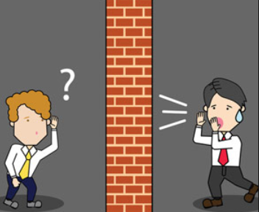
Barriers to effective communication
Language Barrier: Language and Linguistic ability may act as a barrier to communication. However, even when communicating in the same language, the terminology used in a message may act as a barrier if it is not fully understood by the receiver(s).
Psychological Barriers: The psychological state of the communicators is a great influencer on how the message is sent, received and perceived. Examples of Psychological barriers are:
Stress: A stressed person may be preoccupied by personal concerns and not as receptive to the message as if they are not stressed.
Anger: This is another example of a psychological barrier to communication. When angry, it is easy to say things that we may later regret, and also to misinterpret what others are saying.
Low Self-Esteem: Persons with low self-esteem may be less assertive and therefore may not feel comfortable communicating. They feel shy or embarrassed about saying how they really feel, or read unintended negative sub-texts in messages they hear.

Slide 8
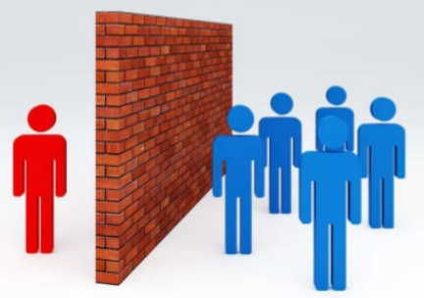
Barriers to effective communication (Cont’d)
Physiological Barriers: This barriers to communication may result from the receiver’s physical state. For examples, a receiver with reduced hearing may not fully grasp the content of a spoken conversation especially if there is significant background noise.
Physical Barrier: Communication is generally easier over shorter distances as more communication channels are available and less technology is requires. The ideal communication is face-face.
Systematic Barriers: Systematic barriers to communication may exist in structures and organizations where there are inefficient or inappropriate information system communication channels, or where there is lack of understanding of the roles and responsibilities for communication.
Attitudinal Barriers: Attitudinal barriers to communication may result from personality conflicts, poor management, resistance to change or lack of motivation

Slide 9
Overcoming Communication Barriers
CONNECT WITH AUDIENCE
SUMMARIZE WHAT WAS SAID
SIMPLE WORDS
EFFECTIVE COMMUNICATION
EFFECTIVE QUESTIONS
BODY LANGUAGE
SEEKING PARTICIPATION
CULTURAL SENSITIVITY
CHECKING FOR UNDERSTANDING

Slide 10
Communication Skills for workplace Success
Listening: Being a good listener is one of the best ways to be a good communicator. If you're not a good listener, it's going to be hard to comprehend what you're being asked to do.
Non Verbal Communication: Your body language, eye contact, hand gestures, and tone of voice all color the message you are trying to convey. Also, pay attention to other people's nonverbal signals while you are talking. Often, non-verbal signals convey how a person is really feeling. For example, if the person is not looking you in the eye, he or she might be uncomfortable or hiding the truth.
Clarity and Concision: Good verbal communication means saying just enough – don’t talk too much or too little. Try to convey your message in as few words as possible with an understandable language.
Friendliness: Through a friendly tone, a person asking question, or simply a smile, you will encourage your coworkers to engage in open and honest communication
Confidence: It is important to be confident in your interactions with others be it client or coworkers. Confidence shows your coworkers that you believe in what you’re saying and will follow through.

Slide 11
Communication Skills for workplace Success (Cont’d)
Empathy: Using phrases as simple as “I understand where you are coming from” demonstrate that you have been listening to the other person and respect their opinions
Open-Mindedness: A good communicator should enter into any conversation with a flexible, open mind. Be open to listening to and understanding the other person's point of view, rather than simply getting your message across.
Respect: People will be more open to communicating with you if you convey respect for them and their ideas.
Feedback: Being able to appropriately give and receive constructive feedback is an important communication skill…be it through email, phone calls, or weekly status updates

Slide 12
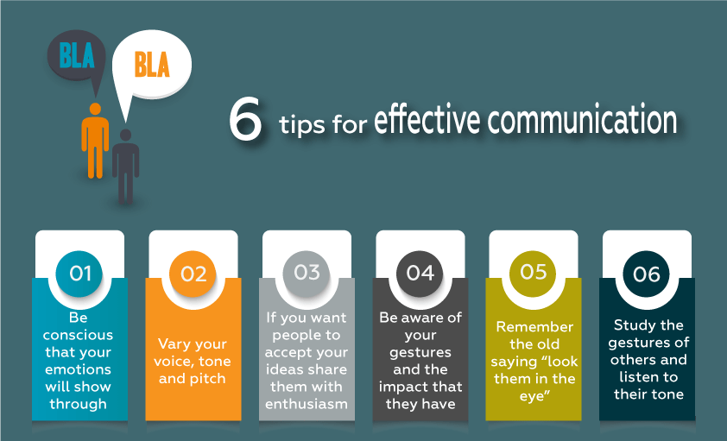
Some Essential Tips for Effective Communication

Slide 13
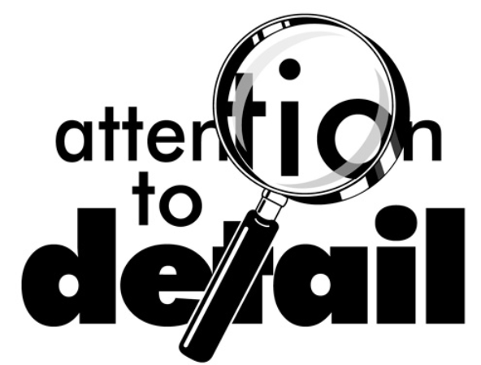
Attention to details
Attention to detail is the ability to achieve thoroughness and accuracy when accomplishing a task. As many employers seek this skill, it is not surprising to see many students list on their resume that they have ‘strong attention to detail’.
We all know that attention to detail is important because it helps prevent mistakes and makes success in the workplace easier. The problem is that being attentive to detail can be nearly impossible when you’re at work and your boss and colleagues keep distracting you, or you’re one of those people who just can’t focus.

Slide 14
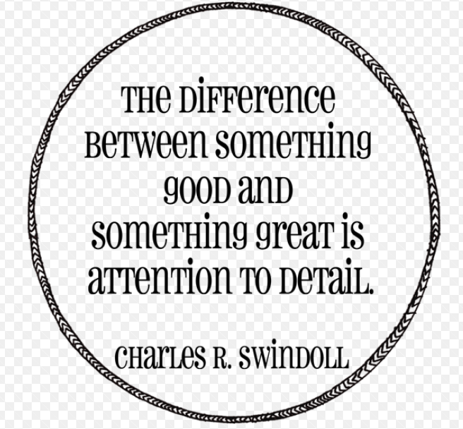
Why Is It Important to Pay Attention to Detail?
Paying attention to details is important for avoiding errors, maintaining efficiency, preventing injuries, making a good impression and analyzing information.
Attention to detail improves accuracy in performing tasks.
Sufficient attention to detail helps to reduce the potential for injuries.
Making a positive first impression is part of the foundation for building professional and personal relationships.
Detail-oriented individuals are preferred as employees by many businesses for their analytical and problem solving abilities.

Slide 15
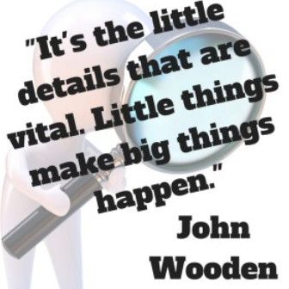
Attention to Details – Behavioral Indicators
− Provides accurate, consistent numbers on all paperwork
− Provides information in a useable form and on a timely basis to others who need to act on it
− Maintains a checklist, schedule, calendar, etc. to ensure that small details are not overlooked
− Follows policies, procedure, safety and security measures in using various equipment
− Work requires little or no checking
− Writes down important details in messages or communications so the details are not lost or forgotten

Slide 16
How to Improve Attention to Details at Work
Create a Work Plan: Create a detailed work plan that outlines the individual elements of each of your key job functions. Use the work plan as a guide if you find yourself becoming distracted or frequently interrupted. Let the plan double as a checklist to verify that each step or critical task has been completed.
Make Lists: If you have a number of things you need to accomplish in a particular time frame, make a list and check off each item as it's completed. If you can’t finish everything on the list, start a new list for the next day and include those leftover tasks.
Plan in Advance: In addition to making daily lists, create long-term lists of projects that need your attention in the near future. For example, if you know you have a presentation at a board meeting in two weeks, mark a reminder on your calendar noting when you need to start developing your materials. When that date arrives, transfer the task to your daily list.
Maintain a Schedule: If you set aside a certain amount of time to devote to specific tasks, you're more likely to stay focused and finish the project with no interruptions or delays.

Slide 17
How to Improve Attention to Details at Work (Cont’d)
Plan in Advance: In addition to making daily lists, create long-term lists of projects that need your attention in the near future. For example, if you know you have a presentation at a board meeting in two weeks, mark a reminder on your calendar noting when you need to start developing your materials. When that date arrives, transfer the task to your daily list.
Limit Distractions: Distractions reduce your ability to pay attention to detail. If you work in an office, close your door, forward your phones or set specific office hours when you're available for unscheduled visitors. Reduce ambient noise with headphones if you find the sounds bothersome.
Avoid Overloading Yourself: When you add more work and pressure to a schedule than your brain can fully comprehend and process, your productivity and effectiveness can decline. Know your limits and try to avoid last-minute deadlines, large simultaneous projects and overscheduling.
Ask for Help: Employ trusted colleagues to look over your work and offer them the same courtesy. If you’ve read the same report over and over again, you’re likely to be so familiar with the content that you miss errors and typos. A fresh set of eyes can help catch mistakes.
Take Care of Yourself: When you’re at work, get up and walk around, take in fresh air and distance yourself from complex projects before going back to double check details. When you’re at home, eat a healthy diet and get plenty of sleep and exercise. These practices will help you stay sharp and focused so you're more likely to pay attention to detail.

Slide 18
Conclusion
It is observed in the Corps that a wide communication gap exists between Commanding Officers and their subordinates particularly in the area of seamless responsibility take-overs.
This is purely the result of ineffective communication.
Commanding Officer
Subordinates

Slide 19
Conclusion (Cont’d)
For the Corps to get every aspect of its administration right as it concerns Human Resources and Human Capital Development and to forestall rumour mongering, information that should be on public domain must be made accessible to staff.

Slide 20
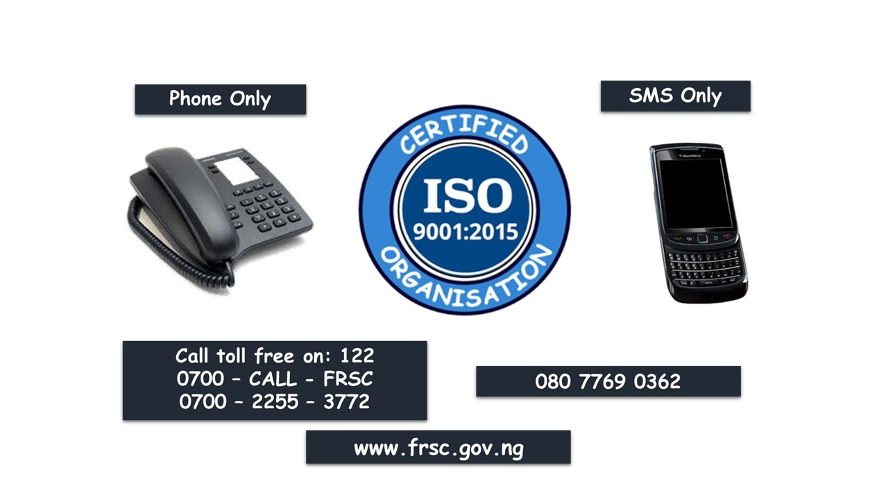
THANK YOU

