Slide 1


THINKING OUTSIDE THE BOX II
Tue, 28 Jan 2020 | RSHQ
Critical Thinking:
A Veritable Vehicle towards Accomplishment of the FRSC 2020 Corporate Strategic Goals
Boboye O. Oyeyemi, Ph.D
MFR,mni,NPoM,FNIM,FCIPM,FCILT
Corps Marshal, FRSC- Nigeria.

Slide 2

Presentation Outline
∙ Introduction
∙ What the UN says about “Goals”
. The Concept of FRSC Corporate Goals
∙ Corporate Strategic Goals (Beginning of Critical
Thinking for the year 2020)
∙ 2020 Goals and the Specific Objectives
. Critical Thinking: The Veritable Vehicle
∙ Steps to Take to Improve In Critical Thinking
. Critical Thinking and FRSC Service Delivery
. Critical Thinking : A Summary
∙ Conclusion

Slide 3
Introduction
Responsibilities of Policy Makers in Road Traffic Crash Reduction
Performance Review or Target Setting has been Identified as one of the main Key Responsibilities of Policy Makers in Road Traffic Crash Reduction worldwide
Enactment of effective Laws and Regulations on Road Safety
Sustainable funding for road safety programmes and activities
Setting of targets and its review/ evaluation
Development of Road Safety Standards
Alignment with International Conventions on Road Safety
Development of National Road Safety Strategies

Slide 4
Introduction (Cont’d)
Similarly, just as:
Road Safety Public Enlightenment
Enforcement
Mere Entertainment
So is Road Safety Policy/ Plan without Performance Targets

Slide 5


What the UN says about “Goals Setting”.
According to the UN Global Plan for the Decade of Action for Road Safety 2011-2020, the overall goal of the Decade is to stabilize and then reduce the global forecast level of road traffic fatalities by 2020. This would be attained through:
• Adhering to and fully implementing the major United Nations road safety related agreements and conventions, and use others as principles for
promoting regional ones, as appropriate;
• Developing and implementing sustainable road safety strategies and
programmes;
• Strengthening the management of infrastructure and capacity for technical
implementation of road safety activities at the national, regional and global
levels;
• Improving the quality of data collection at the national, regional and global
levels;
• Setting an ambitious yet feasible target for reduction of road fatalities by
2020 by building on the existing frameworks of regional casualty targets;

Slide 6
The Concept of FRSC Corporate Goals
Corporate Goals in the Corps was adopted in the FRSC Performance Management System (PMS) model adopted in year 2010 and made fully operational in year 2011.
The Corps has been consistent with this practice till date thus ensuring that targets set provides some institutional guidelines and direction for programmes and activities on Road Safety improvements in Nigeria
2010
2011
2012
2013
2014
2016
2018
2015
2017
2019

Slide 7

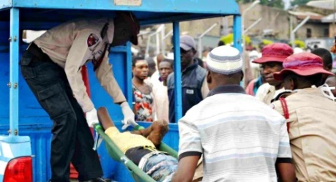
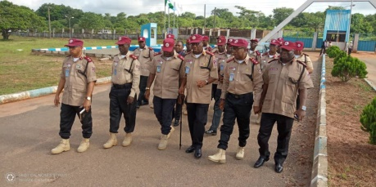
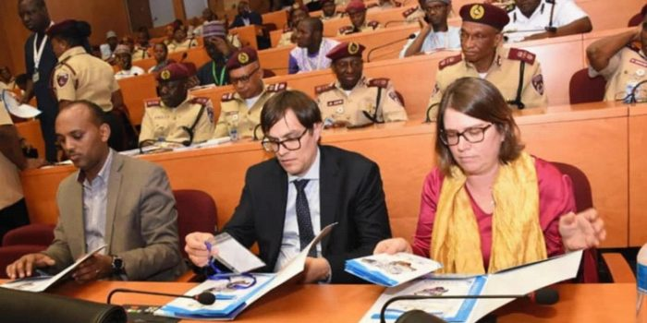

FRSC | 2020
Corporate Strategic Goals (Beginning of Critical Thinking for the Year 2020)
1
Minimize the Risk of Death in Road traffic:
Reduce;
RTC by 15%
Fatality by 20%
2
Improve personnel capacity and competence in Road Safety Management
3
Broaden and Sustain Stakeholders Engagement.
4
Reposition, Strengthen and Sustain Road Safety Programmes.

Slide 8
2020 Goals and The Specific Objectives
The Specific Objectives
Goal 1:
Minimize the Risk of Death in Road Traffic
Reduced:
-RTC by 15%
- Fatality by 20%
Reduce RTC and Fatality.
Prompt response to RTC.
Encourage Community Responders/Stakeholder’s involvement.
Improve data collation and analysis for proper planning and appropriate intervention.

Slide 9
2020 Goals and The Specific Objectives
The Specific Objectives
Goal 2:
Improve personnel capacity and competence in Road Safety Management
Effective training program for staff.
Collaborative training with other Agencies..
Build competencies in staff.

Slide 10
2020 Goals and The Specific Objectives
The Specific Objectives
Goal 3:
Broaden and Sustain Stakeholder’s Engagement
Develop a digital platform for harnessing all stakeholders of the Corps.
Categorize FRSC Stakeholders based on priority, programmes and relevance to be suitably engaged for Road Safety.
Improve on FRSC External Relations
Make NRSP more functional and derivable.

Slide 11
2020 Goals and The Specific Objectives
The Specific Objectives
Goal 4:
Reposition, Strengthen and Sustain Road Safety Programmes
Prompt Response to RTCs to reduce fatalities and promote recovery.
Promote safety consciousness and professionalism among road transport and driving school operators.
Promote standardization among Road Traffic Management Agencies.
Promote discipline among road users while on the highway.
Promote the constructions of forgiving roads in line with International standards.

Slide 12
CRITICAL THINKING
THE VERITABLE VEHICLE

Slide 13

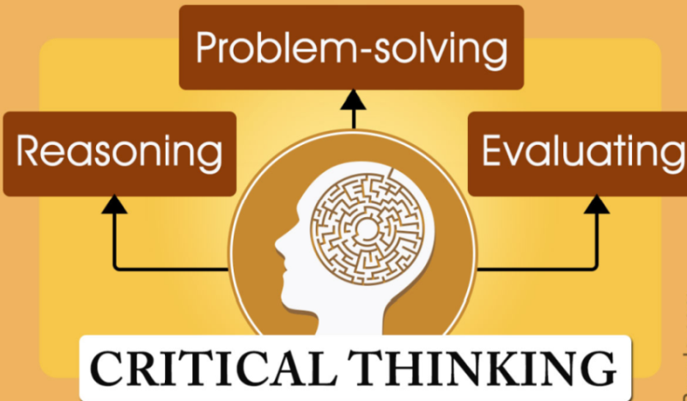
Critical Thinking: THE VERITABLE VEHICLE
WHAT IS CRITICAL THINKING:
Critical thinking is the analysis of facts to form a judgment.
The subject is complex, and several different definitions exist, which generally include the rational, skeptical, unbiased analysis, or evaluation of factual evidence. Wikipedia

Slide 14
Critical Thinking: THE VERITABLE VEHICLE
WHY WE NEED TO INDULGE IN CRITICAL THINKING:
We are in an organization charged with enormous humanitarian responsibilities which are not local but also of global concern and subject of collective approach to achieve. The level of achievement in each country, however, will depend on the quality of personnel who are to implement the various programmes, in office and outside the confines of the offices.
There is no doubt that FRSC is known to have been quite innovative in the discharge if it's responsibilities, this much is reflected in the numerous programmes initiated over the years but having initiated such programmes, there is need for even more critical thinking to sustain them as well as being about best global approach and result.

Slide 15
Critical Thinking: A Necessity for Improved Service Delivery
Thinking smarter and
aiming higher
WHAT CRITICAL THINKING WILL ACTUALLY DO FOR US
b. Taking a stand for oneself (higher order of thinking)
c. Self discovery and
exciting adventure

Slide 16
Critical Thinking: A Necessity for Improved Service Delivery (Cont’d)
d. Filtering oneself with the value of wrong and right. Helps to avoid mistakes and improves our judgement and evaluation skills
WHAT CRITICAL THINKING WILL ACTUALLY DO FOR US
e. Keeps us up to date with contemporary issues
f. It makes one independent and responsible for decisions taken; therefore, taking full ownership of decisions

Slide 17
Critical Thinking: A Necessity for Improved Service Delivery (Cont’d)
g. Assists to make logical and informed decision based on our own values
WHAT CRITICAL THINKING WILL ACTUALLY DO FOR US
h. Encourages coherent outlines possible towards problem solving
i. Generally, it increases the number of positive decisions made and thus also make service delivery easier and more qualitative.
J. Encourages scientific discoveries and consideration of lots of theories
Source: http://www.potential.com

Slide 18
Characteristics Of Critical Thinking:
Critical thinking has the following critical elements:
Creativity and foresightedness
b. Reflectiveness (Consideration of previous experiences to bring up other ideas)
c. Evidence evaluation (e.g. Overloading, Speeding & Use of Phone)
- what is relevant
what is sufficient for decision making
what is correct
d. Adaptiveness (Adapting the new ideas to contemporary/operating environment)

Slide 19
Characteristics Of A Critical Thinker:
Creativeness and foresightedness (Receptiveness to ideas/info)
b. Constantly reflective and adaptive (Institutional memory as guide)
c. Relies on evidence/information to reach conclusion on matters (Research mindedness).
d. Researches and listens to opinions (Able to reach workable conclusion)
e. Confident and progressive (Devoid of negative thoughts and assertions)

Slide 20
Characteristics Of Critical Thinker (Cont’d)’
f. Busy and occupied positively at all times (Always wanting to be at the top of issues)
g. Elevates organizations through quality in put (A good team player)
h. Happy and always ready to serve (A critical stakeholder, almost indispensable)

Slide 21
Characteristics Of Critical Thinker (Cont’d)’
Encourages Team Work
Team building
Team goals
Team spirit
Basic principles of team work:
Effective Communication amongst team members
Reliable team members
Good approach to conflict management
String and effective leadership
Effective allocation of resources
Mutual respect amongst team members
Constructive working relationship
Positive approach to diversity and equality
www.sqaacademy.org.uk

Slide 22

Steps To Take To Improve In Critical Thinking
Have clear view of issues (what are those things concerned)
b. Gather information and sift through them to determine whether they are suitable, relevant or not (All at the background of experience/prevailing situation)
c. Consider the implications whether of short, medium or long term benefits (prioritization and guide against unintended consequences)

Slide 23
Critical Thinking and FRSC Service Delivery in Field Commands

Slide 24
Administration and HR
Unauthorized intra-Zonal posting of staff
Not releasing or delay in the release of staff on posting
Disclosure of classified information/documents
Abuse of the us of the social media
Self development
Leadership succession and mentorship
Monthly allocation and sub-heads disbursement
Operations
Speeding - Command administration
Overloading - Monitoring
Use of phone - Free vehicles checks etc
Observatory
Free Vehicles Safety Checks
Knock down cases
Combating corrupt practices

Slide 25
Performance and Evaluation
APER Issues
- Procedural flaws
- Arbitrary allotment of staff to assessors
- Internet/accessibility
Does our performance review really helps us to get the most of our staff?
Does it really help us to get most of our staff?
Does it do more harm than good?

Slide 26
Training
Quality In-House: Training/Workshop/Seminar content.
Unauthorized further studies
FRSC Staff College
Marshals’ College
TSD
Vehicle and Building Maintenance
Utilities and bills
E- Tablets
Diligent equipment utilization

Slide 27
Driving Schools
Supervision and service delivery
State Committees and duty dispensation
Personnel and Office Security
Physical Security - Guard Duties
Surveillance & Intelligence gathering
Weekend Commands’ porosity
Personal life and security
Legal
Increase in Mobile Courts
Rising Civil/ Criminal cases
Lawyers attendance of Courts & Wardrobe allowances

Slide 28


Socialization and Stake holding
Stakeholders engagement
Intelligence sharing and spirit de corps
State committees on Road Safety
Medical & Health Matters
Non-disclosure of critical staff health statuses
Regular/Annual medical test re-introduction
Declaration of Health Week and activities thereto
Monthly Walking and Jogging
Weekly sporting activities

Slide 29
Critical Thinking: A Summary
Critical thinking is aimed at achieving the best possible outcomes in any situation. In order to achieve this it must involve gathering and evaluating information from as many different sources possible.
b. Critical thinking requires a clear, often uncomfortable, assessment of your personal strengths, weaknesses and preferences and their possible impact on decisions you may make.
c. Critical thinking requires the development and use of foresight as far as this is possible. As Doris Day sang, “the future’s not ours to see”.

Slide 30
Critical Thinking: A Summary (Cont’d)
d. Implementing the decisions made arising from critical thinking must take into account an assessment of possible outcomes and ways of avoiding potentially negative outcomes, or at least lessening their impact.
e. Critical thinking involves reviewing the results of the application of decisions made and implementing change where possible.

Slide 31
Conclusion
From this presentation, it is clear that for the Corps to move forward towards achieving the 2020 Corporate Strategic Goals, we must approach issues differently with the benefits of hindsight, making informed conclusions and implementing them in a sustainable manner such that processes and programmes run without hitch.
It is, therefore, imperative that we put on our thinking cap to constantly be alert and think critically at all times, as attested to by many Scholars and leaders of thoughts who have left us with reminders on this great values:

Slide 32
Conclusion (Cont’d)
If everyone is thinking alike, then somebody isn't thinking - George S. Patton.
To change your reality, simply stop thinking like that - Neale Donald
Everyone wants to live on top of the mountain, but all the happiness
and growth occur while you're climbing it - Andy Rooney
Those who do not think outside the box are easily contained - Nicolas
Manetta.
Being different and thinking differently makes a person
unforgettable. History does not remember the forgettable. It
honours the unique minority, the majority cannot forget - Suzy
Kassem.

Slide 33
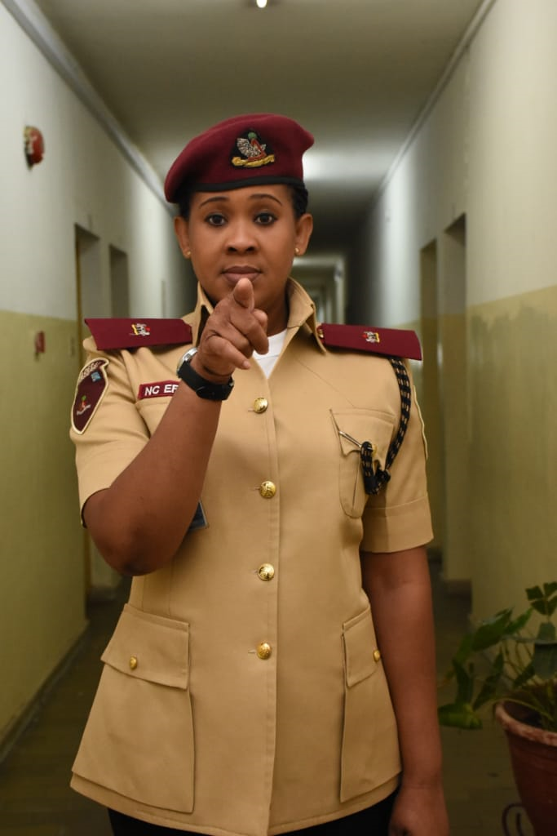
Critical Thinking In FRSC Starts With You

Slide 34


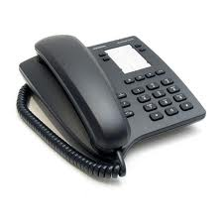
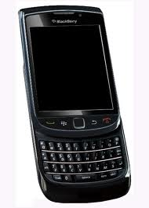
Thank you
Phone Only
SMS Only
Call toll free on: 122
0700 – CALL - FRSC
0700 – 2255 – 3772
080 7769 0362
www.frsc.gov.ng

